Slide 1
School & home: Engaging maths games to develop fluency
Ellen Corovic
Jennifer Bowden
Mathematical Education Consultant
28 April 2020

Slide 2
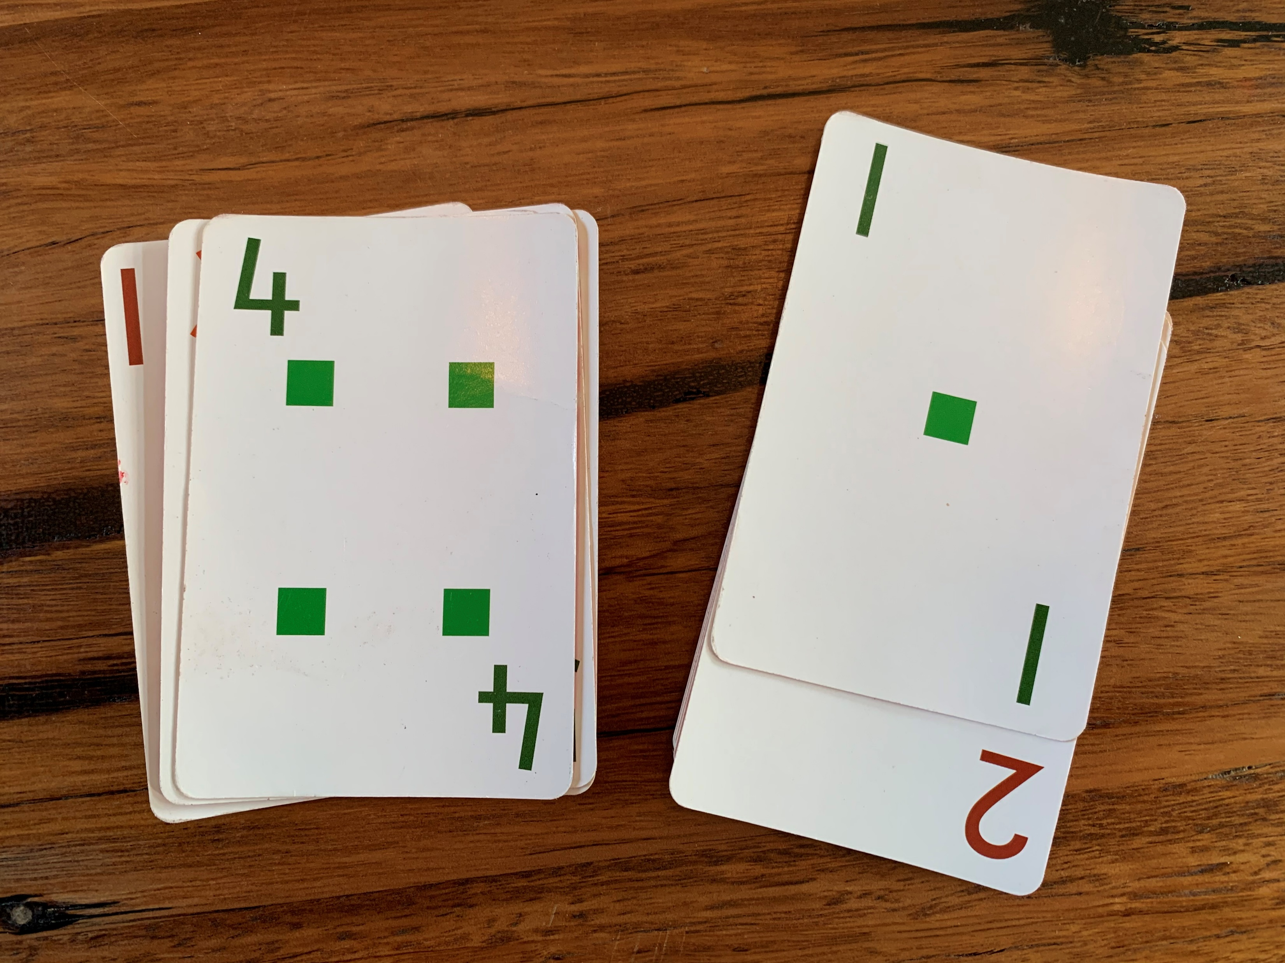
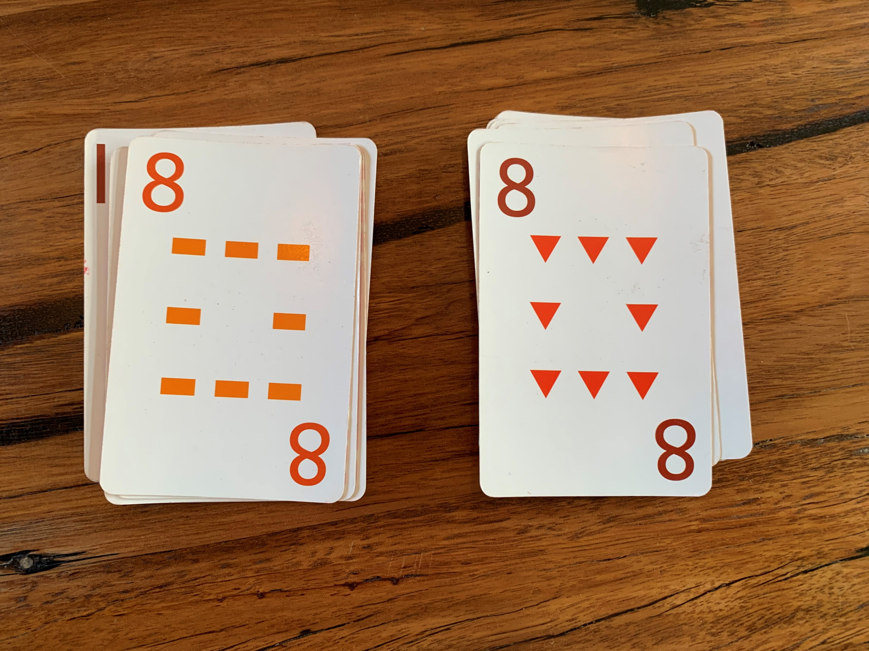
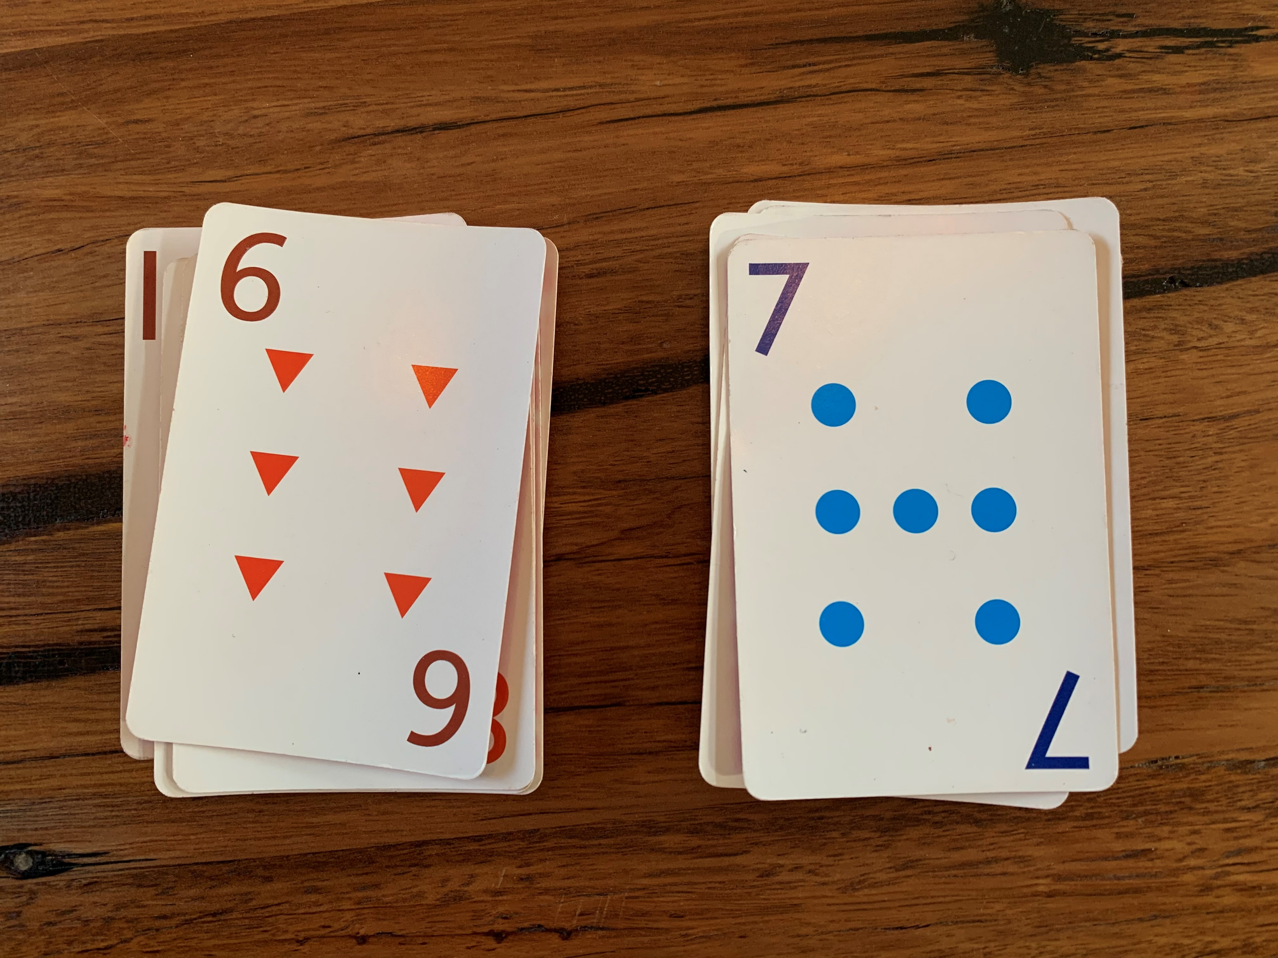
Warm up
SNAP
Colour or shape snap Traditional snap One more/one less

Slide 3
Launch: Let’s get started! Using games to engage students
Overview
For parents and teachers!
maths games that can be played in the classroom, or at home to develop students fluency.
Adaptations for differentiation for all learners.
tasks will be reviewed to highlight how they may also target understanding, problem solving and/or reasoning to develop deeper mathematics skills and knowledge.

Slide 4
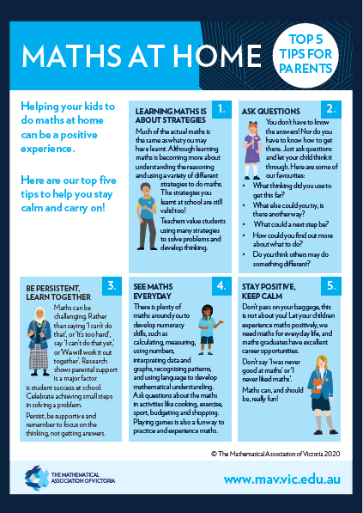
Tips for Maths at Home
Learning maths is about strategies
Ask questions
Be persistent, learn together
See maths in everyday activities
Stay positive, keep calm

Slide 5
Fluency and Reasoning
Fluency is…
In F–2, students become fluent as they develop skills in choosing appropriate procedures; and recalling factual knowledge and concepts readily.
In Years 3–6, students become fluent as they develop skills in choosing appropriate procedures; carrying out procedures flexibly and accurately; and recalling factual knowledge and concepts readily. Students are fluent when they calculate answers efficiently, when they recognise robust ways of answering questions, and when they recall definitions and regularly use facts.
Reasoning is…
In F–2, students develop an increasingly sophisticated capacity for logical thought and actions. Students are reasoning mathematically when they explain their thinking.
In Years 3–6, students develop an increasingly sophisticated capacity for logical thought and actions, such as evaluating, explaining and generalising. Students are reasoning mathematically when they explain their thinking, when they adapt the known to the unknown, and when they transfer learning from one context to another and explain their choices.

Slide 6
What’s so good about games?
Games are:
Engaging
Active/fast
Aid in developing understanding & fluency (and other proficiencies)
Promote or can be extended to promote problem solving and reasoning (particularly in strategy-based games)

Slide 7
Explore: More than just what you see
For each of the tasks, what can a teacher ask to make the task
A fluency task
A reasoning task
An investigation

Slide 8
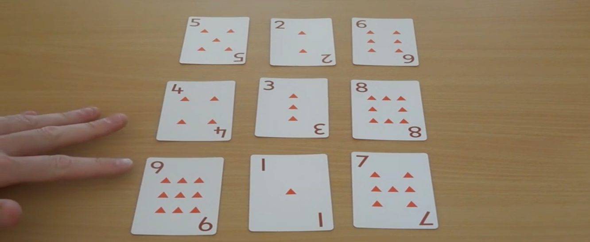
Todays games
Order 10
Stano 9
Number board puzzles
Spinner games
Board games
Traffic Light Os and Xs
Maths tic tac toe

Slide 9
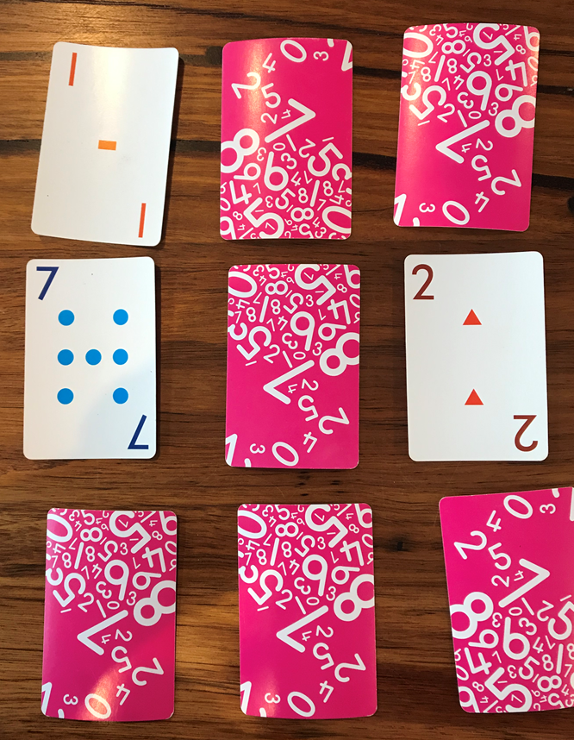
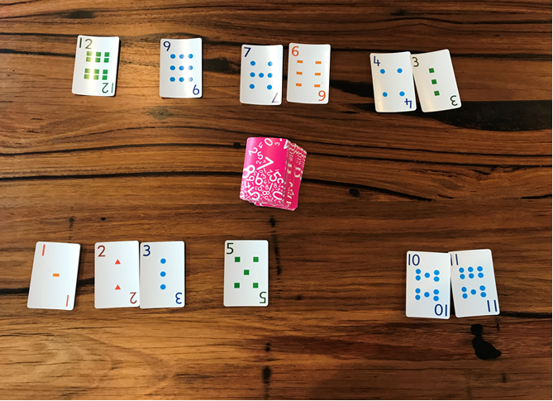
Card games
Stano 9
Using the cards 1 to 9, place them face down in a random order
Players take turns to turn over a card. They can keep turning over a card, as long as the numbers are in order, beginning with 1 (or the lowest number in the series). If they get it wrong, all cards are turned back over and the next player has a turn
Order 10
Players take half a deck of cards each.
They take it in turns to turn over a card and place it in the middle to create a shared number line.
If multiple of the same card is turned over there are several options
The card is added on top of the original card, or
The player turning over the repeated card misses their turn
Engaging Maths: 25 Favourite Lessons

Slide 10
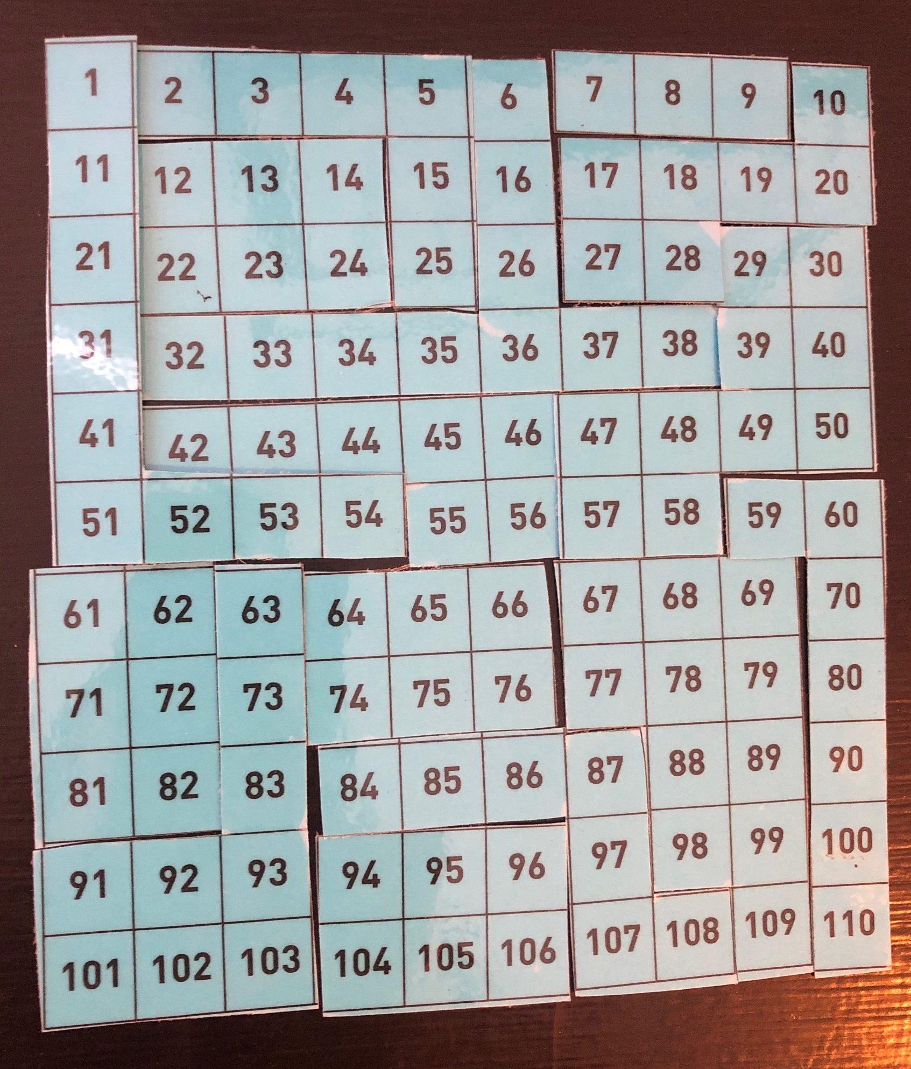
Number board puzzles
https://nrich.maths.org/5572

Slide 11
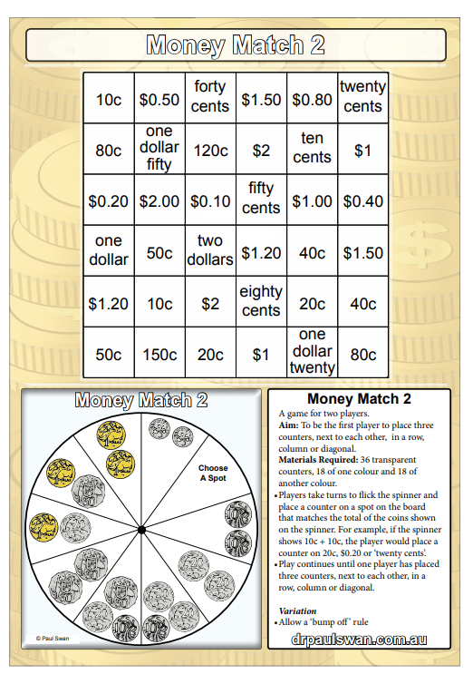
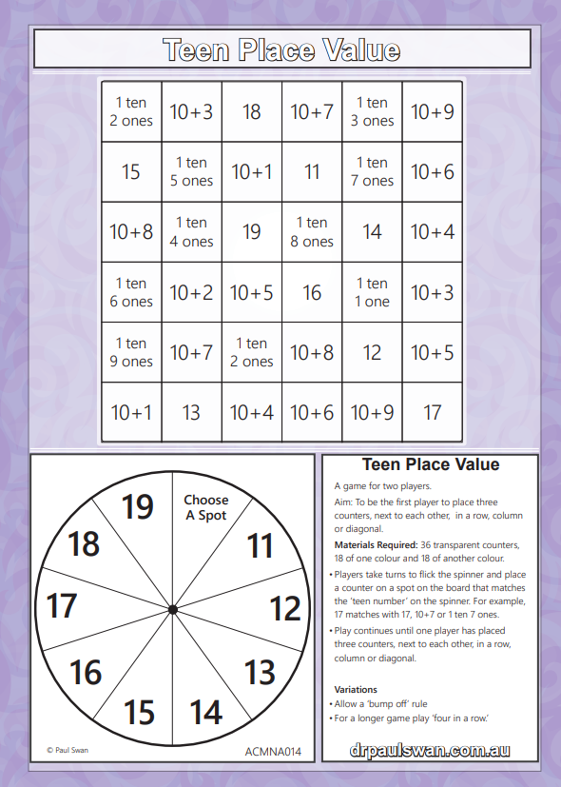
Spinner games
https://drpaulswan.com.au/

Slide 12
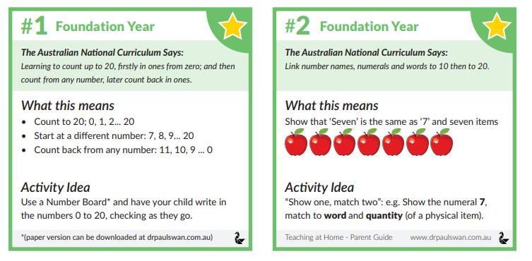
Paul Swan Parent Pages
https://drpaulswan.com.au/teaching-at-home?fbclid=IwAR0qonewBFIhXCFs01aKe09MXUz5iT-wRYPAe34TBtuaUoVBeO4PJ7qNEdA

Slide 13
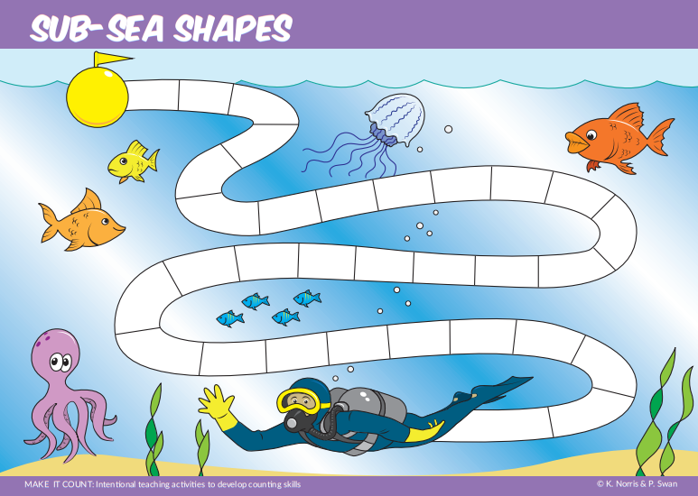
Board Games

Slide 14
Traffic Light Os and Xs
https://www.lovemaths.me/games

Slide 15
Maths tic tac toe
https://thinksquare.com.au/mathematic-tac-toe-game/
Each number between 1 and 9 can be used once only
Winner is the person who scores 15

Slide 16
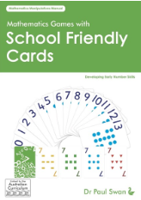
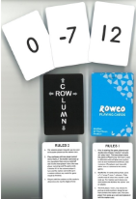
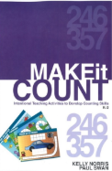
Questions
https://www.mav.vic.edu.au/MAV-Shop

