Slide 1
Developing numeracy in the real world - ideas for tasks using real world situations and environments. (Yr 3 - Yr 6)
Ellen Corovic
Jennifer Bowden
Mathematical Education Consultant
21 April 2020

Slide 2
Jen’s list
Data
Lego Masters
Toilet paper
Cooking
Washing
Joe Exotic
Shopping
Card games
Remote Home Learning Tasks

Slide 3
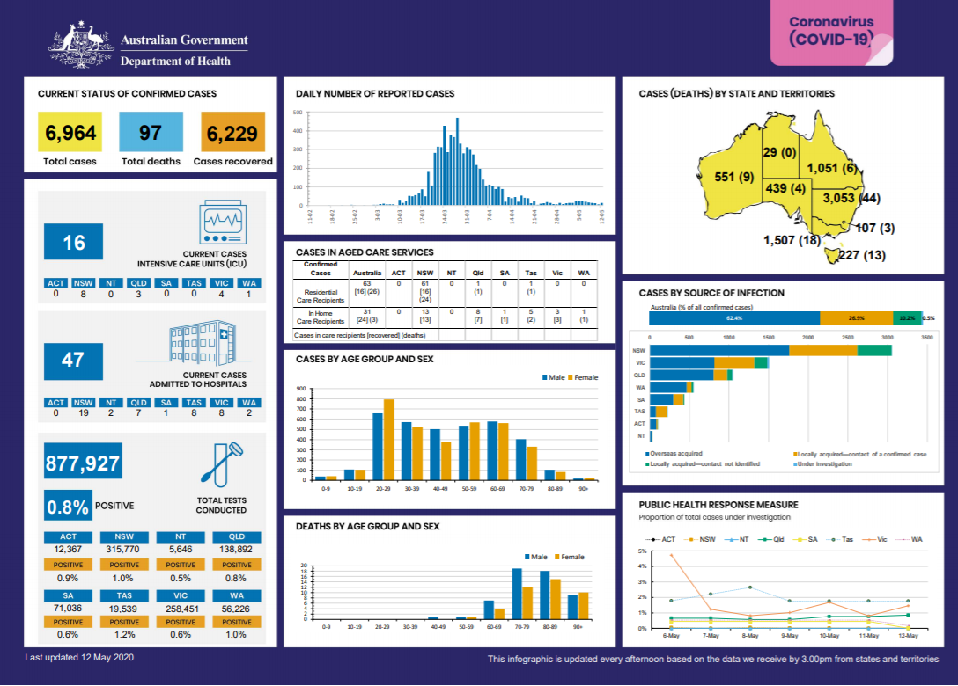

Slide 4
Estimation 180

Slide 5
Maths shots
How many packets of toilet paper might there be?
How many toilet rolls might there be?
https://www.facebook.com/groups/3330266343667719/

Slide 6
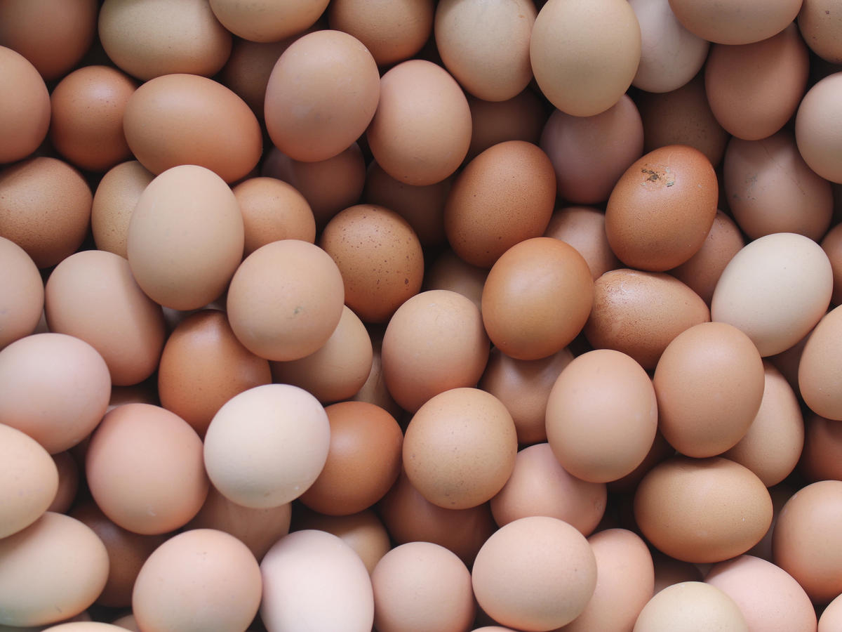
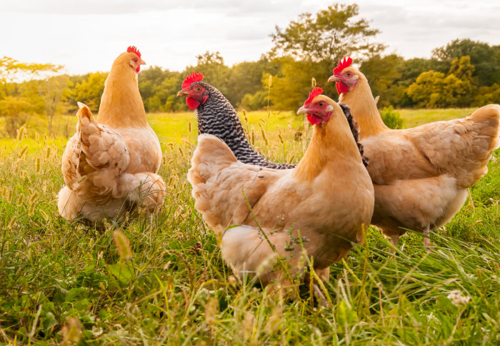
Eggs in isolation
Mum: I bought 30 eggs two days ago and now we have none.
Child: That’s not too bad, it’s 15 eggs a day..
Mum: 15 eggs a day! That’s ridiculous.
Child: It’s isolation mum! We have 5 people in our family, 3 eggs a day isn’t ridiculous.

Slide 7
What do you notice? What do you see?
Can you write some open ended questions that relate to this photo?

Slide 9
How many days between the two photos?
How many months old are the cubs in the:
Oct 2019 photo?
Feb 2020 photo?
What do you notice about the difference in food consumed between the two cubs?
Write a mathematical problem about the data/information to share with a classmate.
https://taronga.org.au/education/digital-programs-online-resources/zoo-mathematics

Slide 10
The yellow circles are an indication of how many packets of each flavour will be in the pack, what is another combination for this pack?
How many combinations can you find?
https://robertkaplinsky.com/work/how-many-chip-bags-will-there-be

Slide 11
EngageMe Maths
https://www.youtube.com/watch?v=qr6_1Bh4hPQ&feature=youtu.be&fbclid=IwAR1rIROqCVw-zFX28EMXNsPoq_VUd2grQbMEfOjL5-7BhX6rhwFkXQw7PPU
https://www.facebook.com/EngageMEmathematics/
Notes:
https://www.youtube.com/watch?v=qr6_1Bh4hPQ&feature=youtu.be&fbclid=IwAR1rIROqCVw-zFX28EMXNsPoq_VUd2grQbMEfOjL5-7BhX6rhwFkXQw7PPU

Slide 12
https://www.mav.vic.edu.au/Tenant/C0000019/00000001/downloads/Resources/remote-learning-support/home-learning-tasks/edition-05/2020-3-6_EDITION-5.pdf

Slide 13
Parental involvement in the form of “at-home” interest and support has a major influence on pupils’ educational outcomes and attitudes. Many parents, however, feel uninformed about current educational practices and how they can be more involved with their child’s learning
Muir (2012)

Slide 14
You can build your child’s numeracy by
be positive about their numeracy experiences and praise effort and perseverance
let your child know that everyone can be successful
seize everyday opportunities to capitalise on numeracy development
involve your child in numeracy-related activities
describe what you are doing in situations that involve numeracy
explain why you make certain numeracy choices
explore numeracy with your child
learn alongside your child and encourage a sharing of numeracy ideas and thoughts.
Birth – Level 10 Numeracy Guide http://numeracyguidedet.global2.vic.edu.au/

Slide 15
Some important things your child needs to know about mathematics
1. Problems can be solved in different ways.
2. Wrong answers sometimes can be useful.
3. Take risks!
4. Being able to do maths in your head is important.
5. It is sometimes okay to use calculators to solve maths problems.
https://www2.ed.gov/parents/academic/help/math/math.pdf
Helping Your Child Learn Maths, US Department of Education (1994)
Notes:
1.Problems Can Be Solved in Different Ways. Although most math problems have only one answer, there may be many ways to get to that answer. Learning math is more than finding the correct answer; it’s also a process of solving problems and applying what you’ve learned to new problems.
2.Wrong Answers Sometimes Can Be Useful. Accuracy is always important in math. However, sometimes you can use a wrong answer to help your child figure out why she made a mistake. Analyzing wrong answers can help your child to understand the concepts underlying the problem and to learn to apply reasoning skills to arrive at the correct answer. Ask your child to explain how she solved a math problem. Her explanation might help you discover if she needs help with number skills, such as addition, subtraction, multiplication and division, or with the concepts involved in solving the problem.
3.Take Risks! Help your child to be a risk taker. Help him see the value of trying to solve a problem, even if it’s difficult. Give your child time to explore different approaches to solving a difficult problem. As he works, encourage him to talk about what he is thinking. This will help him to strengthen math skills and to become an independent thinker and problem solver.
4.Being Able to Do Mathematics in YourHead Is Important. Mathematics isn’t restricted to pencil and paper activities. Doing math “in your head” (mental math) is a valuable skill that comes in handy as we make quick calculations of costs in stores, restaurants or gas stations. Let your child know that by using mental math, her math skills will become stronger.
5.It’s Sometimes OKto Use a Calculatorto Solve Mathematics Problems. It’s OK to use calculators to solve math problems—sometimes. They are widely used today, and knowing how to use them correctly is important. The idea is for your child not to fall back on the excuse, “I don’t need to know math—I’ve got a calculator.” Let your child know that to use calculators correctly and most efficiently, she will need a strong grounding in math operations— otherwise, how will she know whether the answer she sees displayed is reasonable!
https://www2.ed.gov/parents/academic/help/math/math.pdf
Helping Your Child Learn Maths : US Department of Education (1994)

Slide 16
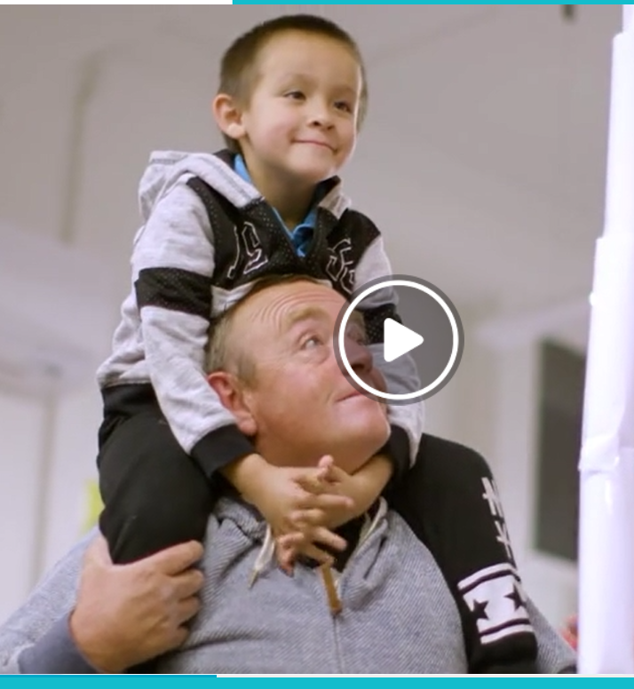
Victorian Maths Challenge
Family participation in learning is one of the most accurate predictors of a child's success in school and beyond.
The Victorian Maths Challenge recognises the important role families have in their childrens' learning and while you might feel that the maths your child is doing at school is different from how you were taught, you can make a difference by supporting what your child learns at school and helping them to learn at home.
The challenge provides families with opportunities to explore maths together. It encourages families to ask questions of one another, to collaborate and to have fun exploring different approaches to open-ended problems.
Notes:
http://vmc.global2.vic.edu.au/

Slide 17
Choose a challenge

Slide 18
What’s the challenge?
Symmetry is an aspect of the study of geometry. By studying symmetry and its properties you can see how maths is very much connected to the real world.
This challenge encourages you and your family to think about symmetry using everyday objects to make a unique design.
Using objects from around the room create an interesting, symmetrical pattern.
Record the mathematical language you have used.

Slide 19
References
Maths Shots https://www.facebook.com/groups/3330266343667719/
Robert Kaplinsky https://robertkaplinsky.com/lessons/
EngageMe Maths https://www.facebook.com/EngageMEmathematics/
http://numeracyguidedet.global2.vic.edu.au/numeracy-at-home-how-can-i-help-build-my-childs-numeracy/
MAV Remote Home learning Tasks https://www.mav.vic.edu.au/Resources/Remote-Distance-and-Home-Learning-Support/MAV-remote-learning-support
Department of Education and Training Victoria
https://www.education.vic.gov.au/parents/learning/Pages/numeracy-years-3-to-6.aspx
https://www.education.vic.gov.au/Documents/school/teachers/teachingresources/discipline/english/literacy/LiteracyandNumeracyTipstoHelpYourChild_Final.pdf
Victorian Maths Challenge http://vmc.global2.vic.edu.au/
Numeracy At Home – Tracy Muir
https://www.nationalnumeracy.org.uk/sites/default/files/numeracy_at_home_involving_parents_in_maths_education.pdf

Slide 20
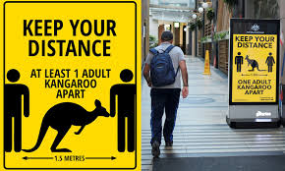
Questions

