Slide 1
School & home: Engaging maths games to develop fluency
Ellen Corovic
Jennifer Bowden
Mathematical Education Consultant
21 April 2020

Slide 2
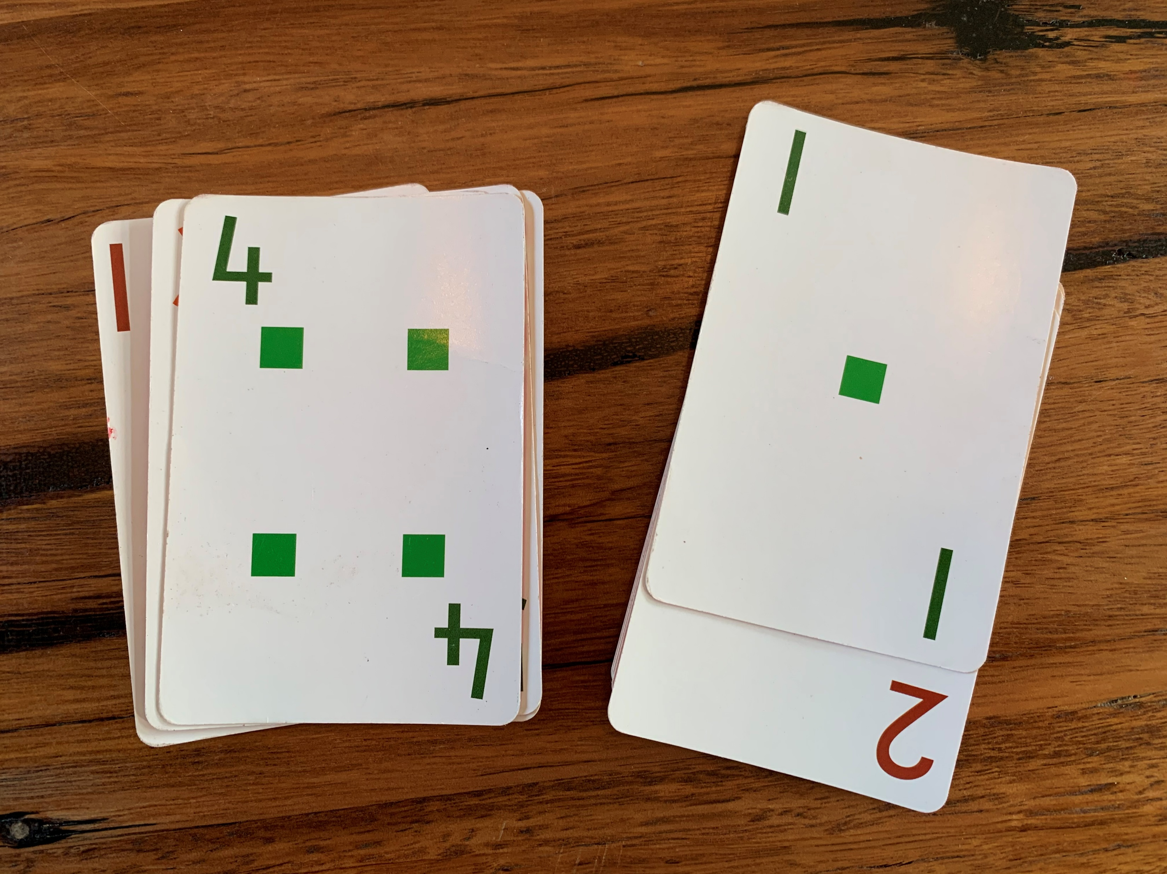
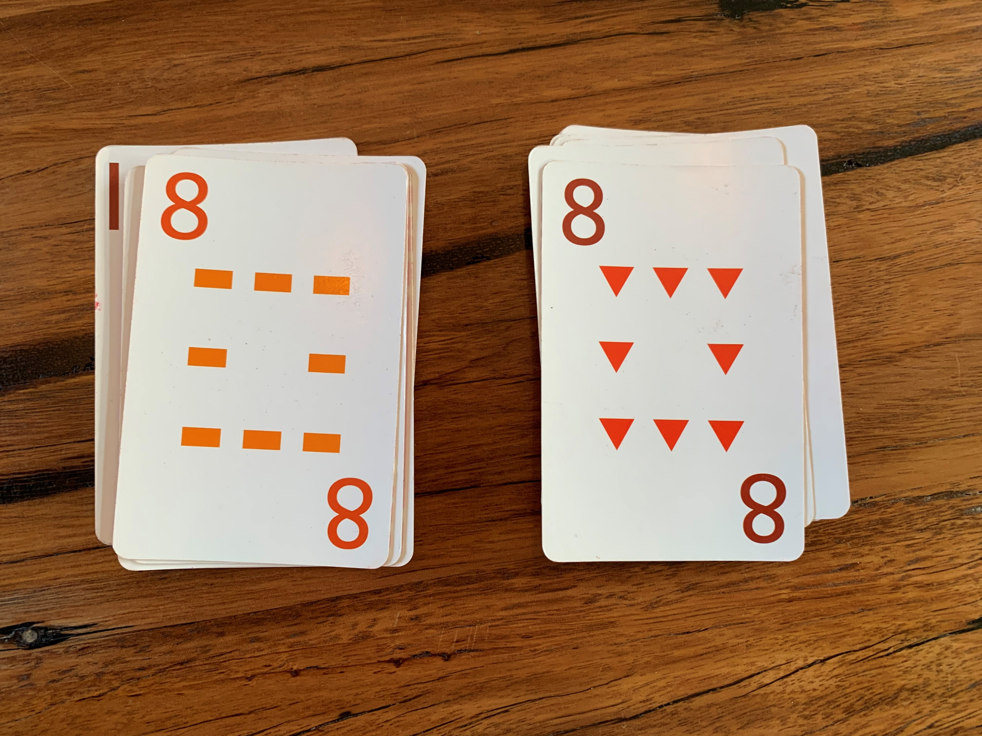
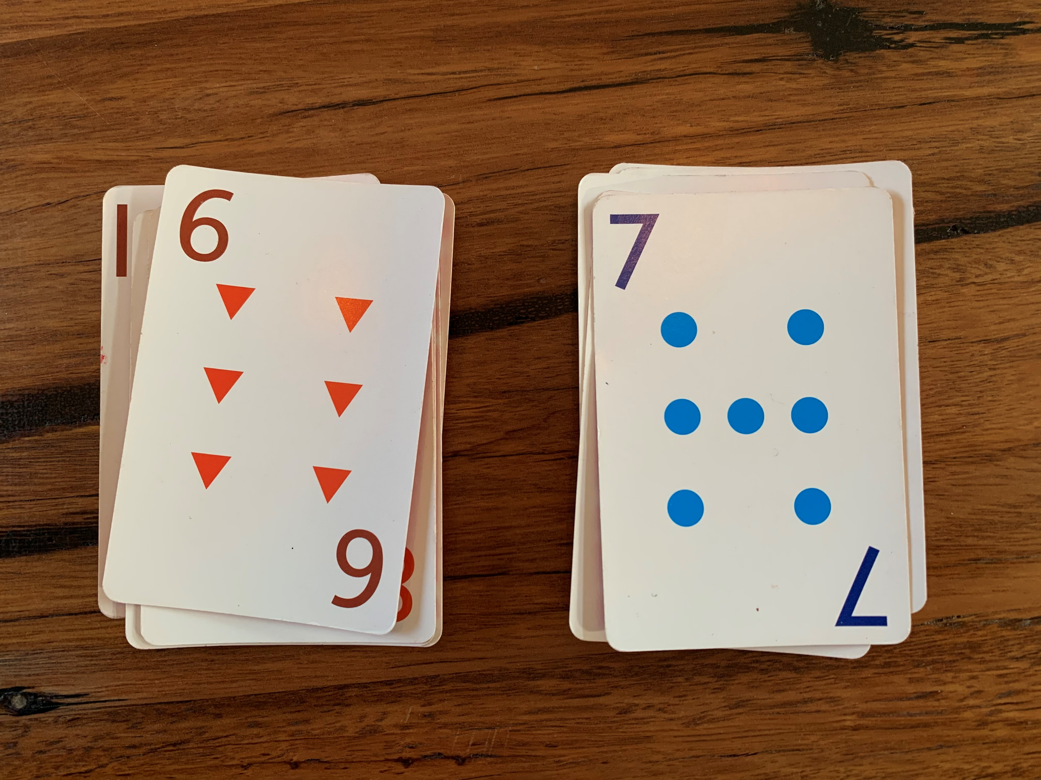
Warm up
SNAP
Colour or shape snap Traditional snap Difference of 1

Slide 3
Launch: Let’s get started! Using games to engage students
Overview
For parents and teachers!
maths games that can be played in the classroom, or at home to develop students fluency.
Adaptations for differentiation for all learners.
tasks will be reviewed to highlight how they may also target understanding, problem solving and/or reasoning to develop deeper mathematics skills and knowledge.

Slide 4
Tips for Maths at Home
Don't expect maths to be like you learnt it
Ask questions
Be persistent, learn together
See maths in everyday activities
Stay positive, keep calm

Slide 5
Fluency and Reasoning
Fluency is…
In F–2, students become fluent as they develop skills in choosing appropriate procedures; and recalling factual knowledge and concepts readily.
In Years 3–6, students become fluent as they develop skills in choosing appropriate procedures; carrying out procedures flexibly and accurately; and recalling factual knowledge and concepts readily. Students are fluent when they calculate answers efficiently, when they recognise robust ways of answering questions, and when they recall definitions and regularly use facts.
Reasoning is…
In F–2, students develop an increasingly sophisticated capacity for logical thought and actions. Students are reasoning mathematically when they explain their thinking.
In Years 3–6, students develop an increasingly sophisticated capacity for logical thought and actions, such as evaluating, explaining and generalising. Students are reasoning mathematically when they explain their thinking, when they adapt the known to the unknown, and when they transfer learning from one context to another and explain their choices.

Slide 6
What’s so good abut games?
Games are:
Engaging
Active/fast
Aid in developing understanding & fluency (and other proficiencies)
Promote or can be extended to promote problem solving and reasoning (particularly in strategy-based games)

Slide 7
Explore: More than just what you see
For each of the tasks, what can a teacher ask to make the task
A fluency task
A reasoning task
An investigation

Slide 8
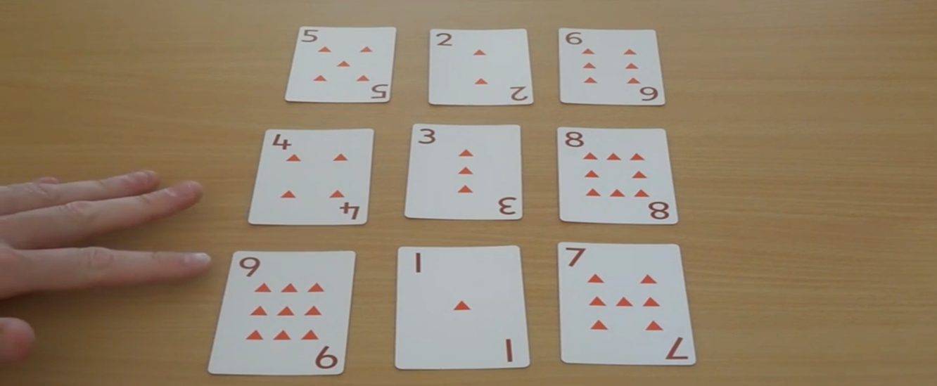
Todays games
ROWCO
Card Dash
Product game
Spinner games
KenKen
Traffic Light Os and Xs

Slide 9
ROWCO
https://drpaulswan.com.au/

Slide 10
20-card dash
Online version https://thinksquare.com.au/20-card-dash/
https://thinksquare.com.au/games/
Notes:
20 Card dash – ThinkSquare
The person with the 20-cards deals them one by one face up on the table and their partner will perform the focus
operation (in our example multiplying by 7) Once a correct answer has been given the next card is dealt and so on untilthe student has worked their way through all 20 cards. Players swap roles after each round is completed.
It is very important that students record each time (especially initially) so they can track their rapid improvement.
Teachers can record student results on our specially made spreadsheet which automatically tracks averages and
highlights each student’s personal best performance.

Slide 11
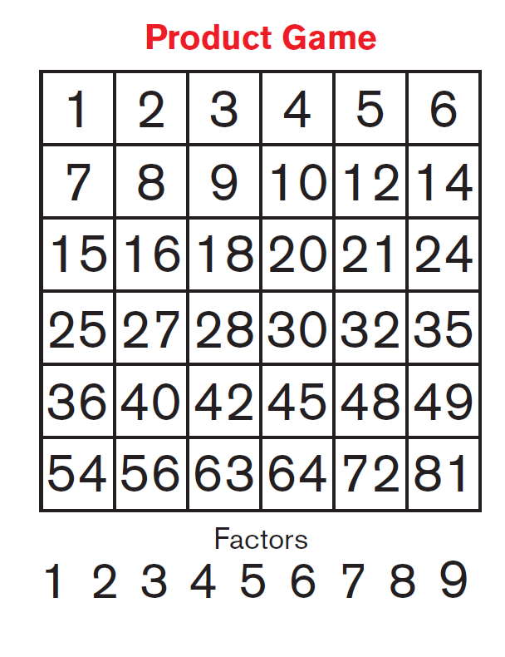
Product Game
Online version https://www.nctm.org/tools/mathresources/nctm_productgame.html
Notes:
Instructions and pdf game board
https://www.mathcounts.org/sites/default/files/u10081/8_Product%20Game.pdf

Slide 12
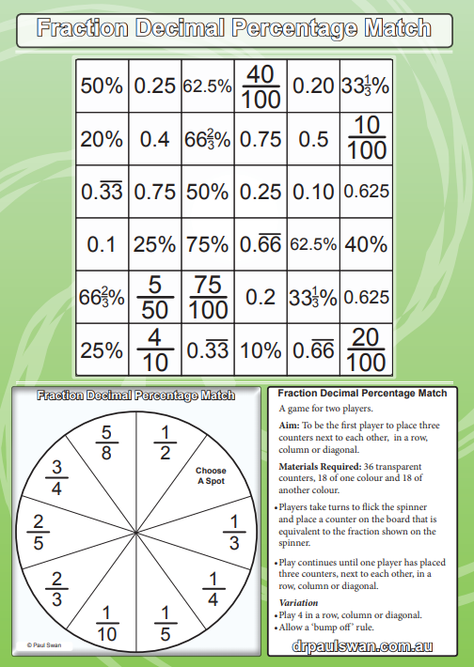
Spinner games
https://drpaulswan.com.au/

Slide 13
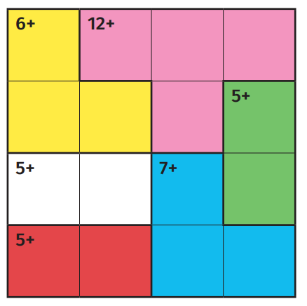
KenKen
https://drpaulswan.com.au/

Slide 14
Traffic Light Os and Xs
https://www.lovemaths.me/games

Slide 15
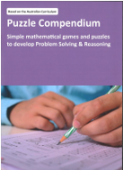
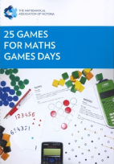
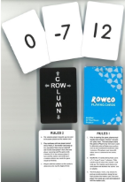
Questions
https://www.mav.vic.edu.au/MAV-Shop

