Slide 1


Using the Context of the Olympic Games to enhance the learning of Mathematics
Pam Hammond, Educational Consultant
ropa1@bigpond.com
MAV 2019
Notes:
Vinicius Vinicius, the 2016 Rio Olympic Games mascot, is a mixture of all the Brazilian animals, said to be born out of the explosion of joy that happened when they announced that Rio would host the Olympic Games, on 2 October 2009.
Being a mixture of Brazilian animals, Vinicius can do all the best things Brazilian animals can do: Run faster, jump higher and be stronger. Vinicius can also imitate the voice of any animal with his super-communicative skills!

Slide 2
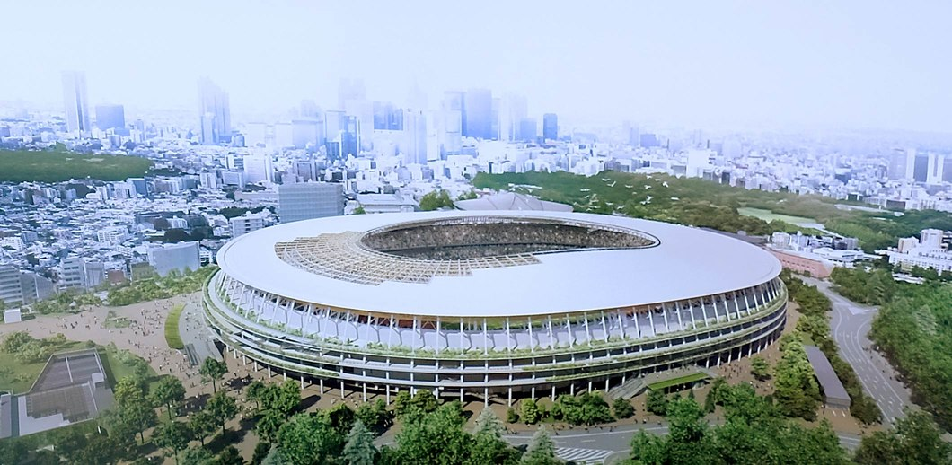
Tokyo Olympics, 2020 July 24th - August 9th https://www.olympic.org/tokyo-2020 Japan will host 50 disciplines across 33 sports, including the debut of Sport Climbing competitions. Of the 339 events: 165 are for men, 156 are for women, 18 are mixed.
Notes:
There are many issues that can be raised in relation to Rio:
Building schedule
Pollution, especially in the harbour
Favolas – slums
Brazil economy

Slide 3
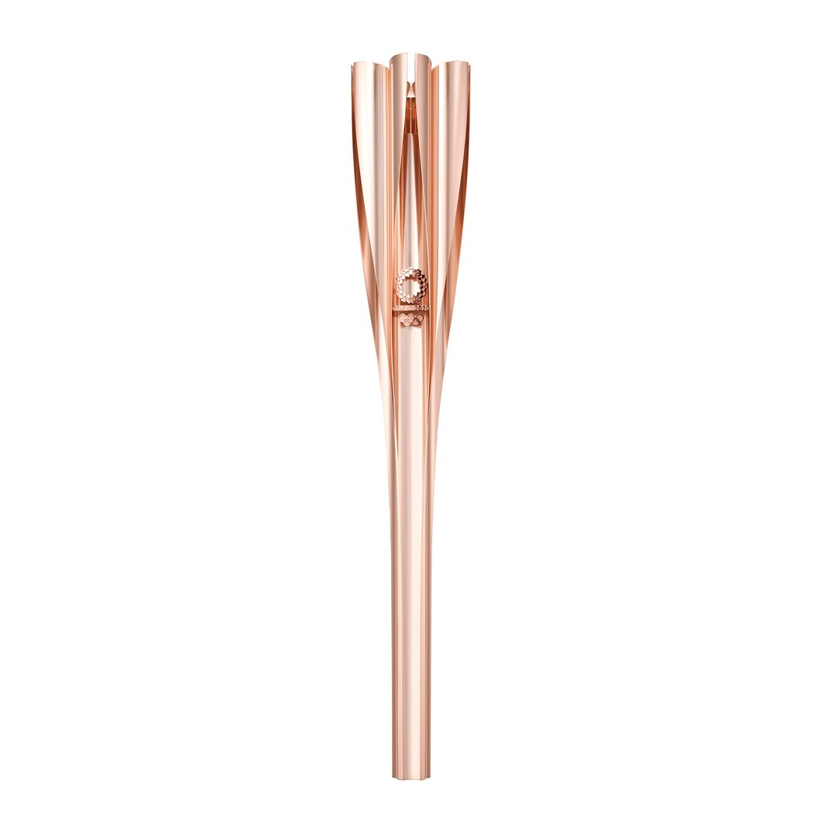
http://www.olympic.org/olympic-torch-relay
The Olympic torch incorporates elements of Japanese culture, and reinforces Tokyo 2020’s Olympic Torch Relay concept: “Hope lights our way”.
The concept is designed to bring the Japanese together around messages of support, acceptance and encouragement of one another, while reflecting the Olympic flame’s ability to promote peace and hope to the world.
Japan’s famed cherry blossoms happen to bloom in March, coinciding with the start of the Olympic Torch Relay, and the shape of the torch also resembles a Japanese traditional “Sakuramon” cherry blossom emblem.

Slide 4

The Olympic Rings
According to most accounts, the rings were adopted by Baron Pierre de Coubertin (founder of the modern Olympic Movement) in 1913 after he saw a similar design on an artefact from ancient Greece. The five rings represent the major regions of the world: Africa, the Americas, Asia, Europe, Oceania. Pierre de Coubertin never said nor wrote that the colours of the rings were linked with the different continents.
The Olympic Flag made its debut at the 1920 Olympic Games in Antwerp, Belgium. At the end of each Olympic Games, the mayor of the host-city presents the flag to the mayor of the next host-city. It rests at the town hall of the next host-city for four years until the Opening Ceremony of their Olympic Games.
Every national flag includes at least one of the five colours.

Slide 5
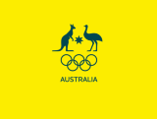
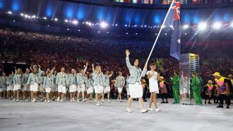
Australia at the Olympics
Australia has been represented at every Modern Olympics since they started in 1896. Since 1908 Australian Athletes have worn the Coat of Arms over their hearts and it has been the organisational mark for 100 years. Synonymous with Australia, it is beloved by both athletes and fans and held with passion and reverence . It has undergone changes over the years but is the enduring national symbol.
The Boxing Kangaroo, BK, is the official mascot of the Australian Olympic Team. He will be cheering on all members of the Team in Tokyo.
The anticipated final size of the 2020 Australian Olympic Team is 450.

Slide 6
Countries that have hosted Olympics
Students investigate where past Olympics have been held:
Locate on world map – latitude & longitude
Population of the country
Which city or cities in the country?
Climate during the Olympics
Height above sea-level
Language spoken
…
How may the location and climate affect performances?
Explore methods of presenting their findings.
Notes:
Students could create a timeline showing the year and host country.
Why have there been some gaps?

Slide 7













Country Flags

Slide 8
165 Countries at the 2020 Olympics
Students investigate the countries that are participating:
Locate on world map
Population of the country
Size of Olympic team
Events in which they are participating
Medals won and/or their results
Explore methods of representing the data.
Analyse data
Are there trends in the data?
If so, what may be the reasons?
Population Reference Bureau
Notes:
Survey students’ ethnic origins and graph results.
Conduct a multi-cultural day at start of the Olympics
When investigating a country – how far did the team need to travel?
- how long did that take (consider time zones)

Slide 9
Sports in the 2020 Olympics – 339 different events
Archery; Artistic Swimming; Diving
Athletics; Badminton; Baseball-softball; Basketball
Beach Volleyball; Boxing; Canoe Slalom; Canoe Sprint
Cycling Bmx; Cycling Mountain Bike; Cycling Road; Cycling Track
Equestrian / Dressage; Equestrian Eventing; Equestrian Jumping;
Fencing; Football; Golf; Handball; Hockey;
Gymnastics Artistic; Gymnastics Rhythmic;
Karate; Judo; Marathon Swimming; Modern Pentathlon; Rowing
Rugby; Sailing; Shooting; Skateboarding; Sport Climbing
Surfing; Swimming; Table Tennis; Taekwondo; Tennis;
Trampoline; Triathlon; Volleyball; Water Polo
Weightlifting; Wrestling Freestyle; Wrestling Greco-roman
Notes:
How have sports changed over the different Olympics?

Slide 10
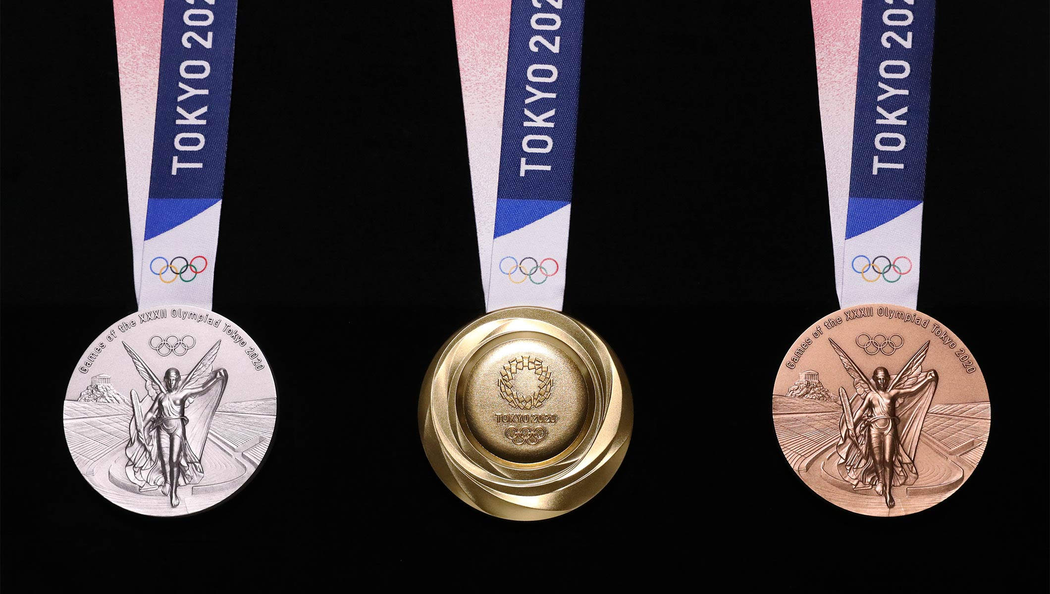
Medal count
Keep a tally of all countries’ medals
Graph results at various times to compare (bar graphs, pictographs …)
Focus on specific category and compare countries (swimming, cycling, sprints, long distance …)
The following countries have won medals, how many gold, silver and bronze has each country won?
China 30 USA 25 Australia 22 Japan 10
Notes:
How many different combinations can you find?
Why are some countries better in particular sports than other countries?

Slide 11
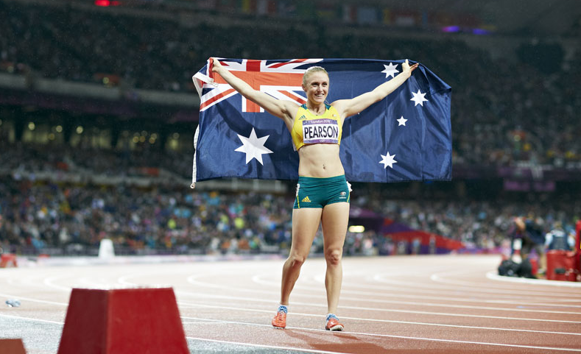
Investigating a sport http://www.olympic.org/sports
Students select favourite sport – create class graph
Research history and when it joined the Olympics
Equipment needed
Rules and Scoring
Where it is played/conducted
When it is scheduled at the Tokyo Olympics
Results
Olympic and World records
Notes:
What sports do students or their families participate in?
Share knowledge of these.

Slide 12
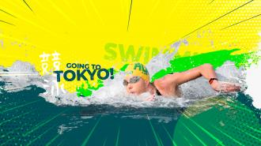
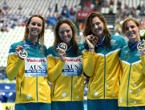
Maths in swimming
Pool measurements (8 lanes)
Distances (number of laps)
Timing including tenths and hundredths of sec.
Split times
Statistics
Personal best times
…
Kareena Lee
4x100m freestyle relay gold medal.
Notes:
What is the width of each lane?

Slide 13
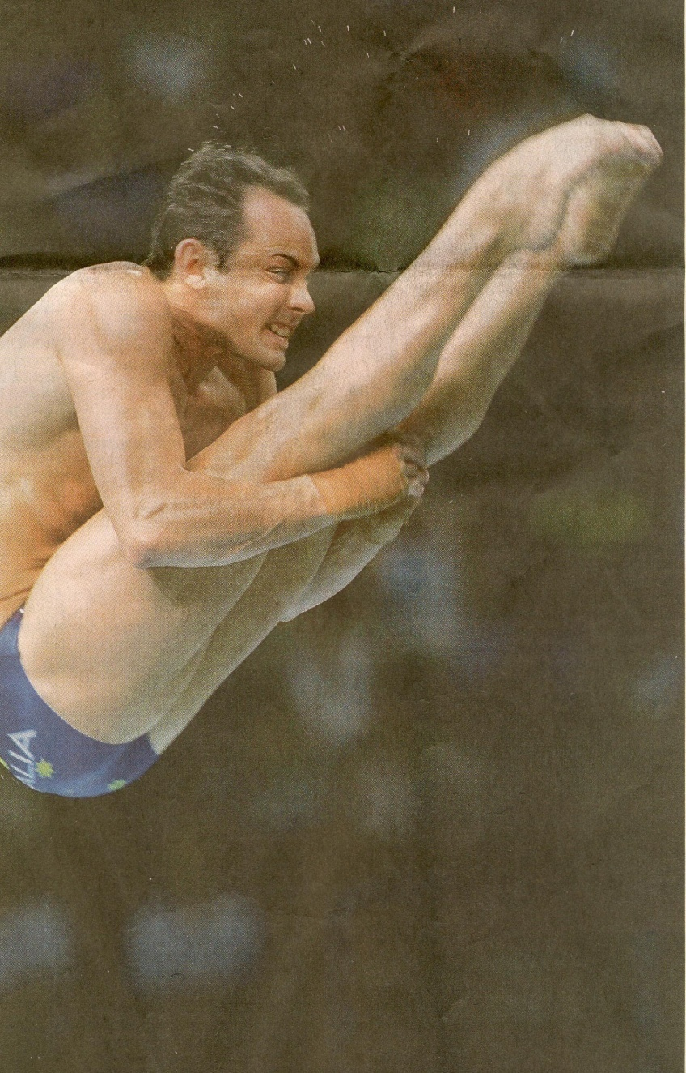
Maths in diving
Pool measurements (5m depth)
Board heights (spring board 3m & platform 10m)
Scoring
Statistics
Personal best scores
…
Matthew Helm winning silver

Slide 14
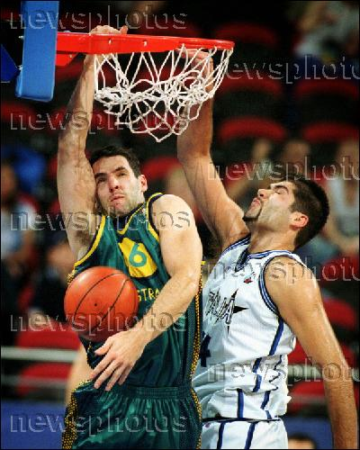
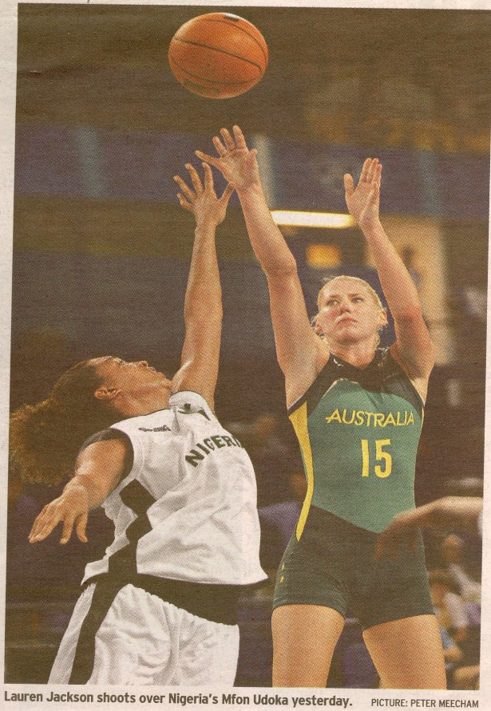
Maths in basketball
Court measurements
Scoring
Statistics
Timing (length of game, time in key, counting down, tenths of seconds)
Ladder, finals draw
.
Notes:
Structure of draw and finals – investigate
Probability of winning gold (can be applied to other team sports)
Model using dice – throw a 1, 2, or 3 for a win
- throw a 4, 5, or 6 for a loss
Is this a valid model? How could you vary it to be more realistic?

Slide 15
Basketball Game
1. What is the final score? The difference in final scores for a basketball game was 12.
What might each team’s score have been?
See how many different scores you can find.
2. The final score in a basketball game was 126 to 104. More than half of each team’s score came from 3 pointers.
How many 3 point goals, 2 point goals and 1 point goals were scored by each team?
Record your answers and the strategy you used.
See how many different answers you can find.
Notes:
Have students share their knowledge of the scoring of basketball.

Slide 16
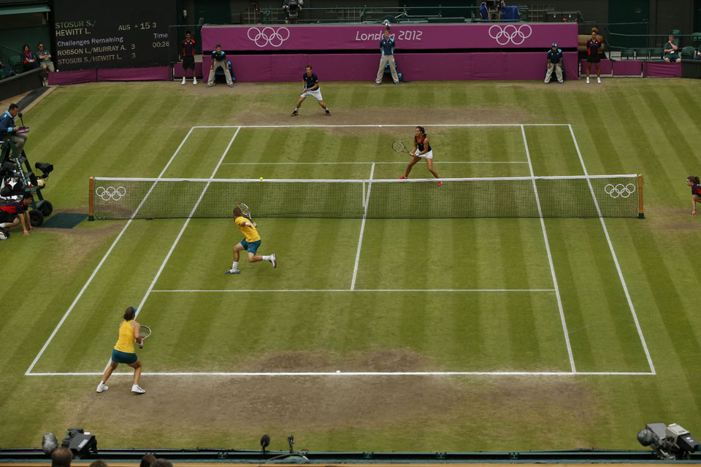
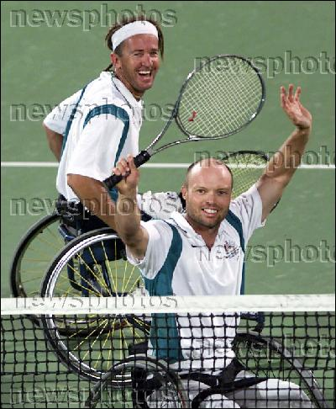
Maths in tennis
Speed of ball
Scoring
Statistics
Court measurements
Equipment
…

Slide 17
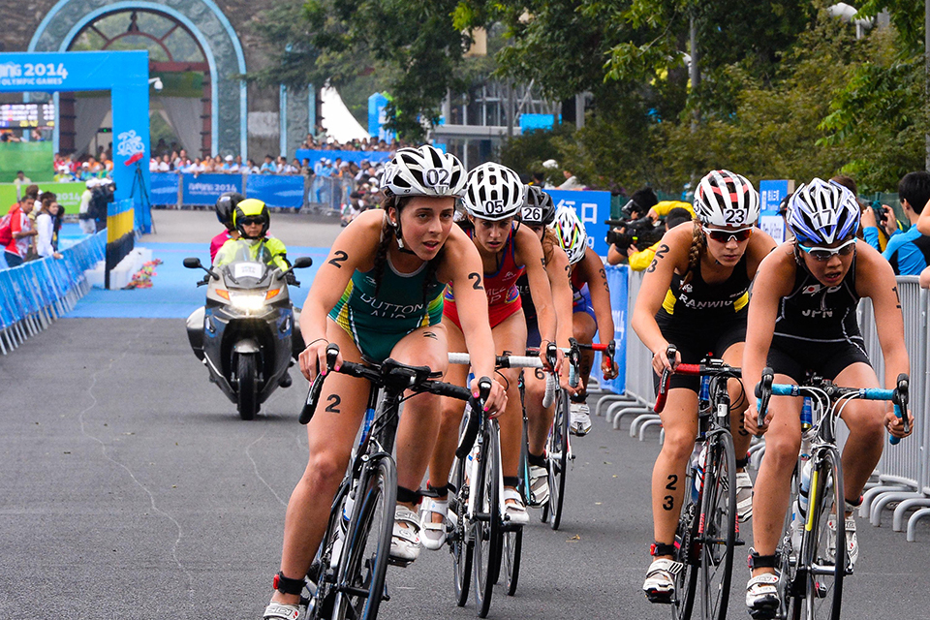
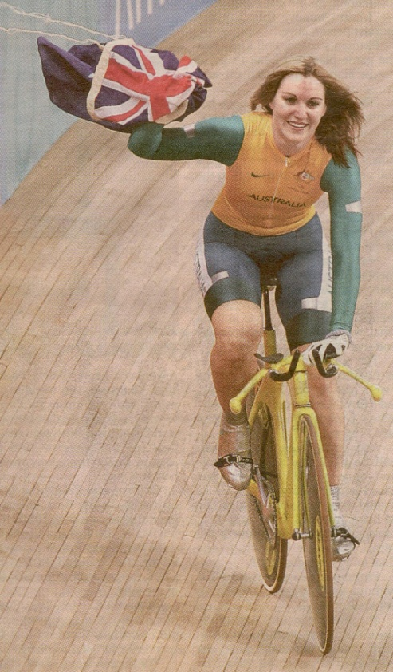
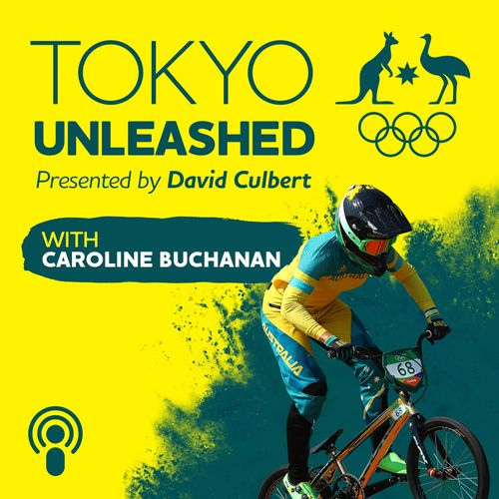
Maths in cycling
Distances
Gearing
Equipment
Timing including tenths and hundredths of sec
Speed
Statistics
Strategic thinking
Anna Meares

Slide 18
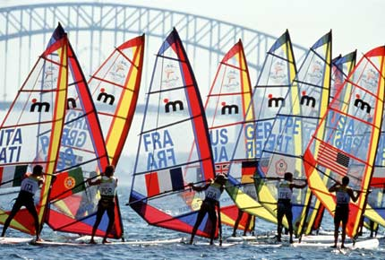
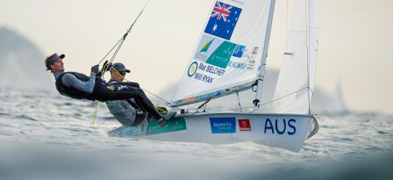
Maths in sailing
Distances
Timing
Size of boats, sails
Speed
Angles and vectors
…

Slide 19
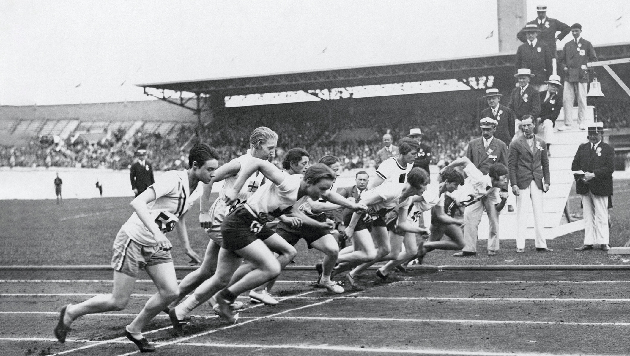
ATHLETICS WAS CONTESTED IN THE FIRST ANCIENT OLYMPIC GAMES, AND CHAMPIONS HAVE BEEN RECORDED FROM AS FAR BACK AS 776 BC.
FIRST AND ORIGINAL
The first event contested in the ancient Olympic Games was the “stadium” race, a sprint of about 192 metres. Winners have been recorded from as far back as 776 BC.
ANCIENT EVENTS
The ancient Olympic Games included a wide variety of track and field events, including longer foot races, a race in armour, a pentathlon event that consisted of the “stadium” race, long jump, discus throw, javelin throw and wrestling.
OLYMPIC HISTORY
Since 1896, athletics has been at each of the Games. This has allowed popularity to increase across the world, strengthened by the creation of the IAAF in 1912. Women’s events appeared for the first time at 1928 Olympic Games in Amsterdam, men’s programme was standardised at 1932 Games in Los Angeles. Today women’s programme is almost identical to that of the men’s.

Slide 20
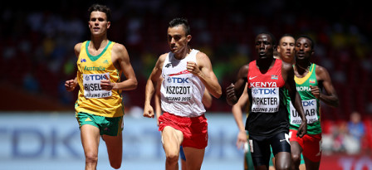
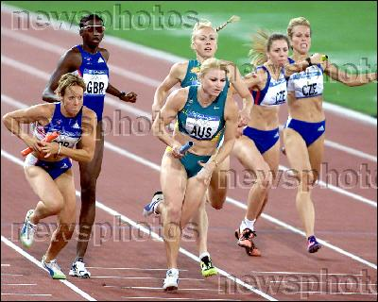
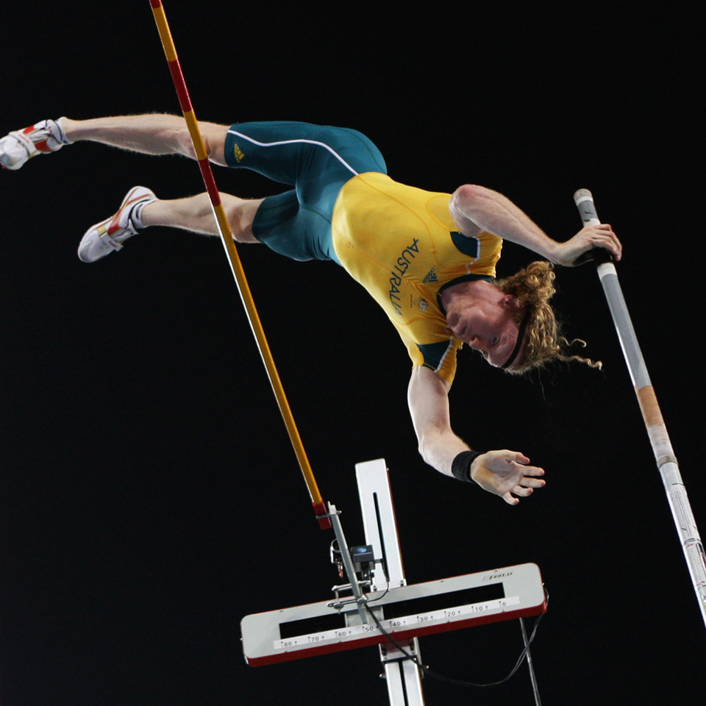
Maths in athletics
Distances, timing
Height, length, mass
Speed
Equipment
Strategies
Notes:
Link with ‘Little Athletics’ and their experiences
Select events and investigate:
Estimate distances, then measure and mark these.
High jumps
Long jumps
Triple jump
Pole vault
100m sprint
Distance between hurdles
Students conduct trials and compare their results with Games records
Plan discus, hammer throw area. They must land in a sector of 40 degrees
Hurdles are placed very accurately

Slide 21
Modern Pentathlon
Olympic History
Modern Pentathlon started in Stockholm in 1912, invented by Pierre de Coubertin, who stated modern pentathlon would result in “a veritable consecration of the complete athlete”. The ancient Olympics had the pentathlon when the victor was regarded as a true all-rounder competing in horse jumping, discus, javelin, running and wrestling.
Components of the modern pentathlon are based on skills required by a military messenger (pre-mechanisation) delivering vital orders in battle. He needed to ride a horse over obstacles, defend himself using his sword and revolver whilst needing to swim and run to avoid capture and ensure the message reached its destination.

Slide 22
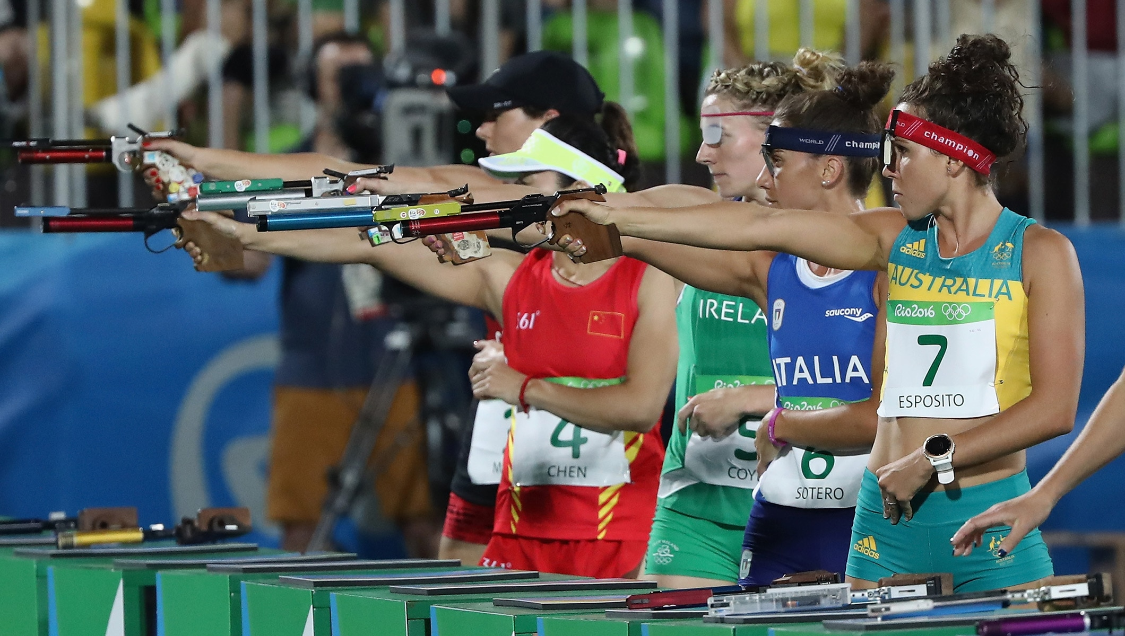
Modern Pentathlon
In one day athletes fire 20 shots from an air pistol in 40 seconds;
fence every other competitor in a round-robin format;
swim 200 metres in seeded heats;
show jump on a horse only known for 20 minutes;
3000m run with pentathletes setting off at intervals corresponding to their points so that the first person across the line wins the gold medal.
A women’s event was introduced in Sydney in 2000.

Slide 23
Students select events and investigate:
Distances – estimate, then measure and mark these
Length of jumps – estimate, then measure and mark
Height of jumps – estimate, then measure and mark
Distance between hurdles
Mass of shotput, hammer, discus – distances they can be thrown, area needed (40° sector), safety issues
Times – estimate (close eyes-hand up at 9/20...sec., how many claps, hold your breath etc)

Slide 24
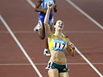
Students select events, for example
How far can you run in the record times?
Mark out 25m, 50m, 100m …
Students time themselves and measure the distance they have run compared with records.
Graph results – individually for different records
– class graph for each record

Slide 25
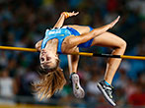
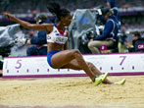
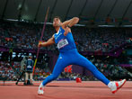
Students select length/height events:
Students conduct trials for chosen event/s, compare their results with records.
Graph results – individually for different records
– class graph for each record

Slide 26
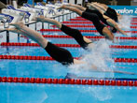
Using Olympic Statistics in the Classroom
Develops concepts of:
Measurement in mass, length, height, distance
Time in minutes, seconds and parts of seconds
Graphical representations e.g., students develop questions to collect data on favourite sports/games; sports played by students; favourite event in the Olympics.. Explore ways of representing data.
…

Slide 27
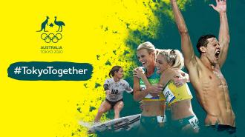
Using Olympic Statistics in the Classroom
Develops concepts of:
Whole number – counting, ordinal, ordering
Decimals – value, comparing, ordering
Operating on decimals
Average
Speed
…
Podcasts available on many athletes:
https://www.olympics.com.au/news/tokyo-unleashed-podcast

Slide 28
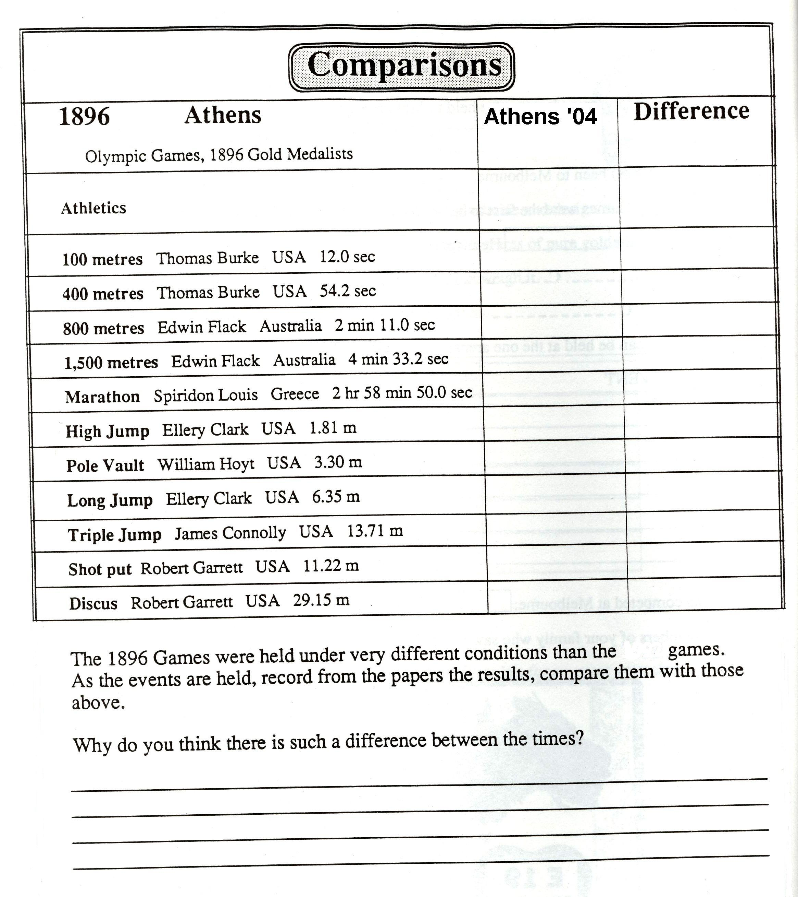
2020
2020
Notes:
Have students note the timing/measurements of the gold medallist in each of these events.
What is the difference since the first Modern Olympics?

Slide 29
Integrated units
Investigate equipment/clothing/playing surfaces design over time. Website for equipment: http://www.olympic.org/athletics-road-equipment-and-history
Plan and conduct school games - timelines/scheduling events - space/shapes/measurements for events - design of flags/logos/medals … - fitness/training/skill development - graph personal performances (training & event) - diet/nutrition

Slide 30
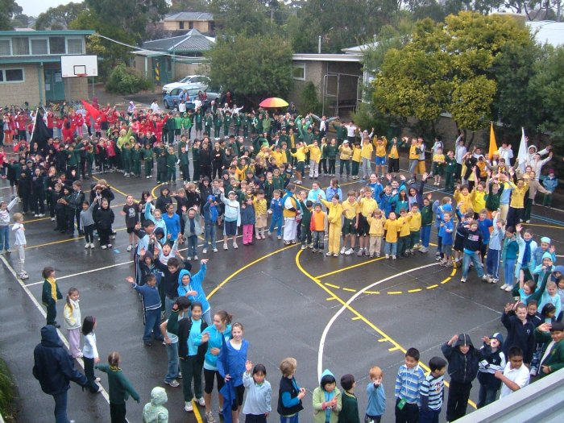
Olympic Day - Move, Learn, Discover
Olympic Day brings together people from all over the world to celebrate the Olympic Games and Values. This encourages young people to participate in sport, lead active, healthy lives.
Olympic Day is internationally celebrated on 23 June each year. In Australia, Olympic Day is celebrated throughout June on a day convenient to participating schools.
You are invited to organise an Olympic Day at your school and the AOC encourages Olympians to pay a visit to a local school . Teacher Guide and Lesson Plans are available in Resources. Start planning 2020 Olympic Day.
Syndal PS

Slide 31
Some further challenges
When might women athletes catch the men? - select an event - graph men’s and women’s results over time - analyse and discuss findings.
How much better can future athletes perform? - select an event - graph results over time - use graph to predict the future.
Why are performances improving?
Notes:
Usain Bolt is WR holder for 100m – 9.72
Wind assisted: if tailwind is more than 2 m/sec.
What about circular events (or oval)? This doesn’t apply as it is seen that the wind would assist from one direction and hold back in opposite direction.
Modelling this shows that wind will slow athlete overall.
Eg 400km North/South pigeon race – 200 km each way with 50km/h Southerly.
Going North, pigeon will be assisted, so if it flies at 100km/h, this will be 150km/h; so first 200 km takes 80 minutes (rather than 2 hours).
Going South, pigeon will fly at 50km/h, so will take 4 hours.
The resistance of wind has a greater effect than the assistance.

Slide 32
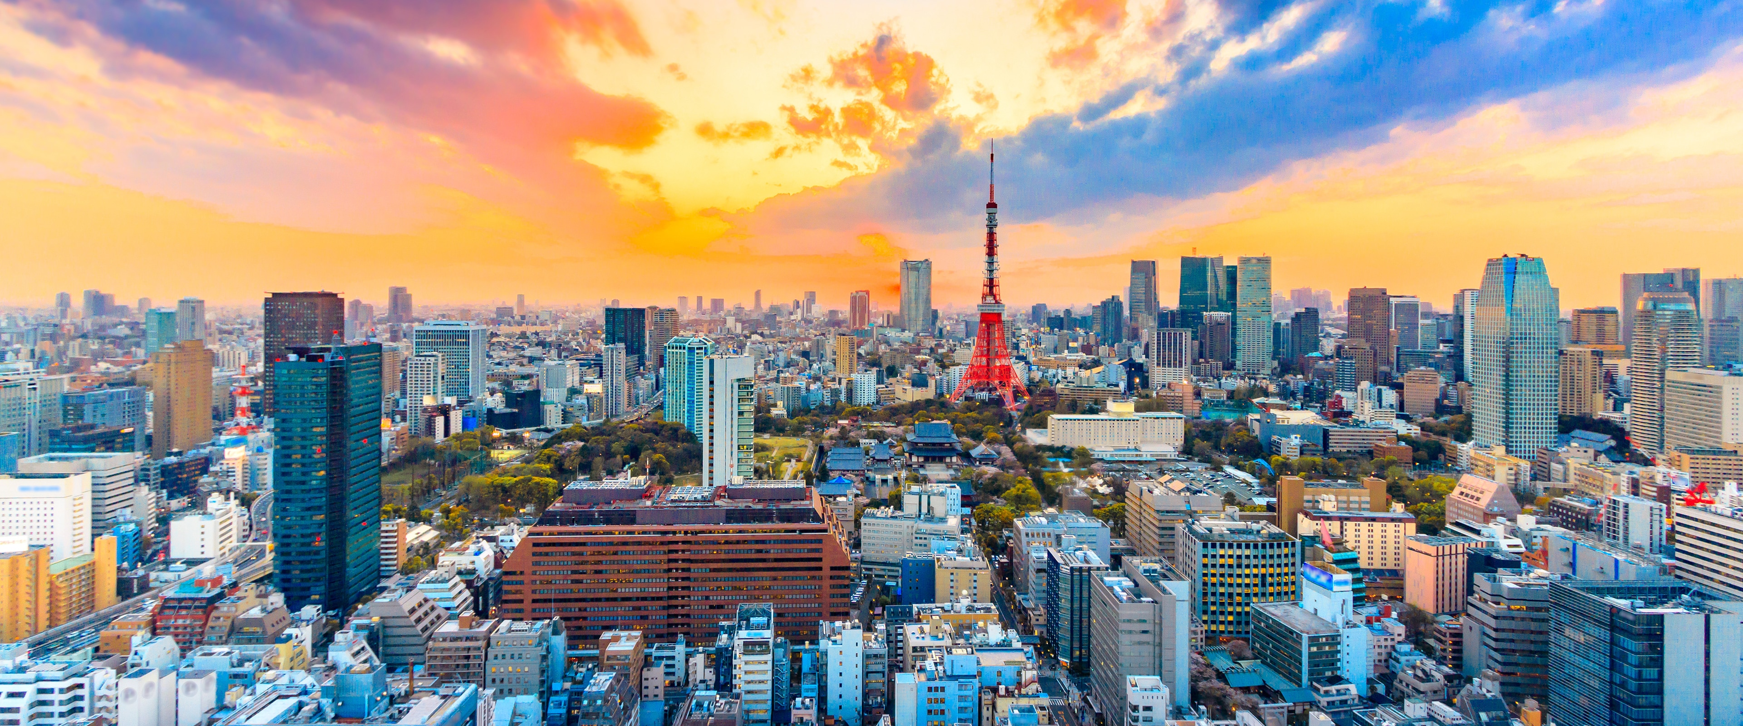
Enjoy the Olympic Games yourself and encourage your class to be involved, both vicariously and genuinely – email athletes, chat online … Get ready for 24/ 07/ 2020
http://olympics.com.au
https://www.olympic.org/news/tokyo-2020
https://www.olympic.org/about-ioc-olympic-movement

