Slide 1
Interesting Physics Applications for Methods & Specialist SACs
By Wayne Semmens

Slide 2
Hook example of interesting physics applications of breaking things with reasonant frequencies
The 1940 Tacoma Narrows Bridge, the first Tacoma Narrows Bridge, was a suspension bridge in the U.S. state of Washington that spanned the Tacoma Narrows strait of Puget Sound between Tacoma and the Kitsap Peninsula. Wikipedia
The Tacoma Bridge disaster was a classic example of the bridge having a reasonant frequency matching local winds.
https://www.youtube.com/watch?v=XggxeuFDaDU
https://www.youtube.com/watch?v=3mclp9QmCGs

Slide 3
Reasonant Frequency & Breaking Things
All objects have a reasonant (natural) frequency of vibration which produces a standing wave.
Classic example is singers breaking glasses with their voice pitch matching the reasonant frequency of the glass. A standing wave results in the glass destroying it.
https://www.youtube.com/watch?v=sH7XSX10QkM

Slide 4
Examples of Reasonant frequencies &killing cancer tumours
Research is also done on destroying cancers with matching reasonant frequency of cancer tumour with sound.
https://www.resonantlight.com/frequency-101/videos?gclid=Cj0KCQiAz53vBRCpARIsAPPsz8WsF8QzNhdUCbo23lZ6-E_QdGVkdqSISwfSyj5Qj0-w5mBRYwtv3SwaAqViEALw_wcB

Slide 5
What determines reasonant frequency of an object?
A lower mass and/or a stiffer beam increases the natural frequency; a higher mass and/or a softer beam lower the natural frequency. https://www.google.com/search?client=safari&rls=en&q=altering+natural+frequency+of+vibration&ie=UTF-8&oe=UTF-8

Slide 6
Model for Dampening Vibrations, Damped Harmonic Pendulum ( Oscillator)
Excellent physics model for applying to interesting applications of mathematics in the world around us;
The three solutions of the differential equation $\ddot{x}+2γ\dot{x}+w^{2}x=0$
involve trigonometric and exponential functions which students need practise in.

Slide 7
Design Parameters for altering Vibrations
$Parameters: γ (friction or resistance to motion of material) and$ w (elasticity of material) . Altering these parameters provides a means to decease or increase the size of a vibration in the consideration of the design of structures such as buildings , bridges and even landscapes (hills) etc. Many applications which lead to many possible SAC applications.
https://www.newport.com/t/fundamentals-of-vibration

Slide 8
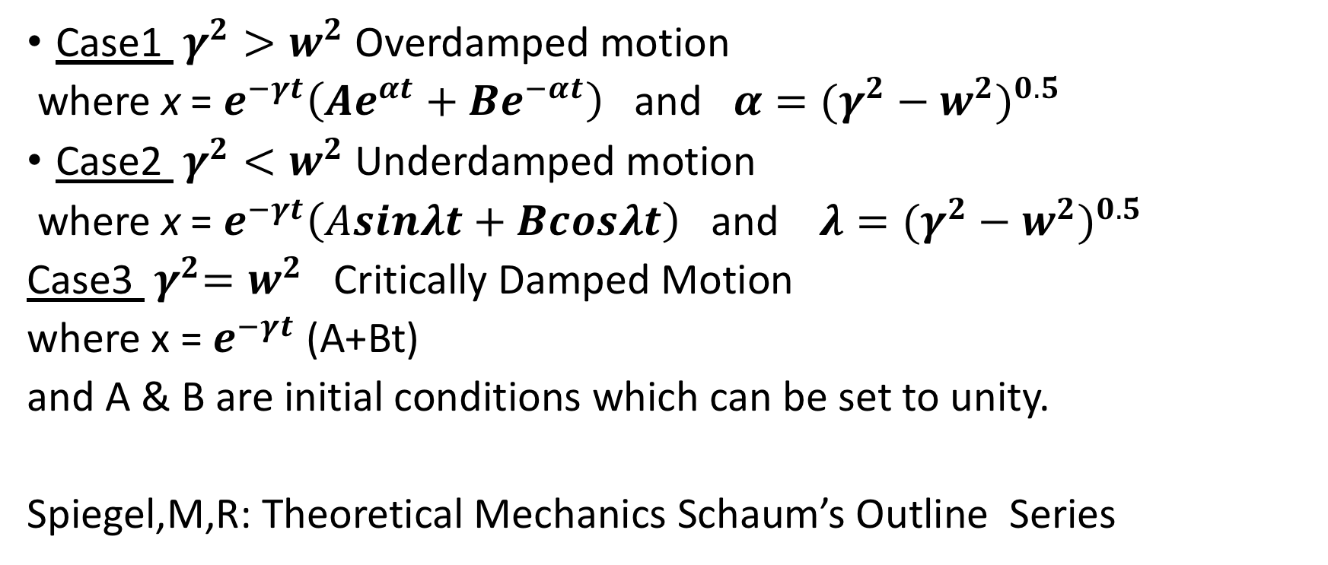
General Solutions of DE
Case1 $γ^{2}>w^{2}$ Overdamped motion
where x = $e^{−γt}\left({Ae}^{αt}+Be^{−αt}\right)$ and $α=(γ^{2}−w^{2})^{0.5}$
Case2 $γ^{2}<w^{2}$Underdamped motion
where x = $e^{−γt}\left(Asinλt+Bcosλt\right)$ and $λ=(γ^{2}−w^{2})^{0.5}$
Case3 ${ γ}^{2}=w^{2}$ Critically Damped Motion
where x = $e^{−γt}$ (A+Bt)
and A & B are initial conditions which can be set to unity.
Spiegel,M,R: Theoretical Mechanics Schaum’s Outline Series

Slide 9
Use of Average amplitude of vibration between 0-6 seconds
Apart from useful practice of average values, this was useful for distinguishing between the influence of the parameters of the Amplitude.
For example, with overdamped values
Case 1 $γ^{2}>w^{2}$ average = $\frac{1}{6}$ $\int_{0}^{6}{e^{−γt}(e^{αt}}+e^{−αt})$dt

Slide 10
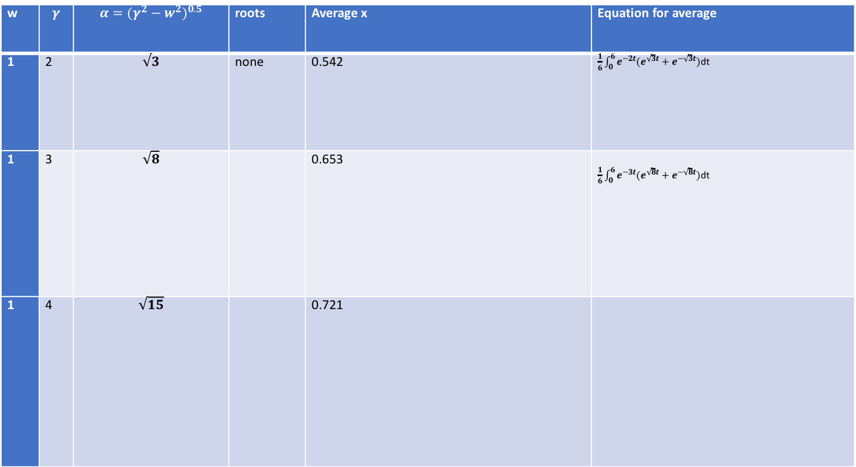
w | $$γ$$ | $$α=(γ^{2}−w^{2})^{0.5}$$ | roots | Average x | Equation for average
1 | 2 | $$√3$$ | none | 0.542 | $\frac{1}{6}$ $\int_{0}^{6}{e^{−2t}(e^{\sqrt{3}t}}+e^{−\sqrt{3}t})$dt
1 | 3 | $$\sqrt{8}$$ |  | 0.653 | $\frac{1}{6}$ $\int_{0}^{6}{e^{−3t}(e^{\sqrt{8}t}}+e^{−\sqrt{8}t})$dt
1 | 4 | $$\sqrt{15}$$ |  | 0.721

Slide 11
VCE Specialist Sample Application assessment Tasks
Specialist Maths
https://www.vcaa.vic.edu.au/curriculum/vce/vce-study-designs/specialistmathematics/advice-for-teachers/Pages/Units3and4AssessmentTasks%E2%80%8B.aspx

Slide 12
SAC Application examples
A starting point for pendulums is the VCAA sample Application tasks for Mathematical Methods Unit 3 was Sample application task 4 – product functions and pendulum clocks
Which introduces products of decaying exponential functions and trig functions such as
s(t) = 5e^{–kt} sin(at)
Maths Methods
https://www.vcaa.vic.edu.au/curriculum/vce/vce-study-designs/mathematicalmethods/advice-for-teachers/Pages/Units3and4AssessmentTasks%E2%80%8B.aspx

Slide 13
Earthquake waves
Earthquakes involve seismic waves. Siesmic waves consist of Surface Waves and Body Waves.
Body waves consist of P, Primary, or Compressional waves which travel the fastest (~6 km/sec in the upper crust).
Surface waves are slower than body waves and its usually surface waves which knock down buildings . They do the damage in Earthquakes. Surface waves are divided also into two types. L waves shake the ground side-to-side like an S wave. R waves displace the ground like rolling ocean waves. The ground rolls forward and up and then down and backwards. This is similar to a p wave but with the extra up-down motion. (From Earthquakes and Seismology) http://www.columbia.edu/~vjd1/earthquakes.htm

Slide 14
Early warning of Earthquakes by birds etc
Some people even report hearing an earthquake (due to the higher frequency P waves vibrating or rustling objects) before they feel the S waves arrival. When S waves deform the ground, it causes lateral or shear (back and forth) forces on structures. Older buildings were constructed primarily to withstand gravity (vertical forces); therefore they are more prone to fail due to the strong lateral (sideways) loading experienced during a big earthquake.

Slide 15
Applicability to Building design and Earthquakes
The period is the reciprocal of the frequency, The resonant frequency of buildings is about 1 Hertz ( 1 cycle /second) . An earthquake having this frequency is more likely to destroy a building.
The frequency range of seismic waves is large, from as high as the audible range (greater than 20 hertz) to as low as the frequencies of the free oscillations of the whole Earth,

Slide 16
Go to SAC

