Slide 1
What makes a good mathematical game?
James Russo @surfmaths
and
Toby Russo @tobyrusso
Notes:
James

Slide 2
Notes:
James

Slide 3
Ready, Steady, Add
Teacher chooses target number (1-20)
Students work in pairs; they can’t communicate.
Students say ‘Ready, Steady, Add’; they ‘throw’ 1-10 fingers.
They continue until they reach the target number.
When they reach their target number, they put their fingers above their heads.
The teacher records their sum and gives the group a new target number.
Carmel Godfrey, 2018. Ready, Steady, Add. Prime Number Vol.1 2018.
Notes:
James

Slide 4
How do you decide which maths games to play in your classroom?
Notes:
Toby

Slide 5
Overview
Introducing the ‘5 Principles of Educationally Rich (Good) Mathematical Games’
Playing games and connecting them to these principles
Workshopping a game
Notes:
Toby

Slide 6
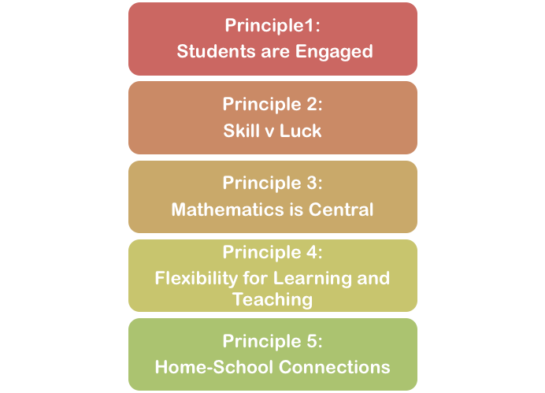
Five Principles of ‘Good’ Maths Games
Notes:
Toby

Slide 7
Principle 1. Students are Engaged
Games should be engaging, enjoyable and generate mathematical discussion.
Games generate more on-task behaviour and dialogue than non-game based activities (Bragg 2012)
Games students are not motivated to play are unlikely to generate positive learning outcomes compared with alternative activities.
Notes:
Luck in numbers chosen.
Skill over several rounds, each player understands strategy of their partner (being random is poor strategy).
Skill in recognising when you reach target number and raising hands.
‘Ready, Steady, Add’, students can get frustrated at each other, disappointment.

Slide 8
Principle 2. Skill and Luck Are Balanced
Without luck, more able students will dominate.
Without skill, intrinsic motivation is limited.
Balance between luck and skill engages students.
Balance can have positive social impact; i.e. all students need to learn to be a ‘good loser’ or ‘gracious winner’.
Notes:
Luck in numbers chosen.
Skill over several rounds, each player understands strategy of their partner (being random is poor strategy).
Skill in recognising when you reach target number and raising hands.
‘Ready, Steady, Add’, students can get frustrated at each other, disappointment.

Slide 9
Principle 3. Mathematics is Central
Games are used purposefully; chosen game matches specific learning objective.
Games could be focused on:
Skill practice (e.g. addition facts)
Strategic thinking / problem solving (e.g. nim games)
Exposure to new concepts (e.g. over/under)

Slide 10
Principle 4. Flexibility for Learning and Teaching
Games should cater to varied ability levels
Through game dynamics (e.g. count-on vs partitioning)
Through game mechanics, i.e. modifications (e.g. number of hands used, target number provided)
Through supporting materials (e.g. hundreds chart)

Slide 11
Principle 5. Facilitates Home-School Connections
Games can be a tool for building positive connections between home and school
Help parents/carers understand mathematical concepts being taught
Help parents/carers recognise value of reasoning strategies vs rote memorisation
Students as ‘experts’
Simplicity of the game structure
Easily available materials

Slide 12
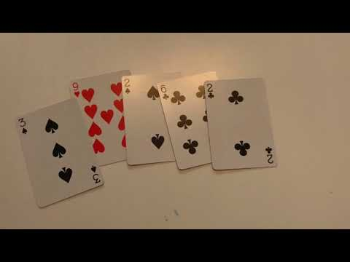
Principle 5. Facilitates Home-School Connections

Slide 13
Skip-Counting Bingo
Materials: 100-chart, 6-sided dice
Students choose three Bingo numbers in turn, and mark these on 100-chart.
Roll a 6-sided dice. Together students count by whatever the number rolled, using the 100-chart to keep track.
Students stop counting when they encounter a bingo number.
The dice is rolled again, and a new counting sequence is explored.
Play continues until one of the players removes all their numbers and shouts ‘Bingo!’.

Slide 14
Skip-Counting Bingo
How does this game connect to the ‘5 Principles’
What are some modifications you could make?

Slide 15
Multiple Mysteries
Materials: Calculator, playing cards (Jacks are zero; remove 10, Q, K)
Choose a target number (e.g., 3, 5, 8).
Five cards are dealt to each player.
First player uses some or all of these cards to make a multiple of the ‘target number’. One point scored for each card used; ‘bank’ these cards, and replenish hand to 5 cards.
Opponents can challenge the player’s multiple, using a calculator and dividing the created number by the target number. If correct challenger ‘banks’ cards; if incorrect pay a one card penalty.
Play continues in turn. Once all the cards in the deck are used, ‘banked’ cards are counted.

Slide 16
Multiple Mysteries
How does this game connect to the ‘5 Principles’
What are some modifications you could make?

Slide 17
Workshopping a Game
Choose a game you know and use.
Describe it.
How does it meet these principles?
How might you modify it?

Slide 18
Summary
Goal of this session: to start a discussion about reflecting on what makes a ‘good’ maths game
Take this discussion to your schools
APMC Paper and other published work can be accessed through Research Gate (James Russo and Toby Russo)
Feel free to contact us to share your ideas and experiences (james.russo@monash.edu and toby@bellps.vic.edu.au)

