Slide 1
Teaching Coding without Technology? Yes I can!
15 November 2018
Samantha Bothe
s.bothe@deakin.edu.au

Slide 2
Learning Intention
Today we are learning to understand the need for coding and how we can implement it without technology

Slide 3
How to make a cup of coffee
Boil water
Put coffee in cup
Add water then sugar / milk if needed
Drink coffee

Slide 4
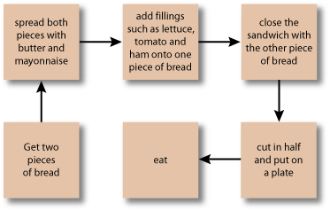
How to make a sandwich

Slide 5
Why should our students learn to Code?
Mandated in the Australian Curriculum
Research
‘Soft skills’ for future employment
‘Everybody in this country should learn to program a computer, because it teaches you how to think’ Steve Jobs, co-founder of Apple Inc.

Slide 6
Why should our students learn to Code?
The Australian Curriculum includes the Digital Technologies curriculum for F-10.
It has 2 strands – Knowledge and Understanding, and Processes and Production Skills.

Slide 7
Australian Curriculum
F-2
Follow, describe and represent a sequence of steps and decisions (algorithms) needed to solve simple problems(ACTDIP004 - Scootle )
3-4
Define simple problems, and describe and follow a sequence of steps and decisions (algorithms) needed to solve them(ACTDIP010 - Scootle )
5-6
Design, modify and follow simple algorithms involving sequences of steps, branching, and iteration (repetition)(ACTDIP019 - Scootle )

Slide 8
Australian Curriculum
7-8
Design algorithms represented diagrammatically and in English, and trace algorithms to predict output for a given input and to identify errors (ACTDIP029 - Scootle )
9-10
Design algorithms represented diagrammatically and in structured English and validate algorithms and programs through tracing and test cases (ACTDIP040 - Scootle )
Source:
https://www.australiancurriculum.edu.au/f-10-curriculum/technologies/digital-technologies

Slide 9
NSW Education Standards Authority
http://educationstandards.nsw.edu.au/wps/portal/nesa/k-10/learning-areas/technology/coding-across-the-curriculum
Coding
Computational Thinking
Algorithmic Thinking

Slide 10
VIC, WA, QLD, TAS Curriculum
http://victoriancurriculum.vcaa.vic.edu.au/technologies/digital-technologies/introduction/rationale-and-aims VIC
https://k10outline.scsa.wa.edu.au/home/p-10-curriculum/curriculum-browser/technologies/digital-technologies2 WA
https://www.qcaa.qld.edu.au/p-10/aciq/p-10-technologies QLD
https://documentcentre.education.tas.gov.au/Documents/Tas-Curriculum-K-10-ICT-Syllabus-and-Support.pdf TAS

Slide 11
Victorian Curriculum: Mathematics
The Victorian Curriculum: Mathematics has included new content descriptions.
These come under the Number and Algebra Strand and the Sub-Strand of Pattern and Algebra.
They are present in all year levels F -10 and relate to patterns, sequences and algorithms.

Slide 12
Strand | Number and Algebra
Level | Number and place value |  | Patterns and algebra
Foundation | Represent practical situations to model addition and subtraction (VCMNA073) | Represent practical situations to model sharing (VCMNA074) | Follow a short sequence of instructions (VCMNA077)
1 | Represent practical situations that model sharing (VCMNA090) |  | Recognise the importance of repetition of a process in solving problems (VCMNA094)
2 |  |  | Apply repetition in arithmetic operations, including multiplication as repeated addition and division as repeated subtraction (VCMNA114)

Slide 13
Strand | Number and Algebra
Level | Number and place value |  | Patterns and algebra
3 |  |  | Use a function machine and the inverse machine as a model to apply mathematical rules to numbers or shapes (VCMNA139)
4 |  |  | Define a simple class of problems and solve them using an effective algorithm that involves a short sequence of steps and decisions (VCMNA164)
5 | Recognise, represent and order numbers to at least hundreds of thousands (VCMNA186) |  | Follow a mathematical algorithm involving branching and repetition (iteration) (VCMNA194)
6 | Select and apply efficient mental and written strategies and appropriate digital technologies to solve problems involving all four operations with whole numbers and make estimates for these computations (VCMNA209) |  | Design algorithms involving branching and iteration to solve specific classes of mathematical problems (VCMNA221)

Slide 15
Research
The new curriculum recognises that specific ways of thinking about problem solving … are necessary for our country’s future success.
Solving problems is as much a thinking skill as it is a digital skill
The UK have designed a curriculum which ‘challenges students to think through problems in a logical and sequential way’.
(Blannin 2017)

Slide 16
Research
Kids that code gain a good appreciation of computational thinking and logical thought …develop good critical thinking skills.
Introducing young minds to the process of instructing a computer allows them to go from “I swiped this” to “I made this”. From watching YouTube stars, to showing schoolyard peers how they made their pet cat photo meow.
For most kids, teaching them to code is about opening their mind to a means to an end, not necessarily the end in itself.
(Goschnick 2015)

Slide 17
‘Soft Skills’ for the Future
Employers are seeking people who are:
Effective Communicators
Positive
Collaborative– team players
Adaptive and creative in Problem Solving
Enterprising and display initiative
Self managed
Good at time management
Resilient
Flexible

Slide 18
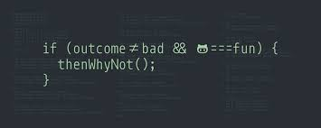
Coding
What is it?
Coding is nothing more than a set of words that tell a website, app, game or piece of software what to do.
These instructions shape what is displayed and available to people using computers, devices, and even home appliances; instructing the computer to switch multiple things on or off at the same time, down to making even the smallest dot on a computer screen appear.
(Moloney 2017)

Slide 19
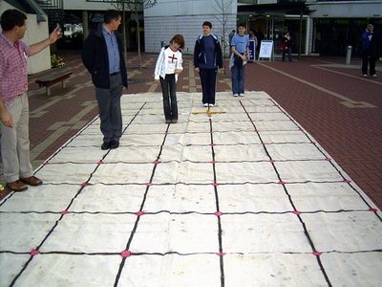
Ideas – Maths Mat
Large mat 3m x 1.5m
Year 1/ 2 We’re Going on a Bear Hunt
Shape cards
Bean bags, landmarks
Digits or letters

Slide 20
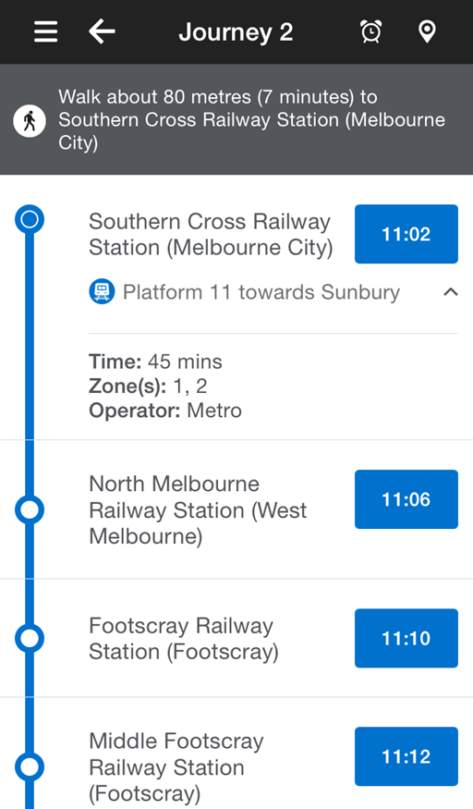
Ideas - Outside
Grid – outdoor paving
School landmarks eg office, playground, oval, drink taps
Plan a sequence of steps for another child to walk through
Orienteering course in the school grounds
Maps – plan a journey (Also PTV planner)

Slide 21
Unplugged Coding
Students can learn to code and learn the principles of coding through a range of hands on tasks without being plugged into a computer.
A range of resources are available online.
https://code.org/curriculum/unplugged
https://www.csunplugged.org/en/
https://www.digitaltechnologieshub.edu.au/

Slide 22
Inexpensive Ideas for Unplugged Coding
Geometric descriptions
Barrier tasks – using Duplo or Lego, geometric shapes
Challenge tasks
Bee-Bot cards and mats
The Emotion Machine
Graph Paper programming

Slide 23
Reflection
How can you incorporate Unplugged Coding into your planning?
What is one thing you’ll try next week
What is one important point that you’ve learnt from today
What is one thing you’d like to find out more about
What is one question you still have

Slide 24
Summary

Slide 25
References
Blannin, J 2017, ‘Coding in the Classroom’, Pursuit, viewed 25 May 2017, <https://pursuit.unimelb.edu.au/articles/coding-in-the-classroom>.
Code Club Australia 2018, ‘5 Coding activities you can do without a computer!’, viewed 9 October 2018, <https://medium.com/code-club-australia/5-coding-activities-you-can-do-without-a-computer-379eab4196c4>.
Goschnick, S 2015, ‘Want your kids to learn another language? Teach them code’, The Conversation, viewed 8 August 2017,<http://theconversation.com/want-your-kids-to-learn-another-language-teach-them-code-47409>.
Moloney, M 2017, ‘What is Coding and How to get Kids and Young People Involved’, CoderDojo, viewed 9 August 2017, <https://coderdojo.com/news/2015/11/19/what-is-coding-how-to-get-kids-young-people-involved-by-mary-moloney/>.
Victorian Curriculum and Assessment Authority 2017, Changes to Mathematical Content Descriptions, Victorian Curriculum and Assessment Authority, Melbourne, viewed 12 June 2017, <www.vcaa.vic.edu.au/.../maths/Mathematics_Content_Description_Changes_Summary>.
Victorian Curriculum and Assessment Authority 2017, Digital Technologies: Scope and Sequence, Victorian Curriculum and Assessment Authority, Melbourne, viewed 12 June 2017, <http://victoriancurriculum.vcaa.vic.edu.au/technologies/digital-technologies/introduction/scope-and-sequence>.

