Slide 1
Teachers Creating Impact
But How is Impact Measured?
Marcel Van Otterdyk & George Lilley
Details of this analysis can be found –
https://visablelearning.blogspot.com/

Slide 2
The Effect Size (ES = d)
The effect Size has become the dominant statistic in Educational policy, largely due to John Hattie’s 2009 book, “Visible Learning”.
“Evidence Base” is now equated with Effect sizes. For example, the “10 High Impact Teaching Strategies” (HITs) by the Victorian Education Department.

Slide 3
The Story, The Story, The Story …
Hattie appears to be shifting his focus from “Know they Impact” to
“the story, the story, the story…”
But Hattie dismisses other’s stories by use of the ES so it must still be the focus of our analysis.
In a recent interview with Hanne Knudsen (2017), he states,
"almost every teacher wants to get up and talk about their story, their anecdotes and their classrooms. We will not allow that, because as soon as you allow that, you legitimise every teacher in the room talking about their war stories, their views, their kids" (p3).

Slide 4
Is the Effect Size a reliable measure of impact?
What will surprise teachers is that there is quite a lot of conjecture and debate over this in the peer reviews.
“Our discipline needs to be saturated with critique of ideas; and it should be welcomed. Every paradigm or set of conjectures should be tested to destruction and its authors, adherents, and users of the ideas should face public accountability.” (Hattie, 2017, p 428).
We’ve listed about 50 peer reviews of the problems with effect sizes here - https://visablelearning.blogspot.com/p/references.html
Our aim is to raise awareness of these critiques and in the spirit of Tom Bennett, the founder of researchEd,
“There exists a good deal of poor, misleading or simply deceptive research in the ecosystem of school debate...
Where research contradicts the prevailing experiential wisdom of the practitioner, that needs to be accounted for, to the detriment of neither but for the ultimate benefit of the student or educator.” The School Research Lead (p9).

Slide 5
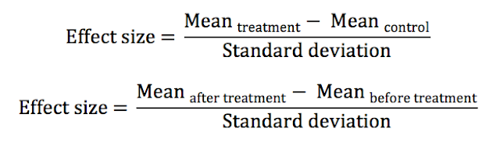
How is the effect size calculated?
Hattie gives details of 2 methods.
Each is meant to measure the difference in student achievement and give what is equivalent to a Z score.
But many reviews show that there are big differences in this measurement depending on whether a standardised test or a specific test (like an algebra test) is used.
Also, the standard deviation is a major issue as there are 4 different standard deviations researchers can use and this has not been consistent over studies over the last 30 years.

Slide 6
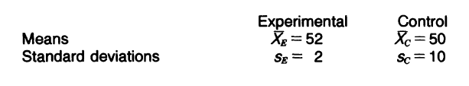
The STDev
Gene Glass (1977) invented the meta-analyses methodology and warns of the issue of standard deviation in his seminal work that Hattie references.
He warns if you compare effect sizes from different studies, as Hattie does. Then you need to account for the different standard deviations researcher use – Hattie does not!)

Slide 7
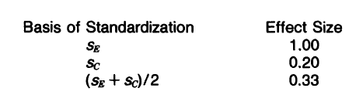
example
Glass (1977) gives this example of how the same intervention can have a totally different effect size depending on which STD is used.
Note: since this work a 4th method to calculate STD is being used – the ‘pooled’ STD.
Which is just the STD of the control and experimental groups combined together.
For these data this would derive an ES = 0.39

Slide 8
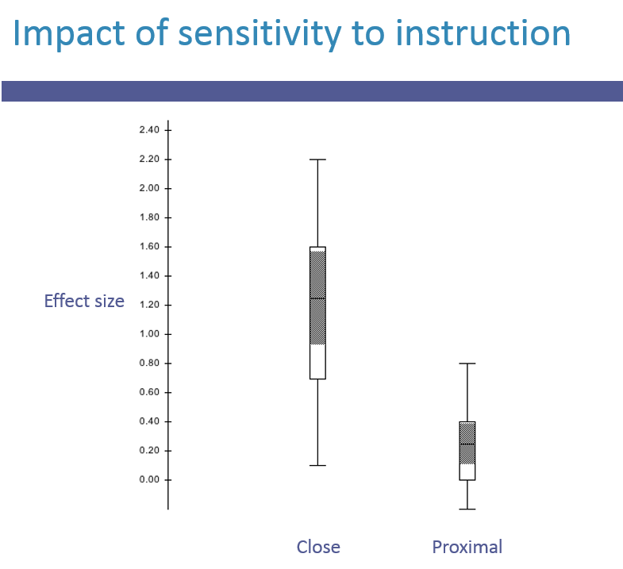
Ruiz-Primo, et al (2002)
Show the effect size for the SAME intervention differs markedly depending on the achievement test used.
As a general rule standardised tests give lower effect sizes and accounts for some of Hattie’s exclamations –”Why is the effect size for class size so small?”
One reason is class size researchers use standardised tests compared to feedback researchers who use specific tests.

Slide 9

Another effect size method?
Hattie often uses a 3rd method to calculate effect size.
He converts a correlation study into an effect via the transformation formula.
Hattie’s gives no justification for using this method as correlation studies are not experiments as he outlined in previous methods.
Bergeron (2017) is very critical of Hattie using this method.

Slide 10
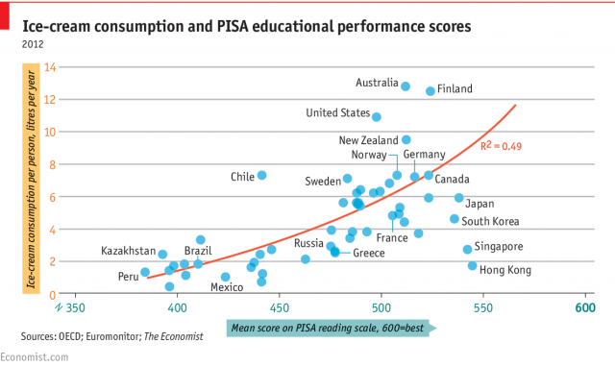
Bergeron (2017)
Bergeron gives an example of the problem of using correlation studies and converting to an effect size.
He shows that ice cream sales correlated highly with PISA achievement scores and if converted to an effect size (=1.96) would be one of Hattie’s highest ranked influences!

Slide 11
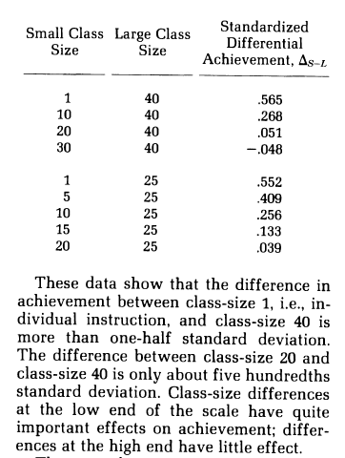
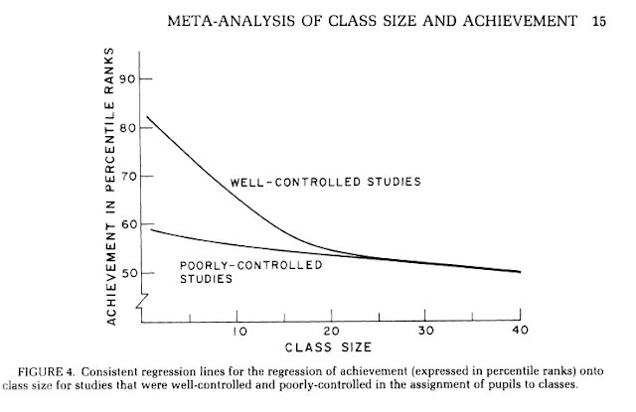
The representation of Studies, AVERAGING?

Slide 12
Glass and Smith (1979) Class Size
Glass and Smith represent their findings in a table and graph above.
Hattie calculated one average ES = 0.09 from the table (but this appears wrong).
This one average does not represent the study and conflicts with the actual authors e.g., Glass (2004).,
"The result of a meta-analysis should never be an average; it should be a graph.“
Bergeron (2017) reiterates,
“Hattie computes averages that do not make any sense.”

Slide 13
Then there are questionable interpretations
The Feedback influence includes meta-analyses on background music as feedback and monetary rewards as feedback. Yet the definition of feedback is different – feedback is specific, timely, etc.
The Welfare influence only uses one meta-analyses that looks at parents being taken OFF welfare not given welfare! This does not represent the range of welfare programs in schools.
Most of the Self-report meta-analyses are not measuring self report or expectations but something else.
Details of these and more –
https://visablelearning.blogspot.com/

Slide 14
More examples
Prof John O'Neill (2011),
“At the very least, the problems below should give you and your officials pause for thought rather than unquestioningly accepting Professor Hattie’s research at face-value, as appears to have been the case.”
Schulmeister & Loviscach (2014),
“If one corrects the errors mentioned above, list positions take big leaps up or down. Even more concerning is the absurd precision this ranking conveys. It only shows the averages of effect sizes but not their considerable variation within every group formed by Hattie and even more so within every individual meta-analysis.”

Slide 15
Dr. Jim Thornton Professor of Obstetrics and Gynaecology at Nottingham University,
“To a medical researcher, it seems bonkers that Hattie combines all studies of the same intervention into a single effect size. Why should ‘sitting in rows’, for example, have the same effect on primary children as on university students, on maths as on art teaching, on behaviour outcomes as on knowledge outcomes? In medicine it would be like combining trials of steroids to treat rheumatoid arthritis, effective, with trials of steroids to treat pneumonia, harmful, and concluding that steroids have no effect! I keep expecting someone to tell me I’ve misread Hattie.”
Nilholm (2017)
“Hattie provides very scarce information about his approach. This makes it very difficult to replicate his analyses. The ability to replicate an analysis is considered by many as a crucial determinant of scientific work...
there is some evidence that his thoughts lead in many ways in the wrong direction” (p3).

Slide 16
Prof Terry Wrigely (2015) in Bullying by Numbers,
“Its method is based on stirring together hundreds of meta-analyses reporting on many thousands of pieces of research to measure the effectiveness of interventions.
This is like claiming that a hammer is the best way to crack a nut, but without distinguishing between coconuts and peanuts, or saying whether the experiment used a sledgehammer or the inflatable plastic one that you won at the fair” (p5).
Prof Pierre-Jérôme Bergeron (2017),
“When taking the necessary in-depth look at Visible Learning with the eye of an expert, we find not a mighty castle but a fragile house of cards that quickly falls apart...
To believe Hattie is to have a blind spot in one’s critical thinking when assessing scientific rigour. To promote his work is to unfortunately fall into the promotion of pseudoscience. Finally, to persist in defending Hattie after becoming aware of the serious critique of his methodology constitutes wilful blindness.”

