Slide 1
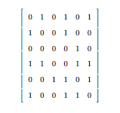
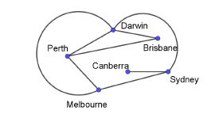
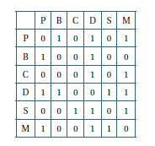
Simple Graphs
Notes:
First we introduce some of the vocabulary:
Node
Vertex
Edge
Arc
Degree
Adjacency matrix
First with the labels and then without – the format generally used

Slide 2
Networks and decision maths
MAV, December 2018

Slide 3
“Airline Scheduling” by Greg Carroll and Vicky Kennard
And
CHOOSEMATHS Online Professional Development for Teachers
Notes:
These are two new products that AMSI have developed to help teachers who are delivering the Network and Graph units in Year 11 and 12.
The first is based around a video, that will be in the next slide, and is a unit of work for students to complete. Showing them an example of networks being used in context.
The other is a module, for our new, Professional Development site for teachers.
We are not a commercial organisation and these resources are/will be available for free from our website.
First I will take you through the student module and then through the PD module.

Slide 4
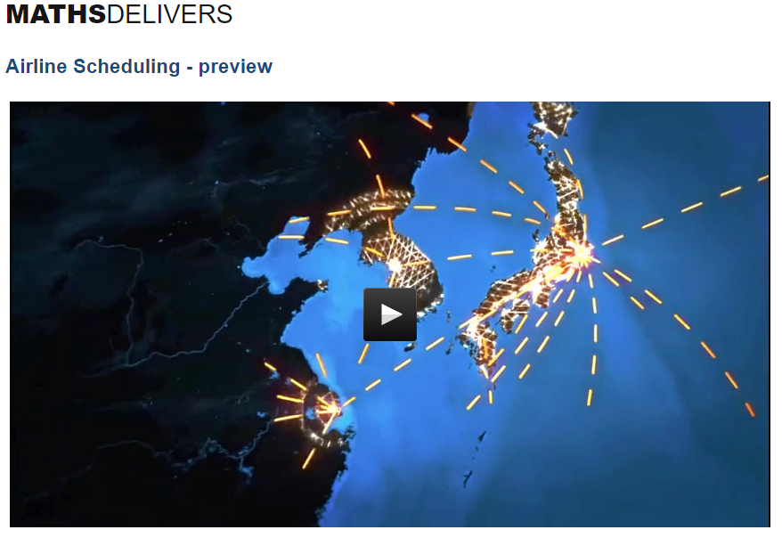
Notes:
The Airline Scheduling module is based on this video – the idea is to link the maths with a real, hopefully interesting, situation
Watch the video
The module is available online and the student resources can be downloaded as a pdf
The online version has several video links and animations
It is split into sections, that follow a logical sequence, with short exercises at the end of each section (with solutions)
All the examples and exercises are on the theme of Airline Scheduling

Slide 5
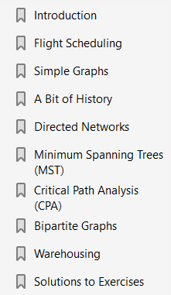
Notes:
This is the index to the module

Slide 6
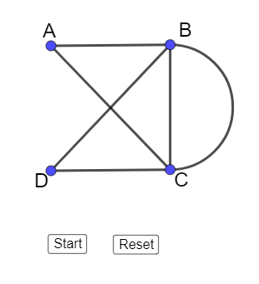
Notes:
We then discuss isomorphic graphs
There are links throughout the PDF to Geogebra files. These can be shared, through the online version, and used in class.
Here is a GeoGebra animation to show what is meant (Have the Geogebra already open in browser)

Slide 7
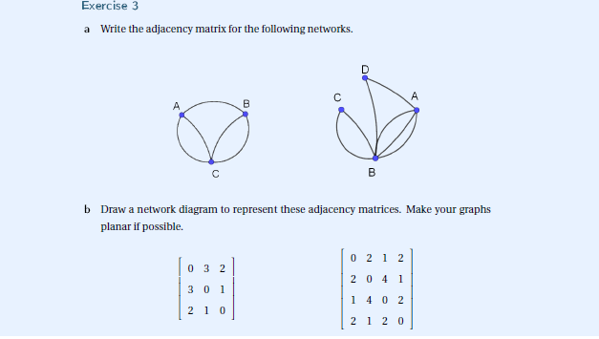
Example of an end of chapter exercise
Notes:
This is an example of the end of chapter exercises.
These are not meant to replace a textbook but just to reinforce the concepts dealt with I the chapter.
The solutions are at the end of the booklet.

Slide 8
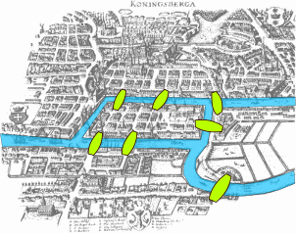
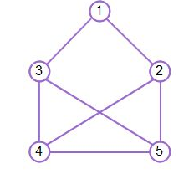
A bit of history
Notes:
We then look at the historical development of this branch of mathematics
From Euler, through the second world war, the Nobel Prizes, travelling salesman and postman problems etc.
Putting maths into its historical context and development can help students to see the ‘usefulness’ of mathematics.
This is a new branch of mathematics, basically grown since the development of computing.

Slide 9
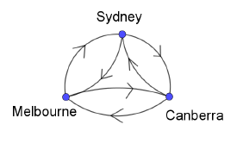
Directed Networks
Notes:
The next section looks at directed networks
The UPS experience and the idea of an optimal solution to a problem – again putting the maths into a modern, relevant/relatable context.
In this area of maths the idea that there can be multiple correct answers can be difficult/problematic/challenging for students to understand – it can make some students a little insecure since they cannot just check their answer against a friends etc.

Slide 10
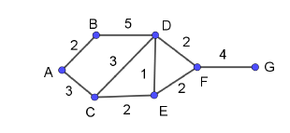
Shortest Path
Notes:
After this introduction we move on to looking at specific algorithms
The first one we look at is Dijkstra’s
We discuss weights on edges and the concept of finding a path through a network, looking for the shortest path
The algorithm is complex to explain on paper and this module is not replace a textbook – hence we have included videos to do the explaining

Slide 11
Directed networks and Flow
Notes:
Directed paths and the concept of flow are then brought into the discussed
Using min cut = max flow

Slide 12
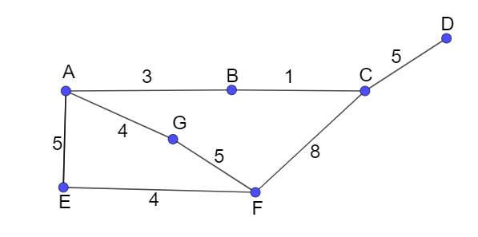
Minimum Spanning Trees
Notes:
The next area is Minimum Spanning Trees
We look at both Kruskal and Prim’s algorithms and contrast them in an animation
Have the animation ready to show in a browser

Slide 13
Critical Path Analysis
Notes:
This takes us to Critical Path Analysis
Forward and backwards passes and floats
Again we use a mixture of video and animation to illustrate this algorithm
Have the animation ready in a browser

Slide 14
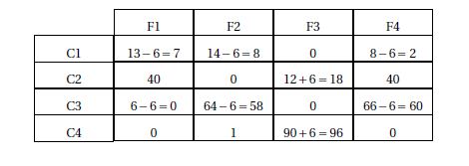
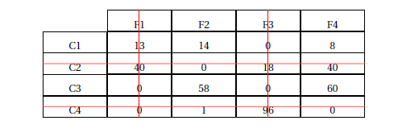
Warehousing and Allocation
Notes:
We briefly discuss Bivariate Graphs and the concept of allocation
Followed by a look at the another allocation algorithm – the Hungarian Algorithm
We work through an example in some detail

Slide 15
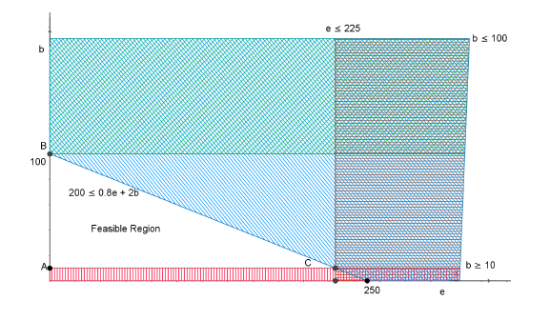
Linear Programming
Notes:
The last area we look at is linear programming (this area is not in all the states curricula)
With a brief mention of integer programming, as mentioned in the video.

Slide 16
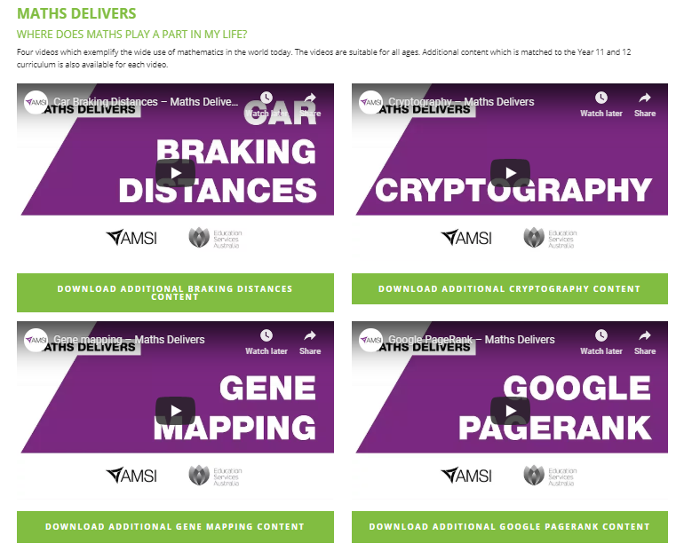
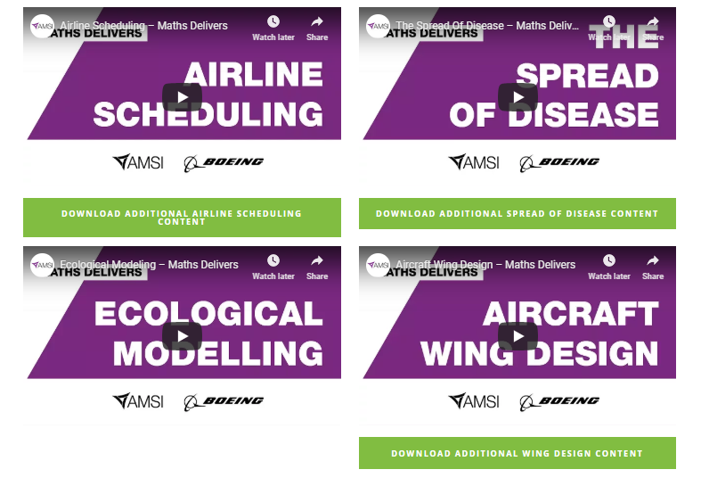
Notes:
The purpose, as I said at the beginning is for students to be able to work through the module to gain an general understanding of the topic in a familiar context. It is not there to formally teach all the material.
There are several other, similar, units of work. Based mainly on the Year 11 and 12 curricula, often at quite a high level (Specialist and beyond)

Slide 17
https://amsi-schools.appspot.com/discrete_mathematics
Notes:
The Professional Development course can be found at the URL on the slide.
The URL for the AMSI online course.
This course is designed for teachers who are new to teaching the Graphs and Networks unit in Mathematics Applications/Further Mathematics
The course takes you through the different techniques needed. We have focused more on the ‘how’ of the teaching rather than content knowledge. It is assumed that a teacher can get this from working through a textbook etc.
The course is free. You have to register and we ask that you give us feedback – this is important as the online course is a new product for AMSI and really do want to know what people think of it (polite comments please)

Slide 18
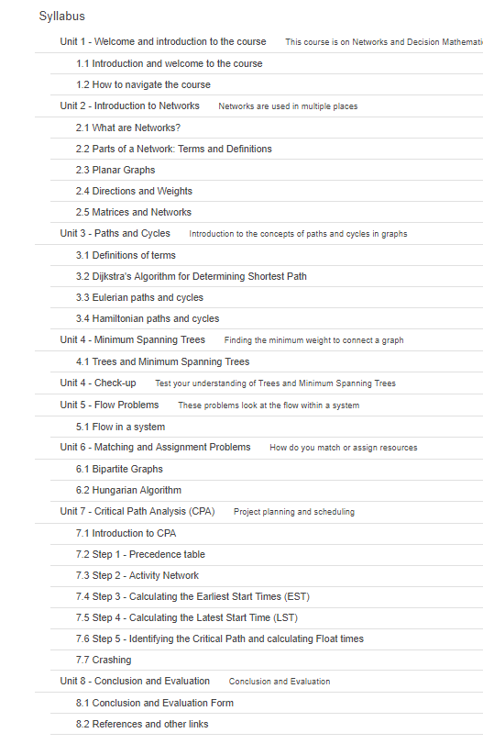
Notes:
There are 6 units plus an introduction and conclusion
The units, roughly, follow the course outline as per the different curricula across the country.
Not all states are exactly the same. We have tried to cover everything, so not all may be relevant.

Slide 19
Notes:
The curriculum areas addressed in each unit/lesson appear at the top. We have tried to do this by state as well as the Australian Curriculum.

Slide 20
Notes:
Each unit starts with an introduction video where we talk about the content covered in the unit. These are in the style of two people talking.
Here is an example. Remember we are new to this!!

Slide 21
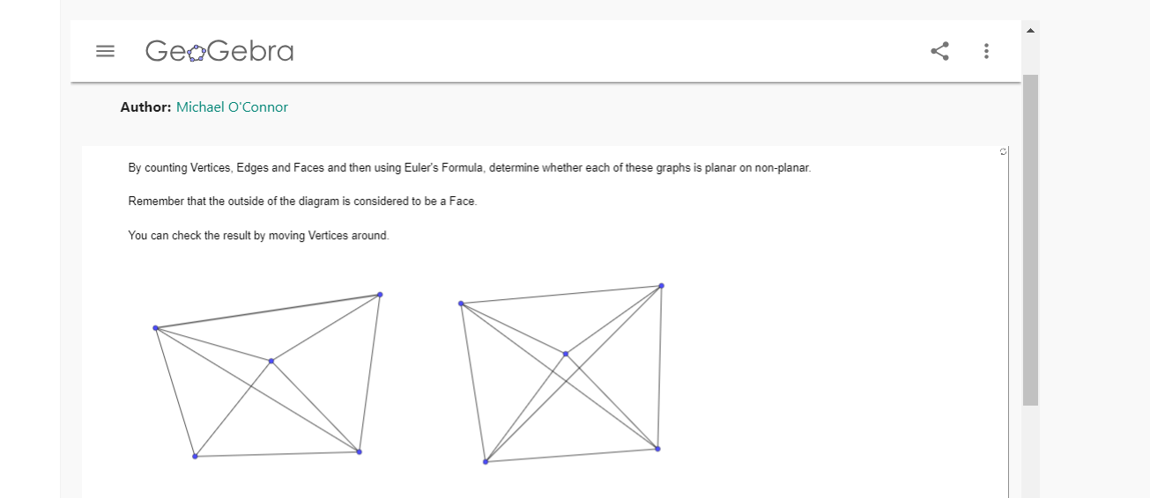
https://ggbm.at/zvmred5q
Notes:
We have developed many GeoGebra applets to illustrate the concepts.
These are available for you to download and share with your students.
There are instructions on how to do this, if you are not familiar with GeoGebra, in the introductory unit at the start of the course.

Slide 22
Notes:
At the end there are links to various websites mentioned in the course

Slide 23
How you can help us!
Notes:
Please login to and complete the course
The evaluation is really important to us at this time as this is how we will improve what we are offering
I have recently added and assessment (Check-up for Unit 2). This is in a different format for the check-up in unit 4. Please let us know which one you prefer.
We are still at the development stage and really want to make these as user friendly and useful as possible.

Slide 24
https://amsi-schools.appspot.com/discrete_mathematics
Notes:
What we are asking for now is that as many people as possible register for the course, complete it and the feedback. We are looking to expand the areas covered by online PD and really need the feedback to make improvements.
We are also interested in any suggestions for what areas you would like to see us cover next.

Slide 25
Resources and links:
https://calculate.org.au/home/videos/
https://calculate.org.au/wp-content/uploads/sites/15/2018/10/airline-scheduling.pdf
https://amsi-schools.appspot.com/discrete_mathematics
Notes:
These are the links to the videos and courses.

