Slide 1
Excel Spreadsheets from 1985 until now

Slide 2
Quantitative Skills of 21st Century Workers © Commonwealth of Australia 2014
‘Many people in the workplace are engaged with technology, particularly in using spreadsheets and graphical outputs.’
‘There is a need to identify and take opportunities to embed work-related technologies—particularly spreadsheets and computer generated graphics—in the mathematics curriculum and teaching in schools.’
Notes:
Watch for these as we go

Slide 3
Digital Skills for Tomorrow's World UK Digital Skills Taskforce (2014)
Digital muggle: no digital skills required
Digital citizen: use technology to communicate, find information and transact
Digital worker: configure and use digital systems
Digital maker: build digital technology
A digital worker might use document formatting tools, build spreadsheets and use sophisticated tools directly related to a particular occupation.
.
Tackling the School - Industry Mathematics Divide
‘More than 90% of Australia’s current workforce will need to be at least a digital citizen to function in a digitally-enabled workforce over the next 2-5 years.’

Slide 4
The New Basics Report Foundation for Young Australians (2017)

Slide 5
Tackling the School-Industry Mathematics Divide Summary Statement
‘It is more important than ever before for teachers to consider how they teach as well as what they teach—what and how cannot be separated when developing skills in key areas such as critical thinking, communication, collaboration, and mathematical modelling.’

Slide 6
Goals for a maths classroom
Maths - concepts, skills and problem solving
Digital skills – spreadsheets and graphical representation
Enterprise skills – teamwork, critical thinking, creativity, communication skills, presentation skills
All three at once?

Slide 7
Some spreadsheets for the maths class
The power of spreadsheets - Three coins simulation
2. For getting started (Year 7?) – linear algebra and graphs
3. Downloading and graphing real data – ABS Drug deaths
4. A group task with big data - reporting on sales data
rob_money22@yahoo.com.au

Slide 8
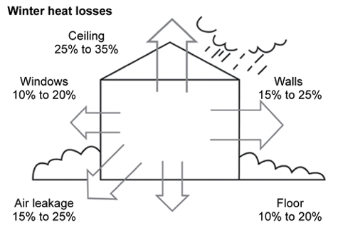
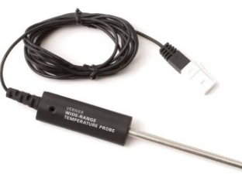
STEM – Real data
 | Probe 1 | Probe 2 | Probe 3
21:56:07 | 85 | 26.31 | 26.19
22:01:10 | 26.56 | 26.75 | 26.87
22:06:13 | 26.69 | 26.75 | 27.06
22:11:17 | 26.69 | 26.69 | 27.12
22:16:21 | 26.62 | 26.62 | 27.12
22:21:24 | 26.62 | 26.56 | 27.06
22:26:28 | 26.62 | 26.5 | 27.06
22:31:32 | 26.5 | 26.44 | 27
22:36:35 | 26.5 | 26.37 | 27

