Slide 1
MAV Conference 2018
(Maths, Magic and More)
“Much of mathematics has the appeal of magic, and some of it is pure magic” – Charles Eames (1960)

Slide 2
Warm ups
Minute Challenge
Ken Ken
Countdown
Quick Maths

Slide 3
Introductions
Stephen Hanlon
Learning Area Leader of Mathematics at Braemar College, Woodend
Teacher of mathematics since 1984
2019 teaching load:
12 Specialist Mathematics
12 Mathematical Methods
9/10 Elective MMM

Slide 4
Maths Magic and More
To the kids:
Welcome to Mr Hanlon’s world of mathematics. In this elective you will learn techniques and methods that will complement your core maths program, make you a better mathematician and maybe even a mathemagician.

Slide 5
To the school administration:
This Semester students undertook work from the three content strands of the Australian Curriculum: Number and Algebra, Measurement and Geometry, and Statistics and Probability. The proficiency strands of Fluency and Understanding included frequent practice of computational number skills using by-hand processes and mental short-cuts. The proficiency strands of Problem Solving and Reasoning included puzzles, conundrums, challenges and assignments. The backbone of the course saw students consolidate their skills by learning mathematical magic tricks and then presenting them to their peers and younger members of the College community. Technology was incorporated throughout by the use of a CAS calculator.

Slide 6
Program (handout)
Semester of 18 weeks
10-day timetable cycle
Five 80 minute sessions per cycle
Each session structure:
Warm-up activity
Skill development
Trick
“To really appreciate mathematics, you have to see it evolve, to work through the twists and turns yourself; it’s almost never enough for someone to just tell you about it” – Hannah Fry (Guardian 2015)

Slide 7
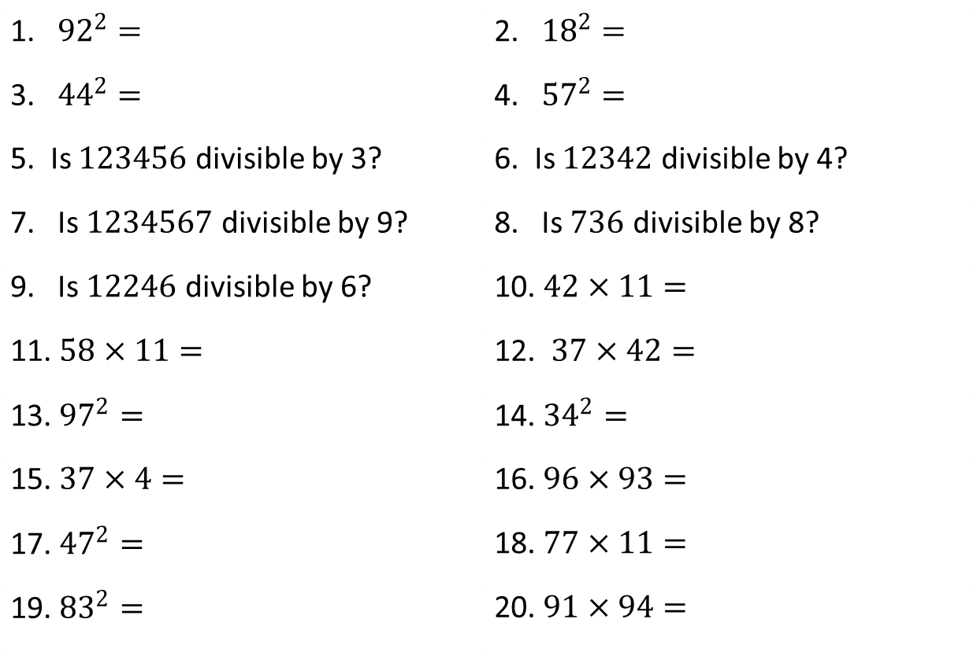
Quick Maths Quiz 3
1. ${92}^{2}=$ | 2. ${18}^{2}=$
3. ${44}^{2}=$ | 4. ${57}^{2}=$
5. Is $123456$ divisible by 3? | 6. Is $12342$ divisible by 4?
7. Is $1234567$ divisible by 9? | 8. Is $736$ divisible by 8?
9. Is $12246$ divisible by 6? | 10. $42×11=$
11. $58×11=$ | 12. $37×42=$
13. ${97}^{2}=$ | 14. ${34}^{2}=$
15. $37×4=$ | 16. $96×93=$
17. ${47}^{2}=$ | 18. $77×11=$
19. ${83}^{2}=$ | 20. $91×94=$

Slide 8
Think of Two Digits HHH#1
Think of any two single digits (eg 7 and 3)
Pick one and multiply it by 5 (7 x 5 = 35)
Add 7 (35 + 7 = 42)
Double (42 x 2 = 84)
Add the other digit first thought of (84 + 3 = 87)
Tell me the result

Slide 9
Secret Step
Subtract 14 to reveal a number made up of the two single digits
(87 ‒ 14 = 73
that is 7 and 3)

Slide 10
Why?
Let the two digits chosen be A and B
A x 5 = 5A
5A + 7
2(5A + 7) = 10A + 14
10A + 14 + B = 10A + B + 14
10A + B + 14 – 14 = 10A + B

Slide 11
Magic Number HHH#28 (2019)
Write down a 4-digit number (eg. 2017)
Write down first digit of the number (2)
Write down first 2 digits of the number (20)
Write down first 3 digits of the number (201)
Add the 3 numbers written down (2+20+201 = 223)
Multiply answer by 9 (223 x 9 = 2007)
Finally, add sum of digits of original number to the answer (2007 + 2+0+1+7 = 2017)
Magic!

Slide 12
This trick can be extended to any number of digits
So everyone has a magic birthdate, postcode etc…
Next year is also magic!

Slide 13
Why?
4-digit number with digits X, Y, Z, W is
1000X + 100Y + 10Z + W
X
XY = 10X + Y
XYZ = 100X + 10Y + Z
Summing X + (10X + Y) + (100X + 10Y + Z) =
111X + 11Y + Z
9 x (111X + 11Y + Z) = 999X + 99Y + 9Z
(999X + 99Y + 9Z) + X + Y + Z + W =
1000X + 100Y + 10Z + W

Slide 14
Sheldon’ Favourite Number
Choose any four-digit number (2019) and enter it twice into a calculator | 20192019
Divide this number by 137
Divide the answer by the original number

Slide 15
Why?
137 x 73 = 10001

Slide 16
The Chuck Norris of Numbers
73 is 21st prime number, its mirror
37 is 12th prime number, its mirror
21 = 7 x 3
73 = 1001001 in binary (base 2) and is a palindrome;
NEVER ODD OR EVEN
I PREFER PI

Slide 17
HHH#2019 A New Year
Use the digits of 2019 and correct mathematical operations to generate the integers 1 – 10.
NB. The numerical order of 2, 0, 1 and 9 must be maintained.

Slide 18

A solution
$1={{2^{0}}^{1}}^{9}$
$2=2+0×1×9$
$3=2+0+1^{9}$
$4=2×0+1+\sqrt{9}$
$5=2+0×1+\sqrt{9}$
$6=−2+0−1+9$
$7=−2+0×1+9$
$8=2×0−1+9$
$9=2×0×1+9$
$10=2×0+1+9$

Slide 19
Consecutive Numbers – HHH#27
Write down three consecutive numbers under 60
Add the numbers
Ask someone for a multiple of 3 under 100
Tell audience to add the ‘called’ number to their sum
Then, multiply their answer by 67
Ask for last two digits of their answer
27, 28, 29 → 27+28+29 = 84 → 84 + ‘51’ = 135
135 x 67 = 9045 → 45

Slide 20
Secret Step
Divide ‘called’ multiple of 3 by 3 and remember value
’51’ ÷ 3 = 17
Subtract remembered number from the result given to reveal the middle of the consecutive numbers.
45 ‒ 17 = 28 (the middle consecutive number)

Slide 21
Why?
Chosen numbers n – 1, n, n + 1
Total = 3n
Multiple of 3 called out = 3y
New total = 3n + 3y = 3(n + y)
3(n + y) x 67 = 201(n + y) = 200(n + y) + (n + y)
Now 3y < 100 so y < 34 and n < 60 so n + y < 94
Therefore final two digits of 201(n + y) is n + y
Hence subtracting y (1/3 of ‘called’ number)
gives n.

Slide 22
Faster than a calculator – HHH#23
Write two single digit numbers, one beneath the other. Write the sum of these two digits underneath Continue to write the sum of the last two numbers underneath until there are ten numbers in a column. Calculate the sum of all ten numbers | 3 7 10 17 27 44 71 115 186 301

Slide 23
Secret Step
Multiply the 7th number in the column by 11 and you have the answer.
(71 x 11 = 781)
Variation: Follow process to list 6 numbers. The sum is the 5th number multiplied by 4.
(27 x 4 = 108)

Slide 24
Why?
X Y X + Y X + 2Y 2X + 3Y 3X + 5Y 5X + 8Y 8X + 13Y 13X + 21Y 21X + 34Y Total = 55X + 88Y = 11(5X + 8Y) | X Y X + Y X + 2Y 2X + 3Y 3X + 5Y Total = 8X + 12Y = 4(2X + 3Y)

Slide 25
Scramble 2 HHH#31
Write down a 6-digit number (any digit no.)
Sum its digits
Subtract this sum from original number
Finally, cross out one non-zero digit from answer and then rearrange remaining digits
Ask for final result
Example:
574338 ‒ (5+7+4+3+3+8) = 574308 → 548073 → 48073

Slide 26
Secret Step
Add digits of their final result, repeating process with your answer, until 1-digit result. Subtract this from 9 to reveal the crossed out number.
(or difference of sum from next multiple of 9)
4+8+0+7+3 = 22 → 2 + 2 = 4 → 9 ‒ 4 = 5
(or 27 ‒ 22 = 5)

Slide 27
Why?
For any multiple of 9, the sum of the digits is also a multiple of 9. Similarly, any number (N) and the sum of its digits (N’) leave the same remainder when divided by 9.
Subtracting leaves a multiple of 9
N = 9X + r
N’ = 9Y + r
N – N’ = 9X – 9Y = 9(X – Y), a multiple of 9 etc…
(see Mini Scramble example)

Slide 28
Mind Reading Birthdate HHH#26*
Think of the number of your birthdate
As the cards are dealt say YES or NO to whether your number appears or not on each card

Slide 29
16 | 17 | 18 | 19
20 | 21 | 22 | 23
24 | 25 | 26 | 27
28 | 29 | 30 | 31

Slide 30
2 | 3 | 6 | 7
10 | 11 | 14 | 15
18 | 19 | 22 | 23
26 | 27 | 30 | 31

Slide 31
8 | 9 | 10 | 11
12 | 13 | 14 | 15
24 | 25 | 26 | 27
28 | 29 | 30 | 31

Slide 32
4 | 5 | 6 | 7
12 | 13 | 14 | 15
20 | 21 | 22 | 23
28 | 29 | 30 | 31

Slide 33
1 | 3 | 5 | 7
9 | 11 | 13 | 15
17 | 19 | 21 | 23
25 | 27 | 29 | 31

Slide 34
Secret Step
Add digits in top left corner of each card when response is YES to reveal the number

Slide 35
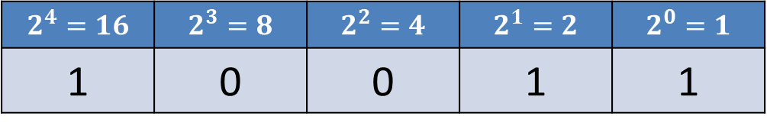
Why?
Each card starts with a power of 2. Every number on that card is composed of that power of 2 when written as a binary number.
Example:
19 =
Q: What are the 10 kinds of people in the world?
A: Those who understand binary, and those who don’t.
$$2^{4}=16$$ | $$2^{3}=8$$ | $$2^{2}=4$$ | $$2^{1}=2$$ | $$2^{0}=1$$
1 | 0 | 0 | 1 | 1

Slide 36
Binary Card Trick
Not the most impressive trick but one that introduces card tricks into the course.
Extends to a Ternary Card trick

Slide 37
Base Numbers
Problem-Solving Assignment 3 - The One Hundred
One day a mathematics teacher was asked how many students were in her class. She answered that there were 25 boys and 31 girls that totalled 100.
What number base did the teacher use?
How many students were in the class?

Slide 38
Adding Reveal Trick
Obtain a three-digit number
Write the answer on a piece of paper
Obtain two more three-digit numbers
Say “This is taking too long. I am going to add a couple to make it harder”, and add your own two numbers
Add all the numbers and reveal the hidden answer.

Slide 39
Why?
470
Hidden answer: 2468
+ 762 + 837
+ 237 (762 + 237 = 999) + 162 (837 + 162 = 999)
= 2468

Slide 40
Presentations

Slide 41
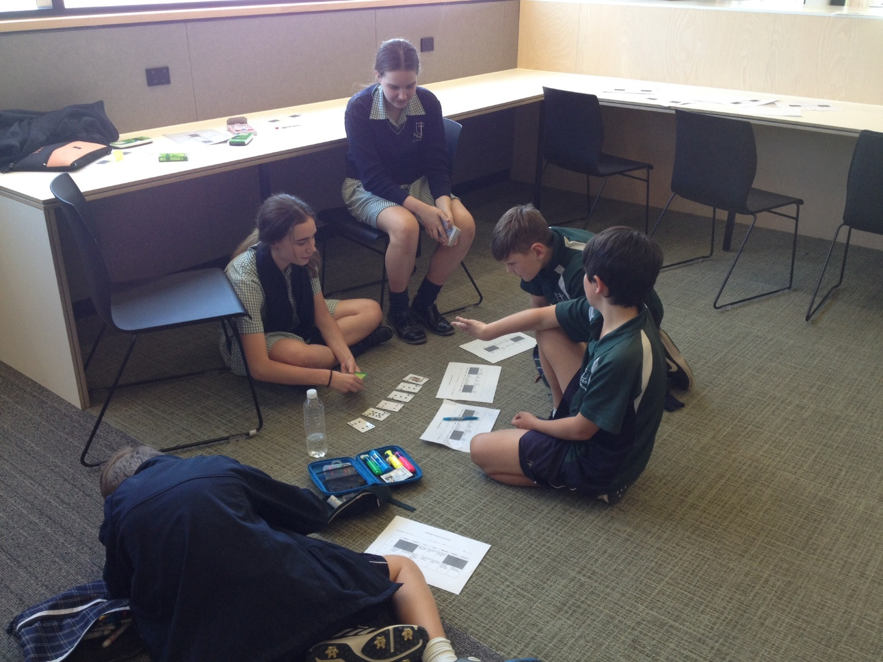

Slide 42
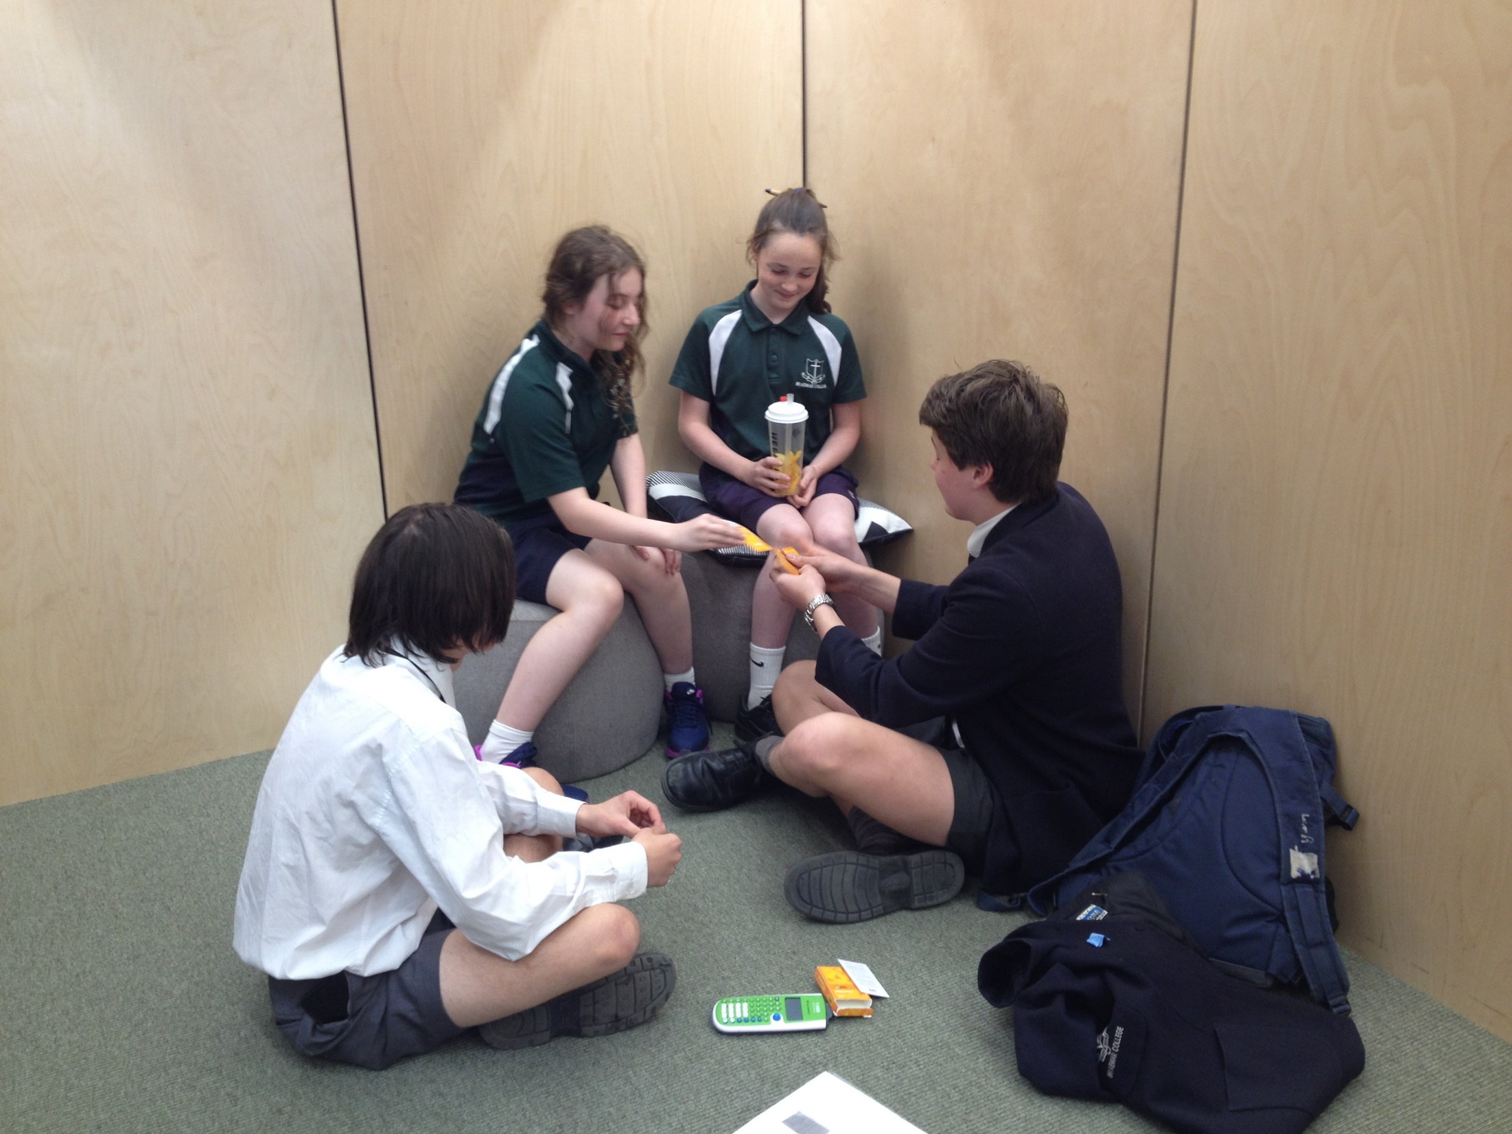

Slide 43
A Few Card Tricks
Best of 9 Card Trick
Psychic Card Trick
Si Stebbins Stack
Eight Kings Stack
Seventeen of Diamonds
Tetrahedron
Happy Christmas

Slide 44
Final Festivities
Write down a 3-digit number whose digits are all different and the first and last digits differ by more than 1 (eg: 732)
Reverse the number (237)
Subtract the smaller from the larger (732 ‒ 237 = 495)
Add this result to the reverse of itself (495 + 594)
Now multiply the answer by 100 000
Subtract 1135847
Use the table to replace the digits with letters
E | M | B | S | X | A | Y | R
0 | 1 | 2 | 3 | 4 | 5 | 6 | 7

Slide 45
My details
Stephen Hanlon
Email: s.hanlon@braemar.vic.edu.au
References
It’s a Kind of Magic – Mathematical magic tricks explained
by David Crawford
The Mathematical Association (UK) publication
ISBN 978-0-906588-67-3
The Manual of Mathematical Magic – McOwan & Parker
VINCULUM (Vol 54), Greg Carroll
www.nrich.maths.org

