Slide 1
Embedding Design Thinking in class activities
Jan and Ming
Nov 2018

Slide 2
Session outline
Warming up
Experiencing teamwork
An view of the Design Thinking process
The Challenge – Creating a story board in groups
Pitching
Linking to curriculum areas and beyond the activity

Slide 3
Warming up
“One, two, three, four, I declare a thumb war”, “Five, six, seven, eight, this should be a piece of cake!”

Slide 4
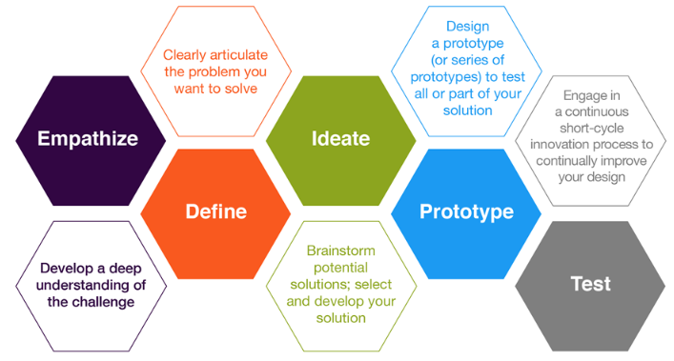
An overview of the Design Thinking Process
A human centred approach to collaborative and creative problem solving

Slide 5
Experiencing teamwork – Producing holographic images
Producing 3D image

Slide 6
The challenge – Design a story board which tells a story about the 2018 Melbourne Cup to the students of WSC’s Sister Schools
You need to:
go through the Design Thinking procedure.
use at least 4 types of shapes such as triangles, rectangles/squares, parallelograms, trapezia, circles and/or semicircles.

Slide 7
Learning intentions & more …
Knowledge set | Mindset | Skills | Tools & Materials
Understanding of Design Thinking Process Investigating uses of the Design Thinking in class | Collaborative Growth Reflective Innovative Creative | Communication Collaboration Critique | Brains Post-its Pens, pencils, scissors and glue sticks Colour paper

Slide 8
Empathize (1 min)
Work in groups to develop a deep understanding of
the challenge
- What is the challenge?
- Who are the people involved in the challenge?
- What are the key requirements?
- Observe, interview and try to understand different perspectives.
- Record your findings as a reference point.

Slide 9
Define
Articulate the challenge including
the key requirements
people involved in the challenge
the available resources

Slide 10
How might we use geometry shapes to design a story board for students in order to help them understand the 2018 Melbourne Cup?
The “HOW MIGHT WE……” questions such as

Slide 11
Ideate (5 mins)
Generate and draw as many ideas as possible on post-its.
Share your design ideas with your groups and improve.
Produce designs as a group.

Slide 12
Prototype
Getting the idea out of your head
Use materials provided to produce a prototype.
Communicate simply

Slide 13
Test, Critique and Improve
Engage in a short-cycle innovation process to continually improve your groups’ design.
Things to remember:
Listen and look mindfully
Hard on content, soft on people
Be kind - but realistic
Be specific - focus on the parts to make the whole better
Be helpful - give feedforward
Hold your ideas lightly
Make the changes you want to make

Slide 14
Pitching
Present your design and tell a short story about the 2018 Melbourne Cup

Slide 15
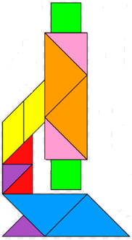
Link it to your curriculum area
How might we use the activity in class?
Calculating perimeters and areas
May use this activity in teaching Measurement and Geometry
- naming shapes
- calculating unknown angles
- writing definitions of shapes

Slide 16
Beyond the activity
We have used Design Thinking:
to run a class activity on study skills for Year 10
to create an assessment task called “Design a 21st Century Middle School Precinct and Create and Solve Advanced Trigonometry Problems” for Year 9 High flyers
to design a learning task for Counting Methods for Year 11 Methods
to create an assessment task on Calculus for Year 12 Methods

Slide 17
Beyond the activity
How to use Design Thinking to create learning tasks and project-based learning in your curriculum area?

