Slide 1
GeoGebra in the classroom
Danijela Draskovic
ddraskovic@mav.vic.edu.au

Slide 2
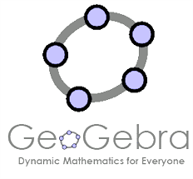
Overview
GeoGebra is fantastic and FREE!
It is good for Geometry, Algebra, Graphing, Calculus, Spreadsheets, Statistics, Probability and it has CAS functionality!
Fully Dynamic and Interactive
Easy-to-use interface
https://www.geogebra.org/download
Please download GeoGebra Classic 6 if you haven’t already

Slide 3
How you can use it
Pre-prepared applets to model concepts [beginners]
Create your own graphs, interactive graphics [beginners - intermediate]
Create rich tasks by setting up worksheets in GeoGebra that students can enter solutions in and get instant feedback [intermediate – advanced]
Get students to create their own applets, models, graphics [any level]

Slide 4
Today’s Workshop
What maths will we do?
Transformations of linear and quadratic functions.
Trigonometry: where do sin, cos and tan come from? Exploring the symmetry of the unit circle.
Pythagoras’ Theorem. Stepping students through the process of modelling it themselves (plus a rich extension task to enhance their problem solving & geometry)

Slide 5
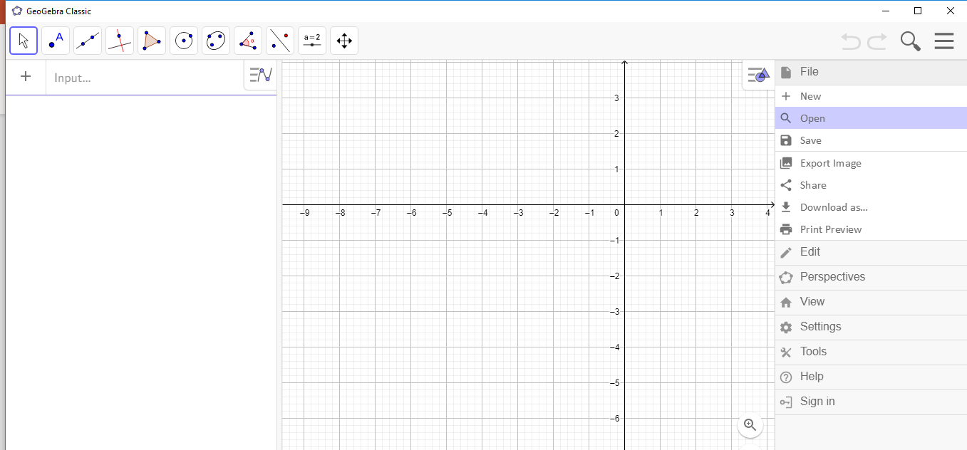
Let’s Begin
Open GeoGebra app
You must open the files from within the app itself.
From now on the presentation will continue from within GeoGebra, not the PowerPoint.

Slide 6
Your feedback
https://www.surveymonkey.com/r/MAV1806 (Thursday)
https://www.surveymonkey.com/r/MAV1807 (Friday)

