Slide 1
Specialist Mathematics
Exam 2
Multiple Choice

Slide 2
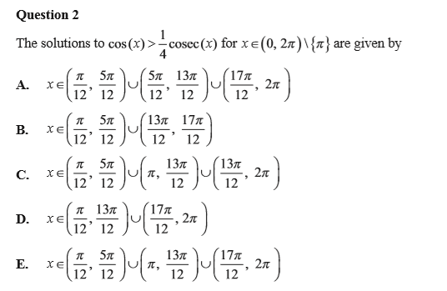
(B 30%) Question 2 E 37%

Slide 3
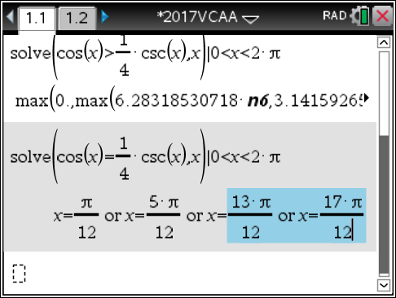
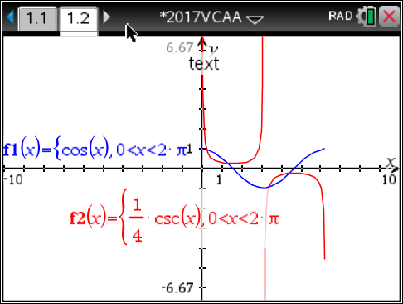
Question 2

Slide 4
(E 35%) Question 3 D 47%

Slide 5
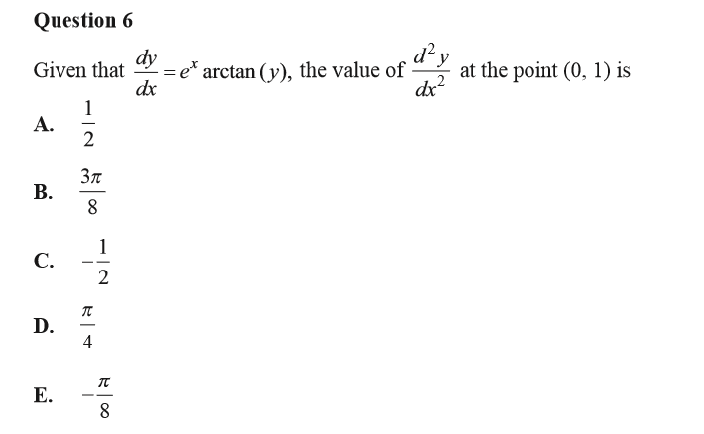
(D 30%) Question 6 B 46%

Slide 6
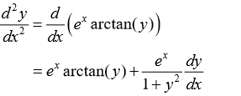
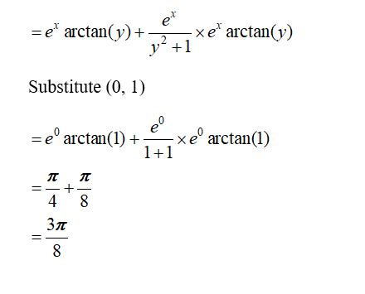
Question 6

Slide 7
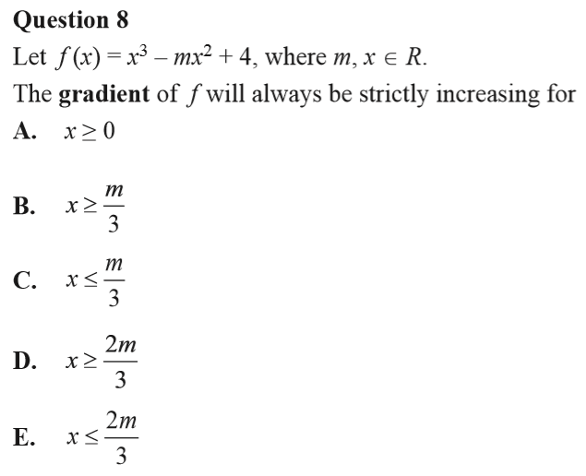
(D 52%) Question 8 B 29%

Slide 8
(E 30%) Question 9 B 45%
Option E

Slide 9
(C 45%) Question 10 E 6%

Slide 10
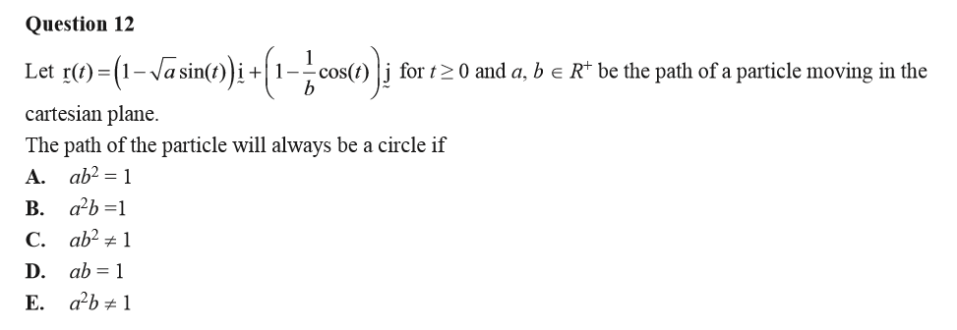
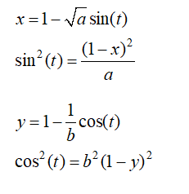
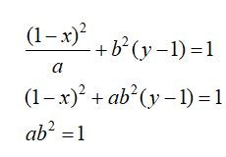
(B 21%) Question 12 A 49%

Slide 11
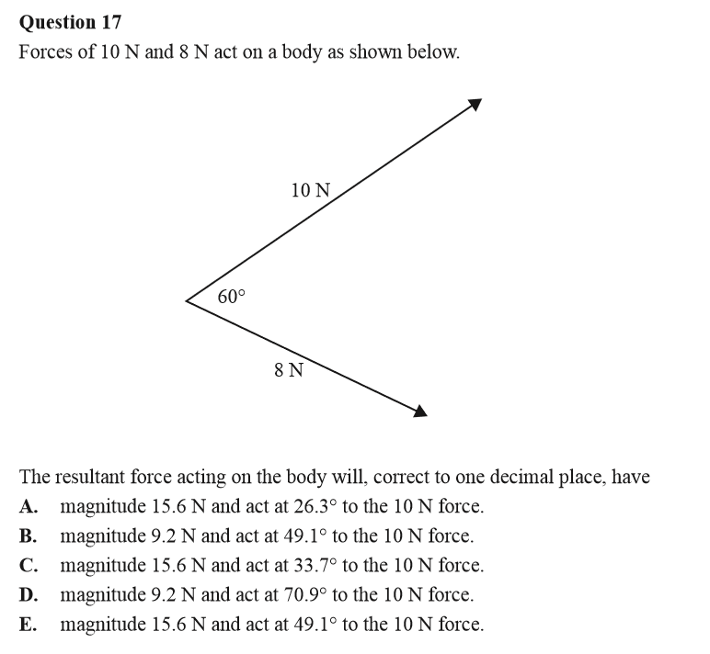
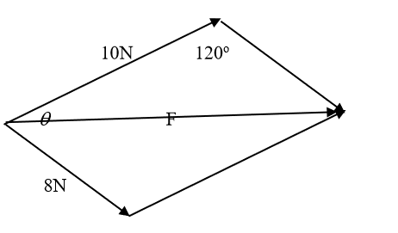
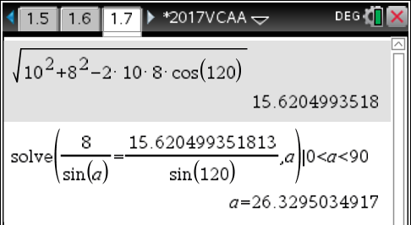
(C 20%) Question 17 A 37%
Option C

Slide 12
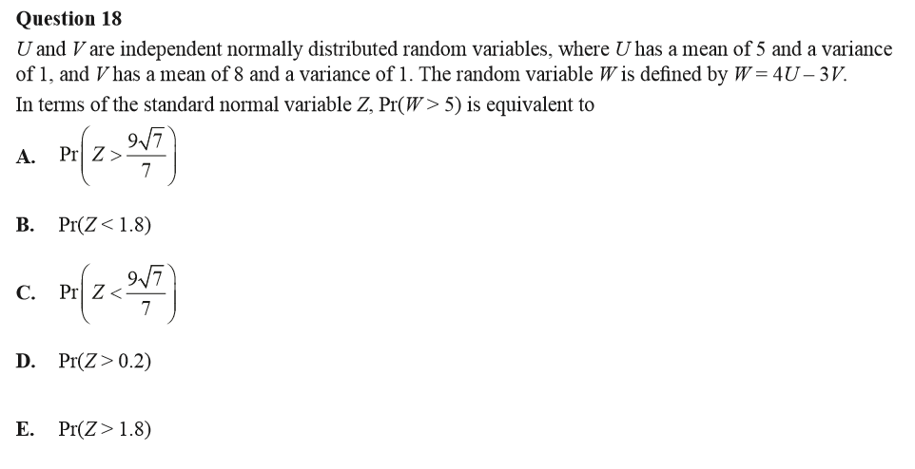
(A 25%) Question 18 E 42%

Slide 13
(C 19%) Question 19 D 44%

