Slide 1
Specialist Mathematics Exam 2 Section B 2017

Slide 2
Question 1
A significant number of students did not state the horizontal asymptote.

Slide 3
Question 1
$$f^{′}\left(x\right)=\frac{1−2x^{3}}{{\left(1+x^{3}\right)}^{2}}$$
Some students did not give the coordinates in the required form.

Slide 4
Question 1
A common error was the inclusion of $\left(0,0\right).$

Slide 5
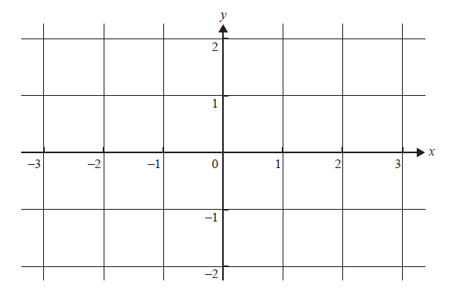
Question 1

Slide 6
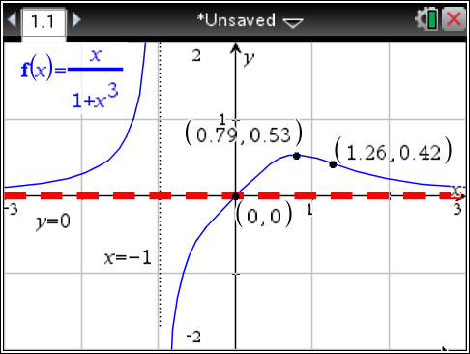
Question 1
Students are advised to set their CAS window as shown in the exam paper.
Required points were sometimes not marked clearly or in the correct position.

Slide 7
Question 1
Errors: failure to square f(x)
π on one side only

Slide 8
Question 2
Most correct answers used constant acceleration formulae.

Slide 9
Question 2

Slide 10
Question 2
Many students were unsure how to proceed.
Some answers were not given in exact form.

Slide 11
Question 2
Issues: integrating from 0 to 30
giving the time after 2 seconds
no attempt

Slide 12
Question 2
$$5.8 s$$
Consequential upon 2 d. i.

Slide 13
Question 2
Omission of 19.6 was common.

Slide 14
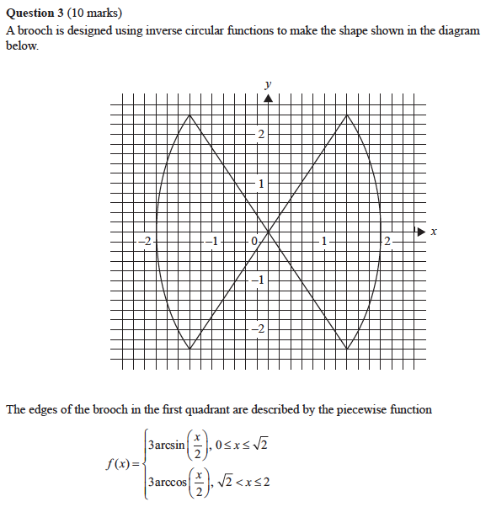
Question 3

Slide 15
Question 3
$$\left(\sqrt{2},\frac{3π}{4}\right)$$

Slide 16
Question 3
Only one of the functions should be defined at $x=−\sqrt{2}$.
A variety of correct equivalents seen.

Slide 17
Question 3
$$Area=4\left[\int_{0}^{\sqrt{2}}{{3sin}^{−1}\left(\frac{x}{2}\right)}∙dx+\int_{\sqrt{2}}^{2}{3\cos^{−1}\left(\frac{x}{2}\right)∙dx}\right]$$
$$=9.9$$
Missing factor of 3 was the most common issue.

Slide 18
Question 3
$Calculate the gradient of y=3\sin^{−1}\left(\frac{x}{2}\right) at (0,0)$.
$$θ=56.3099°$$
$$∴Acute angle required=67.4°$$
Many did not attempt the question.

Slide 19
Question 3
Issues: not applying the arc length formula
‘show that’ not always followed
where a = 16, b = 144

Slide 20
Question 4
$$4 cis\left(−\frac{2π}{3}\right) or equivalent$$
A diagram would help students avoid quadrant errors.

Slide 21
Question 4
$$Show using the quadratic formula.$$
$$or by completing the square$$
$$and applying the null factor law.$$
$$z^{2}+4z+16=0$$
$$∴ z=\frac{−4±\sqrt{16−64}}{2}$$
And so on to evaluate
$$z^{2}+4z+16=0$$
$$∴z^{2}+4z+4+12=0$$
$$∴{\left(z+2\right)}^{2}−12i^{2}=0$$
And so on to evaluate
‘show that’, roots v factors

Slide 22
Question 4
$$−2−2\sqrt{3}i=−\left(\overline{2−2\sqrt{3}i}\right)=\left(2−2\sqrt{3}i\right)−4$$
$$−2+2\sqrt{3}i=−\left(2−2\sqrt{3}i\right)$$
$$or equivalent forms$$

Slide 23
Question 4
$$Let z=x+yi to get$$
$$\sqrt{x^{2}+y^{2}}=\sqrt{{(x−2)}^{2}+{(y+2\sqrt{3})}^{2}}$$
$$and then simplify$$
A smaller proportion used a perpendicular bisector approach.

Slide 24
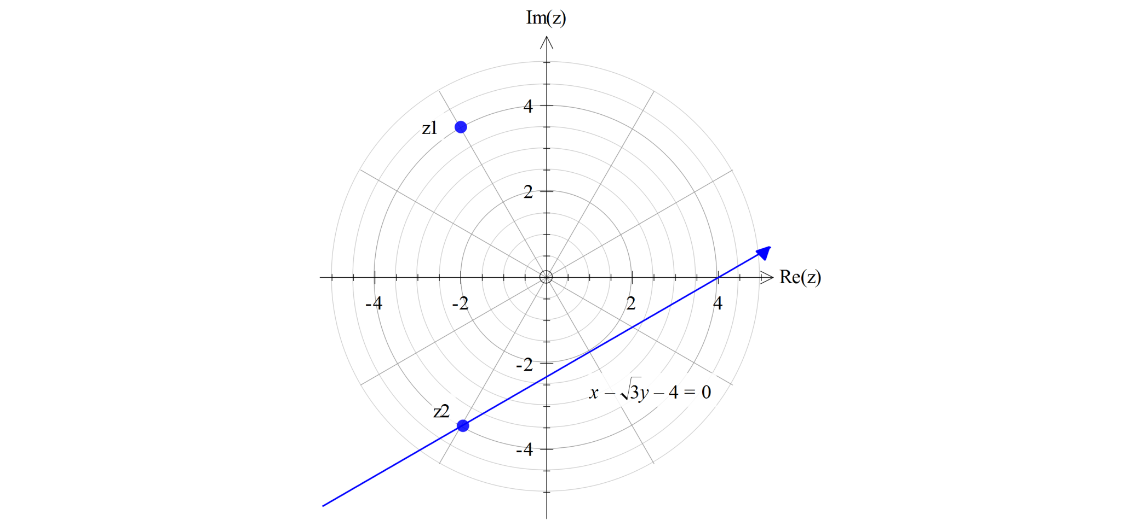
Question 4
Accuracy and clarity matter.

Slide 25
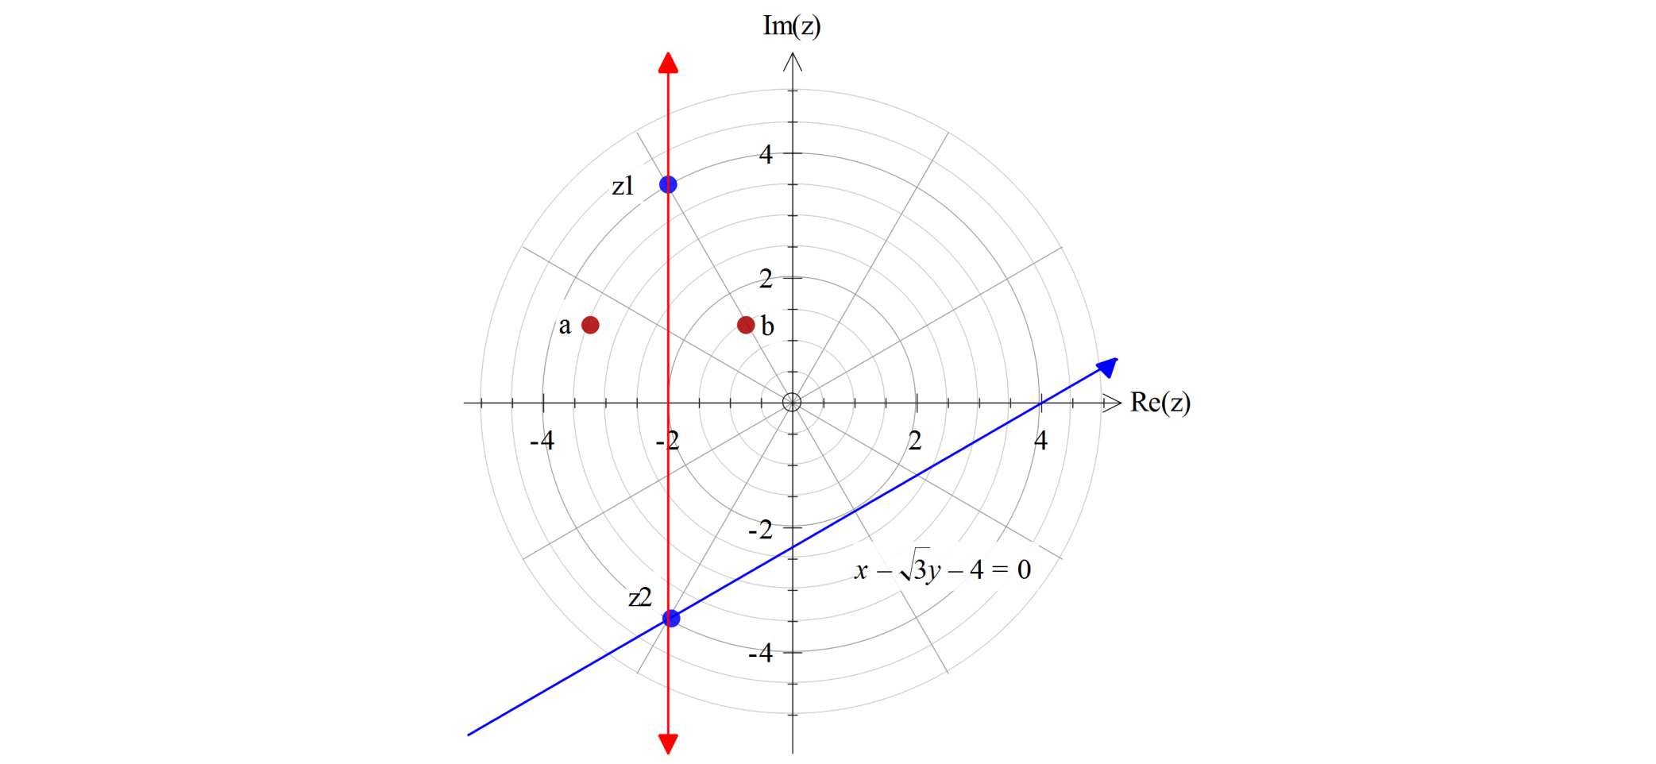
Question 4
$$Let a=m+ni and b=p+qi$$
$$∴−2−m=p−\left(−2\right)$$
$$∴p=−m−4$$
$$and n=q$$
$$∴b=\left(−m−4\right)+ni$$
$$=−\left(m−ni\right)−4$$
$$=−\overline{a}−4$$

Slide 26
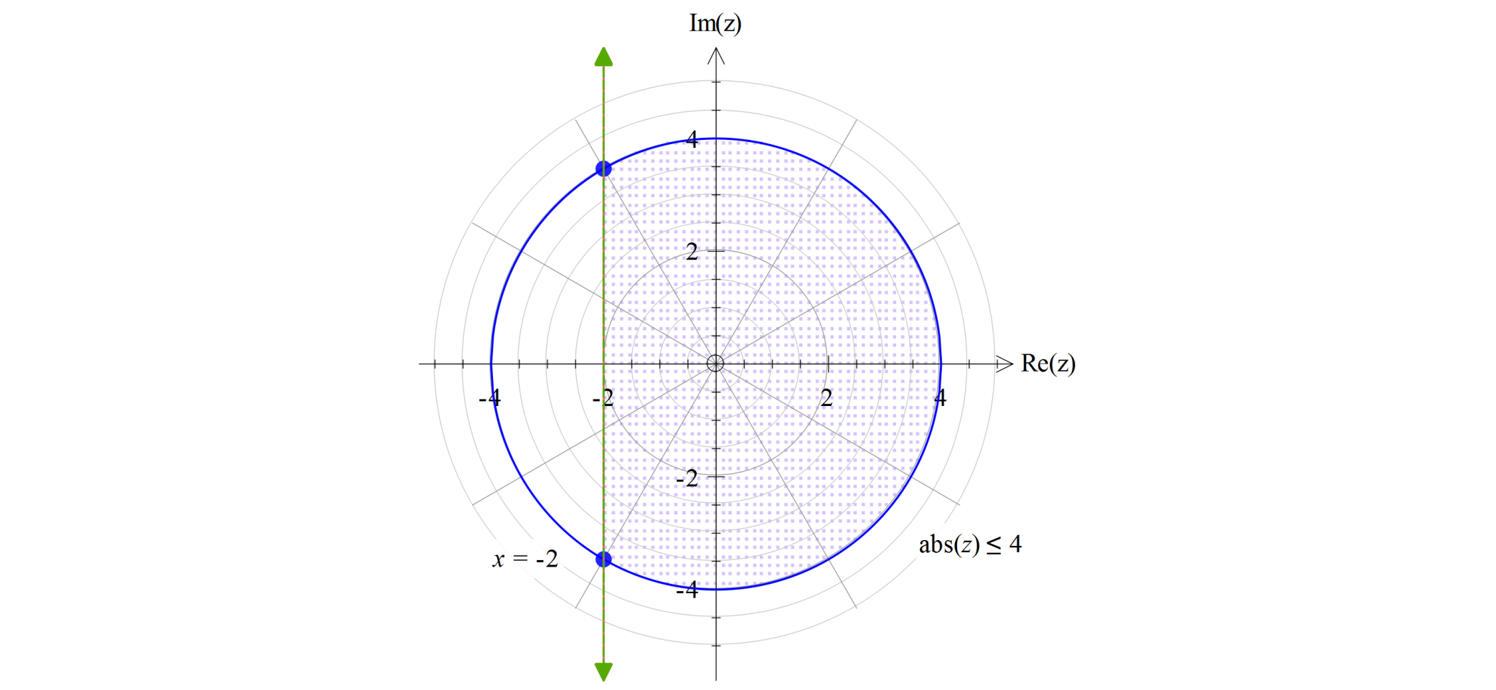
Question 4
$$A=\frac{1}{2}r^{2}(θ−\sin\left(θ)\right)$$
with $θ=\frac{4π}{3}$
To get $\frac{32π}{3}+4\sqrt{3}$
Incorrect sector angles often used.

Slide 27
Question 5

Slide 28
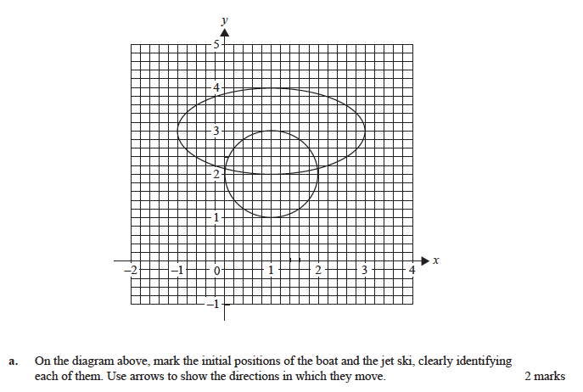
Question 5
Boat
Jet ski
Significant numbers of students did not label the direction of motion or identify the paths.

Slide 29
Question 5
Equate speeds of objects and solve by hand/CAS to get $t=π$
The most common error was equating velocity vectors rather than speeds.
$$\left(3,3\right)$$

Slide 30
Question 5
$$d=\left|{\tilde{r}}_{B}(t)−{\tilde{r}}_{J}(t)\right|$$
$$=\sqrt{{\left(\sin\left(t\right)−2cos⁡(t)\right)}^{2}+{\left(1+\sin\left(t\right)+cos⁡(t)\right)}^{2}}$$
Take care with CAS expressions.
$$0.33$$

Slide 31
Question 5
$$Equating i components gives t=\tan^{−1}(2)$$
$$Equating j components then gives a=3+\frac{3}{\sqrt{5}}$$
Exact values unless otherwise specified.

Slide 32
Question 6
$$79.8 \%$$
Instructions to give a percentage to 1 d.p. were often not followed.

Slide 33
Question 6
$$Var\left(10V\right)=10Var\left(V\right)=10∙36=360$$
$$∴sd\left(crate\right)=6\sqrt{10}$$
Errors occurred when calculating the variance.

Slide 34
Question 6
$$99.6 \%$$

Slide 35
Question 6
$$0.999=1−Pr⁡\left(Z<\frac{20000−20050}{σ}\right)$$
$This gives a z−score of −3.0902 and σ=16.$18
$$∴sd=5.1$$

Slide 36
Question 6
$$p−value=0.0569$$
$$p>0.05 so claim should not be rejected$$
Some students did not continue to explicitly answer the question.

