Slide 1
Specialist Mathematics
Exam 1
Short Answer

Slide 2
Exam Instructions

Slide 3
Question 1

Slide 4
Question 2

Slide 5
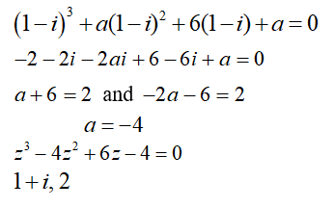
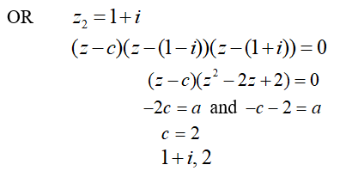
Question 3

Slide 6
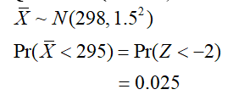
Question 4

Slide 7
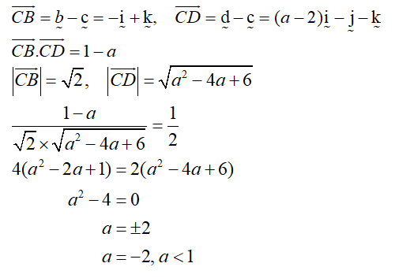
Question 5

Slide 8
Question 6

Slide 9
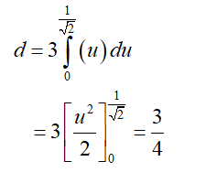
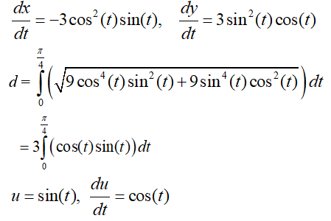
Question 7

Slide 10
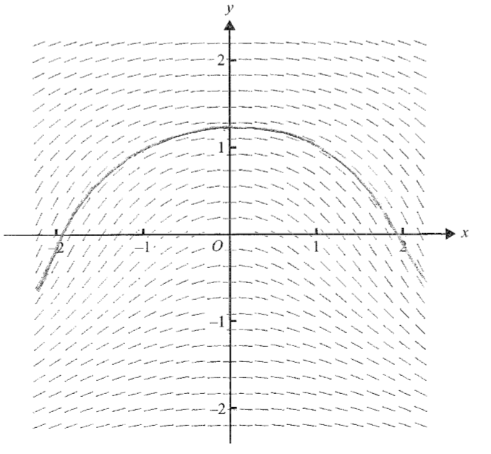
Question 8

Slide 11
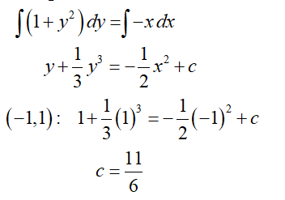
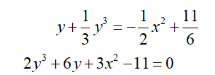
Question 8

Slide 12
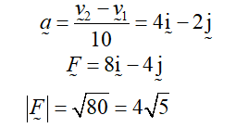
Question 9

Slide 13
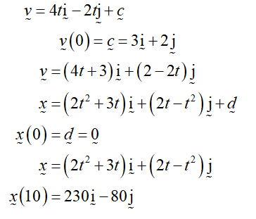
Question 9

Slide 14
Question 10

Slide 15
Question 10

Slide 16
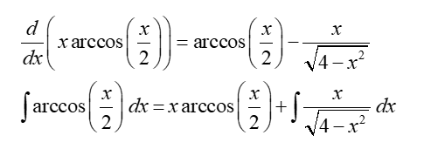
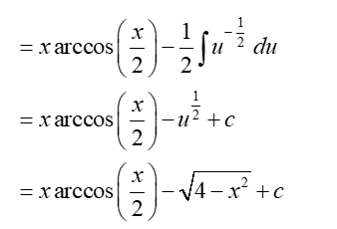
Question 10

