Slide 1
Meet the Assessors
Math Methods
2018
Allason McNamara
mcnamaraa@trinity.vic.edu.au

Slide 2
Assessment Report for Exam 2
http://www.vcaa.vic.edu.au/Documents/exams/mathematics/2017/mm2_examrep17.pdf

Slide 3
MAV Solutions
MAV_Solns2017VCAAMMExam2.pdfc

Slide 4
Scaling 2017
Mean 34.0 (33.6) and SD 8.4 (8.4)
20 (21)
25 (28)
30 (35) +1
35 (40)
40 (45)
45 (49) +1
50 (51) +1

Slide 5
Multiple Choice 2017
92% answered Question 1 and 88% answered Question 6 correctly.
Question | Answer | Question | Answer
1 | C | 11 | D
2 | D | 12 | C
3 | C | 13 | E
4 | E | 14 | D
5 | A | 15 | B
6 | C | 16 | C
7 | B | 17 | D
8 | A | 18 | D
9 | A | 19 | D
10 | D | 20 | B

Slide 6
Question 1 C 92%

Slide 7
Question 6 C 88%

Slide 8
B Question 15 (A 14) 58%

Slide 9
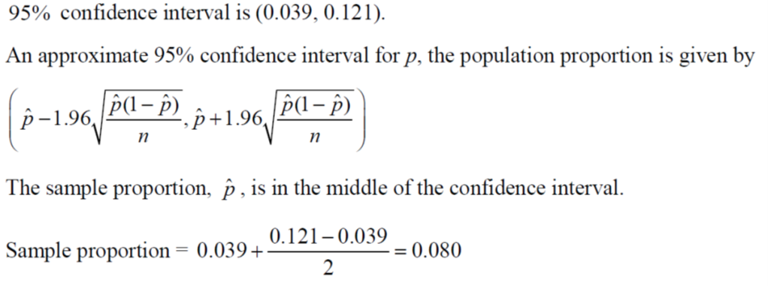
A Question 5 (B 20) 47%

Slide 10
B Question 7 (D 29) 32%

Slide 11
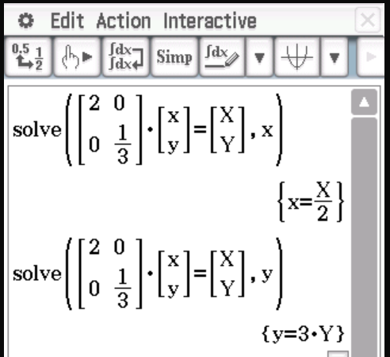
D Question 10 (B 23) 47%

Slide 12
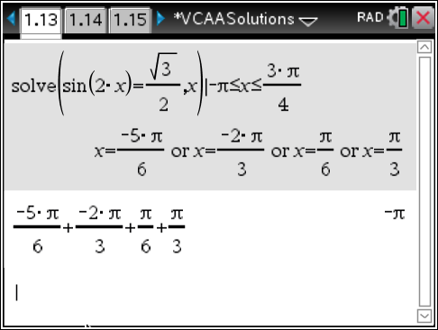
C Question 12 (B 18) 45%

Slide 13
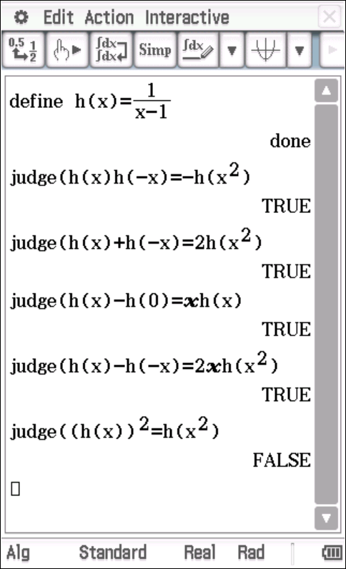
E Question 13 (C 17) 46%

Slide 14
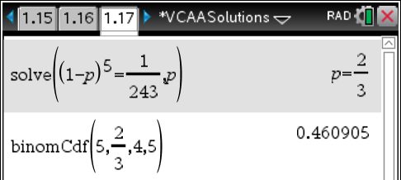
C Question 16 (D 17) 41%

Slide 15
D Question 17 (B 37) 21%

Slide 16
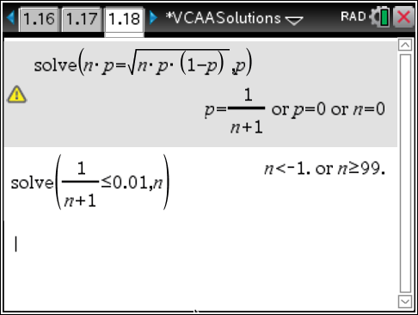
D Question 18 (C 25) 38%

Slide 17
B Question 20 (C, D 18) 47%

Slide 18
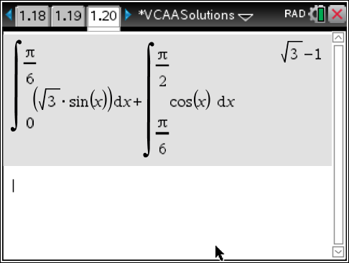
B Question 20 (C, D 18) 47%

Slide 19
Extended Answer
Give an exact answer unless otherwise stated.
No calculator syntax.
Show working for questions worth more than one mark. (Rule and answer)
Work to more decimal places than the required answer.
Use the variables that are given within the question. (SAC questions)

Slide 20
Extended Answer
Reread questions.
Take time when drawing graphs – scale axes, check if coordinates are required, one sharp line…
Don’t assume steps in Show That questions.
Use brackets correctly.
Transcribe formulas correctly (reread the calculator).
Put units in the final answer.
Check that the final answer makes sense.
Use the calculator.

Slide 21
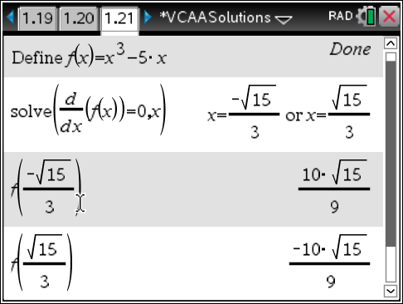
Question 1a
Marks | 0 | 1 | 2 | Average
% | 7 | 20 | 74 | 1.7

Slide 22
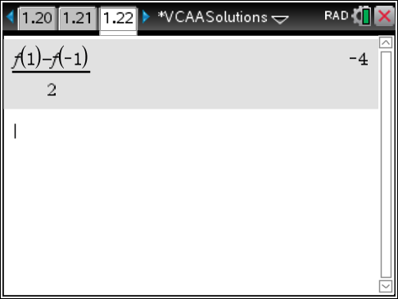
Question 1b.i.
Marks | 0 | 1 | 2 | Average
% | 16 | 9 | 75 | 1.6

Slide 23
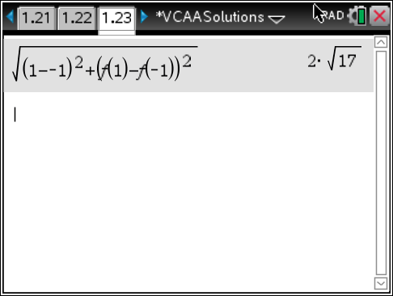
Question 1b.ii.
Marks | 0 | 1 | Average
% | 22 | 78 | 0.8

Slide 24
Question 1c.i.
Marks | 0 | 1 | 2 | Average
% | 17 | 20 | 64 | 1.5

Slide 25
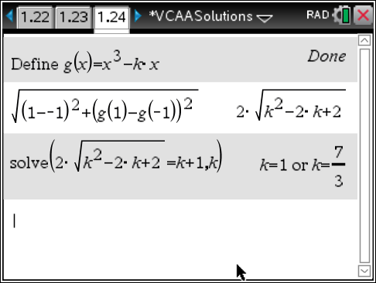
Question 1c.ii.
Marks | 0 | 1 | Average
% | 37 | 63 | 0.6

Slide 26
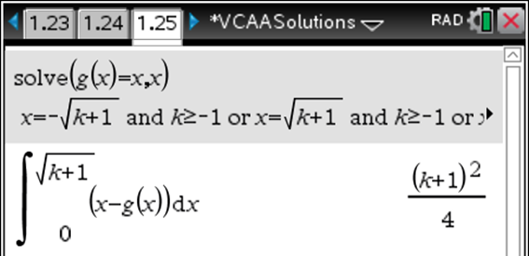
Question 1d.i.
Marks | 0 | 1 | Average
% | 38 | 62 | 0.6

Slide 27
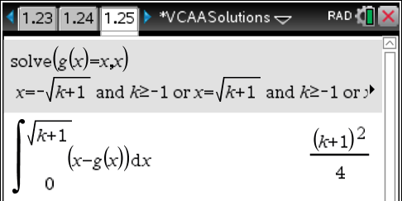
Question 1d.ii.
Marks | 0 | 1 | 2 | Average
% | 40 | 18 | 42 | 1.0

Slide 28
Question 2

Slide 29
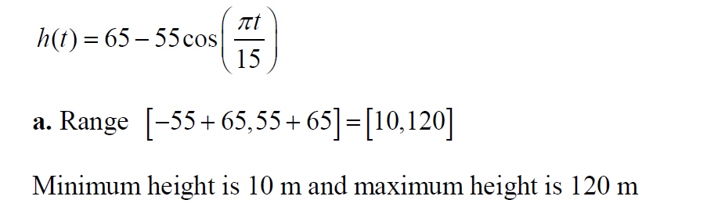
Question 2a
Marks | 0 | 1 | Average
% | 11 | 89 | 0.9

Slide 30
Question 2b
Marks | 0 | 1 | Average
% | 16 | 84 | 0.8

Slide 31
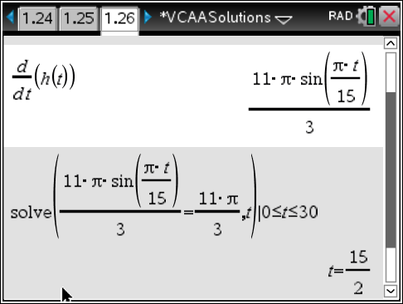
Question 2c
Marks | 0 | 1 | 2 | Average
% | 29 | 42 | 29 | 1.0

Slide 32
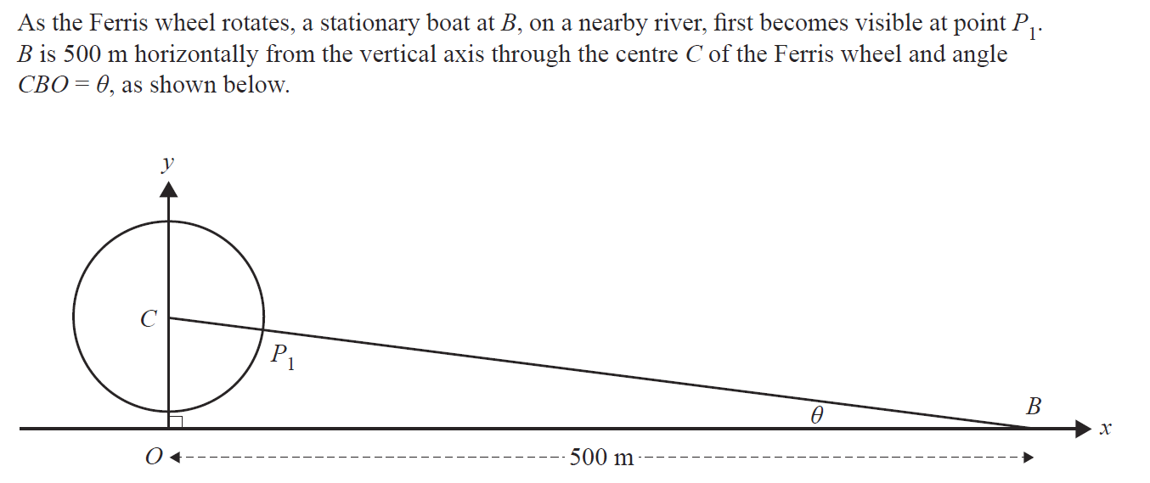
Question 2

Slide 33
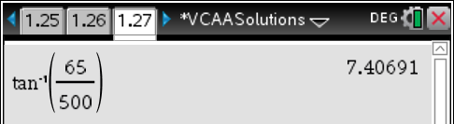
Question 2d
Marks | 0 | 1 | Average
% | 64 | 36 | 0.4

Slide 34
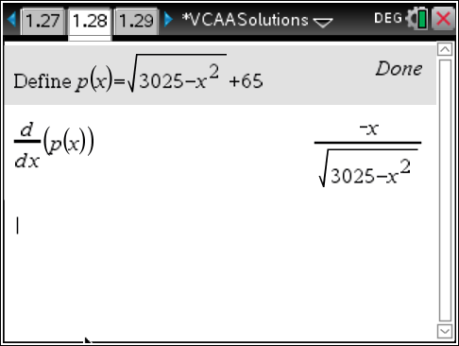
Question 2e
Marks | 0 | 1 | Average
% | 10 | 91 | 0.9

Slide 35
Question 2f

Slide 36
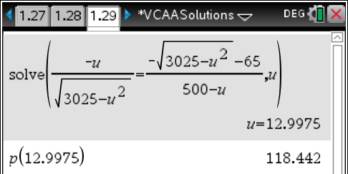
Question 2f
Marks | 0 | 1 | 2 | 3 | Average
% | 67 | 21 | 4 | 8 | 0.5

Slide 37
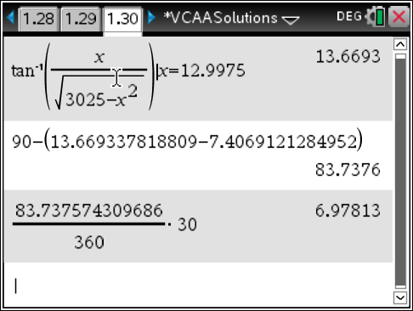
Question 2g
Marks | 0 | 1 | Average
% | 93 | 7 | 0.1

Slide 38
Question 2h
Marks | 0 | 1 | 2 | Average
% | 94 | 5 | 2 | 0.1

Slide 39
Question 3a
Marks | 0 | 1 | 2 | 3 | Average
% | 15 | 12 | 44 | 29 | 1.9

Slide 40
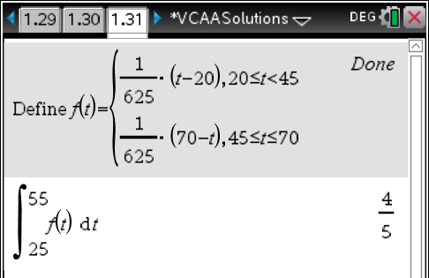
Question 3b
Marks | 0 | 1 | 2 | Average
% | 24 | 6 | 70 | 1.5

Slide 41
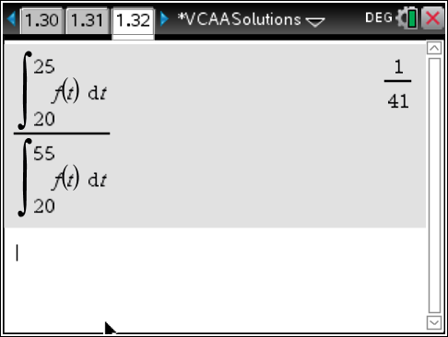
Question 3c
Marks | 0 | 1 | 2 | Average
% | 21 | 30 | 49 | 1.3

Slide 42
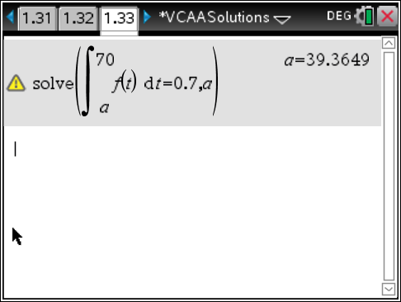
Question 3d
Marks | 0 | 1 | 2 | Average
% | 59 | 11 | 30 | 0.7

Slide 43
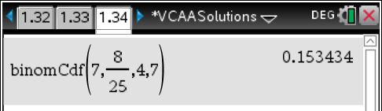
Question 3e.i.
Marks | 0 | 1 | 2 | Average
% | 26 | 16 | 58 | 1.3

Slide 44
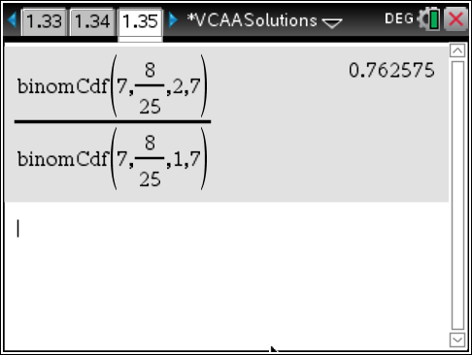
Question 3e.ii.
Marks | 0 | 1 | 2 | Average
% | 31 | 11 | 59 | 1.3

Slide 45
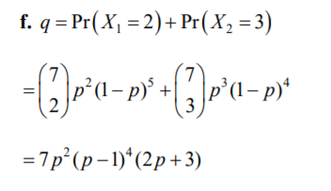
Question 3f.
Marks | 0 | 1 | 2 | Average
% | 60 | 8 | 32 | 0.7

Slide 46
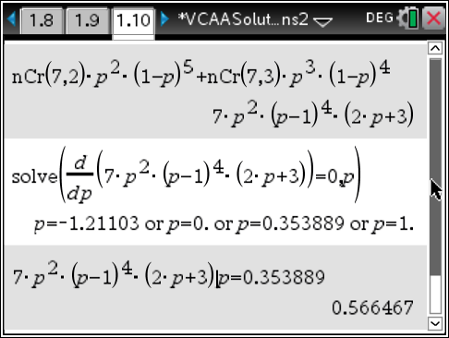
Question 3g.i.
Marks | 0 | 1 | 2 | Average
% | 64 | 13 | 23 | 0.6

Slide 47
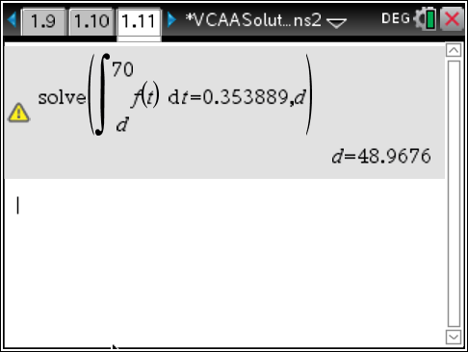
Question 3g.ii.
Marks | 0 | 1 | 2 | Average
% | 91 | 3 | 7 | 0.2

Slide 48
Question 4a
Marks | 0 | 1 | 2 | Average
% | 24 | 28 | 48 | 1.2

Slide 49
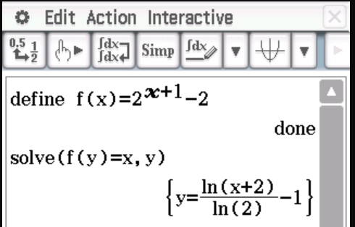
Question 4b
Marks | 0 | 1 | 2 | Average
% | 12 | 25 | 64 | 1.5

Slide 50
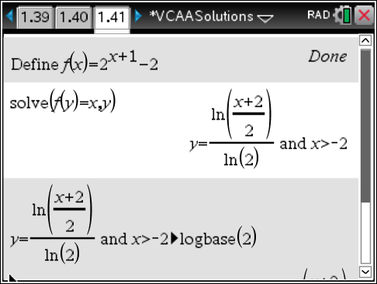
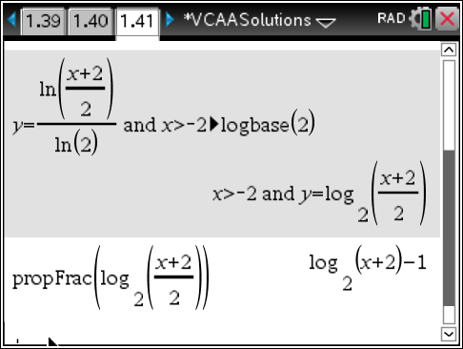
Question 4b

Slide 51
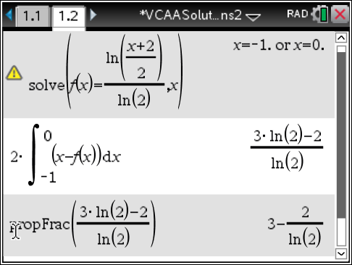
Question 4c
Marks | 0 | 1 | 2 | 3 | Average
% | 22 | 10 | 20 | 49 | 2.0

Slide 52
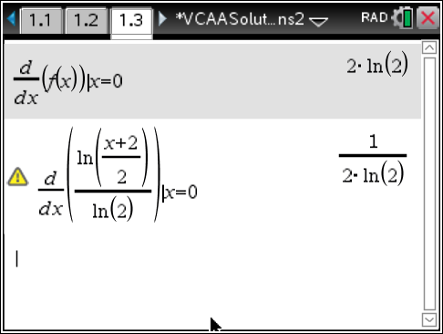
Question 4d
Marks | 0 | 1 | 2 | Average
% | 26 | 13 | 62 | 1.4

Slide 53
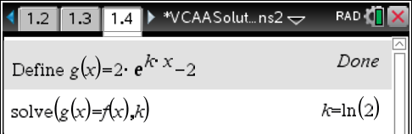
Question 4e
Marks | 0 | 1 | Average
% | 35 | 65 | 0.6

Slide 54
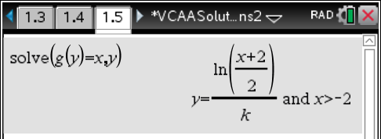
Question 4f
Marks | 0 | 1 | Average
% | 42 | 58 | 0.6

Slide 55
Question 4g.i.
Marks | 0 | 1 | Average
% | 69 | 31 | 0.3

Slide 56
Question 4g.ii.
Marks | 0 | 1 | Average
% | 70 | 30 | 0.3

Slide 57
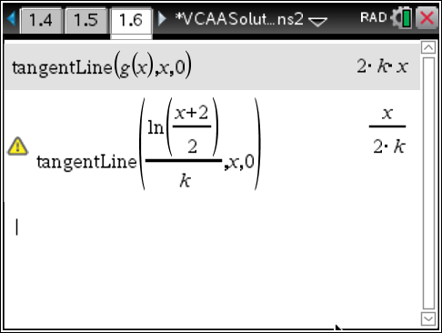
Question 4h
Marks | 0 | 1 | 2 | Average
% | 77 | 21 | 2 | 0.3

Slide 58
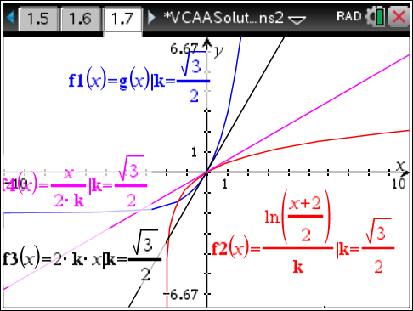
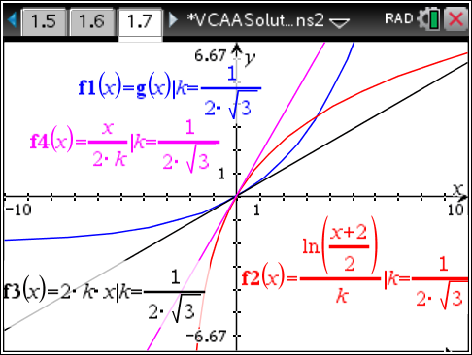
Question 4h

Slide 59
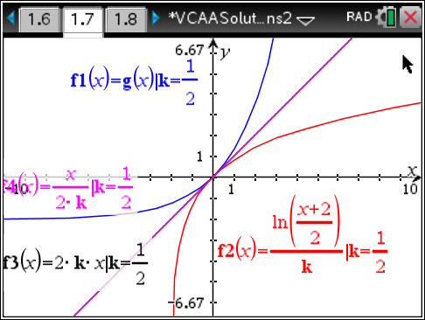
Question 4i.i
Marks | 0 | 1 | 2 | Average
% | 95 | 2 | 3 | 0.1

Slide 60
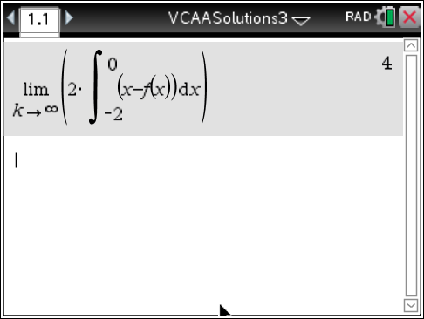
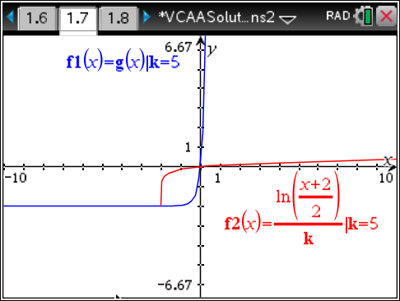
Question 4i.ii
Marks | 0 | 1 | Average
% | 98 | 2 | 0.0

