Slide 1
Further Mathematics Application and Modelling Problem Solving Tasks
Intention criterion for this session
Be confident to write a task that complies with the guidelines of the new study design.

Slide 2
SAC report summary
https://www.vcaa.vic.edu.au/Pages/vce/studies/mathematics/further/furthermathindex.aspx
Intention of SAC tasks
School-assessed coursework enhances validity of student assessment by providing the opportunity for a context to be explored mathematically in greater depth and breadth than is possible in an examination, with non-routine and open-ended elements explored more fully.

Slide 3
SAC report summary
https://www.vcaa.vic.edu.au/Pages/vce/studies/mathematics/further/furthermathindex.aspx
Intention of SAC tasks
The tasks for School-assessed Coursework are to be implemented over a longer continuous period, where modelling, problem-solving or investigative techniques or approaches are employed and the related use of technology (as a tool for working mathematically) is suitably incorporated.

Slide 4
SAC report summary
https://www.vcaa.vic.edu.au/Pages/vce/studies/mathematics/further/furthermathindex.aspx
Tasks should be based on the application of mathematics in a practical context.
Students should consider:
assumptions
definitions
conditions and constraints

Slide 5
SAC report summary
https://www.vcaa.vic.edu.au/Pages/vce/studies/mathematics/further/furthermathindex.aspx
With respect to the context, students should make decisions and communicate key stages of mathematical:
reasoning
formulation
solution and
interpretation

Slide 6
Further Mathematics Application and Modelling Problem Solving Tasks
Study Design Content
A task for School-assessed Coursework need not cover all of the content from an area of study, module or topic, or all of the key knowledge and key skills for an outcome. An itemised list helps to identify the components linked to your task.
Task Design
What do you want it to look like? Tell your story.
Assessment Design
What process will best assess your task?
What will it look like?

Slide 7
Further Mathematics Application and Modelling Problem Solving Tasks
Application Task Design
Openness
Represent the two distributions and compare in terms of shape, center and spread. Give appropriate statistics to justify your responses.

Slide 8
Further Mathematics Application and Modelling Problem Solving Tasks
Application Task Design
Choice
Create a suitable plot showing the relationship between your two chosen variables

Slide 9
Further Mathematics Application and Modelling Problem Solving Tasks
Application Task Design
Options
A smoothing technique may create a different impression of the data. One suggestion is to implement a 5 point median smoothing technique as the data fluctuations appear to be linked to a related pattern.
Another suggestion is to apply a 4 point moving mean technique with centring as is it based on a seasonal pattern.

Slide 10
School Assessed Coursework Tasks
The Application Task – some background
2.35
It is a guided investigation of a given data set with several variables.
The task has three components of increasing complexity:
• the construction, description and interpretation of data plots
(including smoothed plots where time series data is used)
• the calculation and interpretation of summary statistics
(including seasonal indices and their application with time series data)
• the modelling of linear associations, or trends where time series data is used (including the use of data transformation as appropriate).

Slide 11
School Assessed Coursework Tasks
The Application Task – some background
For the (data-analysis) application task, suitable data for several variables for a topic of interest or context should be used, and related statistical questions investigated.
Tasks should not be too specific or mirror an extended set of examination-style questions.
Multiple-choice items are not suitable for either an application task or a modelling or problem-solving task.

Slide 12
School Assessed Coursework Tasks
The Application Task – some background
The selection of a suitable and large enough data set with related natural or topical questions of interest is central to developing a task that enables students to
choose the method of presentation of data
type of display
type of rule
suitable scale
accuracy

Slide 13
School Assessed Coursework Tasks
The Application Task – some background
The selection of a suitable and large enough data set with related natural or topical questions of interest is central to developing a task that enables students to
apply techniques to identify key characteristics of data
finding summary values
fitting regressions
smoothing data

Slide 14
School Assessed Coursework Tasks
The Application Task – some background
The selection of a suitable and large enough data set with related natural or topical questions of interest is central to developing a task that enables students to
choose an approach to analysis
investigate possible trends
make comparisons.

Slide 15
School Assessed Coursework Tasks
The Application Task – some background
The application task is to be of 4–6 hours duration over a period of 1–2 weeks.
Outcome 1
Define and explain key concepts and apply related mathematical techniques and models as specified in Area of Study 1 in routine contexts.
Outcome 2
Select and apply the mathematical concepts, models and techniques as specified in Area of Study 1 in a range of contexts of increasing complexity.
Outcome 3
Select and appropriately use numerical, graphical, symbolic and statistical functionalities of technology to develop mathematical ideas, produce results and carry out analysis in situations requiring problem-solving, modelling or investigative techniques or approaches.

Slide 16
Further Mathematics Application and Modelling/Problem Solving Tasks
Some Examples
Use the reference ‘Developing an Application, Modelling or Problem Solving Task’ contained in your handout package
Sample 3: The Australian Dollar
Sample 4: Fuel prices

Slide 17
Further Mathematics Application and Modelling Problem Solving Tasks
Thoughts so far ??

Slide 18
Further Mathematics Application and Modelling/Problem Solving Tasks
Marrying the Assessment style with your task?

Slide 19
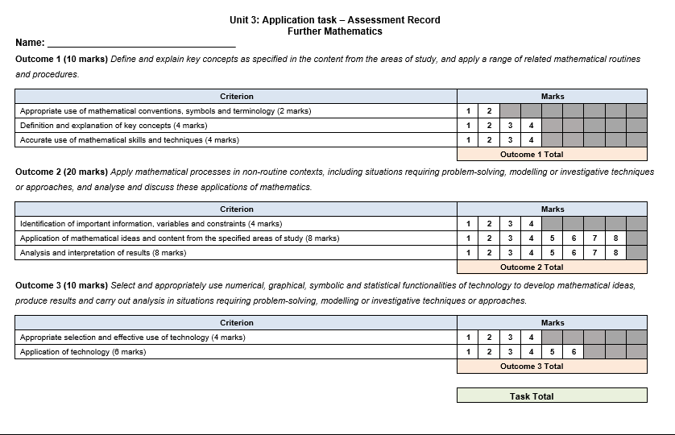

Slide 20
Further Mathematics Application and Modelling/Problem Solving Tasks
Scenarios related to modelling a situation for analysis, or solving types of problems related to a context should be explored. For example:
salary packaging
retirement investment
stock and share portfolios
exchange rates
insurance
financial problems
debt consolidation
taxation

Slide 21
Further Mathematics Application and Modelling Problem Solving Tasks
Study Design Content
A task for School-assessed Coursework need not cover all of the content from an area of study, module or topic, or all of the key knowledge and key skills for an outcome. An itemised list helps to identify the components linked to your task.
Task Design
What do you want it to look like? Tell your story.
Assessment Design
What process will best assess your task?
What will it look like?

Slide 22
Further Mathematics Application and Modelling Problem Solving Tasks
Problem Solving or Modelling Task Design
Openness
Provide at least two options that can be undertaken over the next 10 years to meet his goal of achieving a final balance of $50000 and to travel in that time period within the amounts he has set himself.

Slide 23
Further Mathematics Application and Modelling Problem Solving Tasks
Problem Solving or Modelling Task Design
Choice
Create a display that will reflect the value of the investment over the next four years.

Slide 24
Further Mathematics Application and Modelling Problem Solving Tasks
Problem Solving or Modelling Task Design
Options
Their combined salaries allow an increase in their monthly repayments to $3200 and the bank has agreed that they can vary the length of the loan.
The Credit Union that is linked to your employer is offering a fixed loan rate of 3.6% pa for loans taken out over a 30 year period.

Slide 25
School Assessed Coursework Tasks
The Recursion and Financial Modelling Task
The selection of a suitable scenario or context with topical questions of interest is central to developing a task that enables students to
choose the method of presentation
type of display (table, list, graph, financial solver)
type of rule (explicit or recursion)
accuracy

Slide 26
School Assessed Coursework Tasks
The Application Task – some background
The selection of a suitable scenario or context with topical questions of interest is central to developing a task that enables students to choose
The type of loan or investment
the investment or loan amount
The rates of interest
the compounding periods
the time of loan or investment

Slide 27
School Assessed Coursework Tasks
The Application Task – some background
The selection of a suitable scenario or context with topical questions of interest is central to developing a task that enables students to choose
choose an approach to analysis
investigate possible trends
make comparisons.

Slide 28
Further Mathematics Application and Modelling/Problem Solving Tasks
Modelling or problem-solving task 1 is to relate to ‘recursion and financial modelling’. This task is to be of 2–3 hours duration over a period of 1 week.
Outcome 1
Define and explain key concepts and apply related mathematical techniques and models as specified in Area of Study 1 in routine contexts.
Outcome 2
Select and apply the mathematical concepts, models and techniques as specified in Area of Study 1 in a range of contexts of increasing complexity.
Outcome 3
Select and appropriately use numerical, graphical, symbolic and statistical functionalities of technology to develop mathematical ideas, produce results and carry out analysis

Slide 29
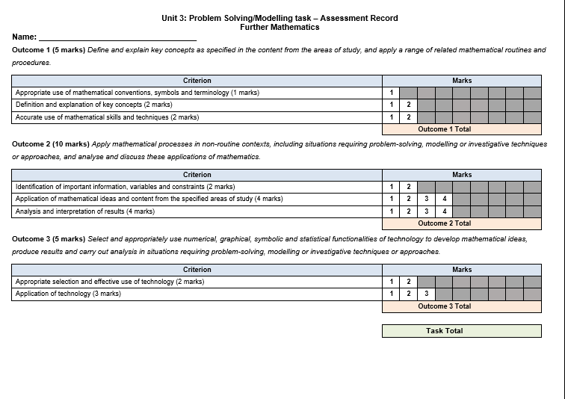

Slide 30
Further Mathematics Application and Modelling/Problem Solving Tasks
Some Examples – questions to not fit current study design
Use the following starting values and rules to generate the first five terms of these sequences:
a) Multiply 40 by 4 at each step
b) Increase 20 by 5 at each step
c) Determine the presence of outliers. Show all working out.
d) Sketch the box plot and using its summary statistics, comment on its form, centre and spread.

Slide 31
Some Examples – currently do not fit study design brief
The balcony (shown below) off the large function room forms a semi-circle which they need to resurface the flooring to meet OHS requirements. The diameter of the balcony is 9 metres.
They plan to resurface the balcony with a portion in concrete and 15m² in artificial grass.
Determine how much area will be resurfaced with concrete to 1 decimal place

Slide 32
Some Examples – amended to be more open
The balcony (shown below) off the large function room forms a shape which they need to resurface the flooring to meet OHS requirements. The diameter of the balcony is variable.
They plan to resurface the balcony with a portion in concrete and a portion in artificial grass.
Explore different shapes and portions of concrete to be resurfaced. Are the other alternatives?

Slide 33
Some Examples – don’t fit with the new study design brief
The matrix (N) below outlines the student numbers in each language class.
How many students have chosen French? (1 mark) O1
How many students in total are in Year 8? (1 mark) O1
What does N2,3 represent? (1 mark) O2
What was the most selected language elective? (1 mark) O1

Slide 34
Some Examples – don’t fit with the new study design brief
Each subject requires a textbook. The cost (C) of each textbook is listed in the matrix below.
What is the order of Matrix C? (1 mark) O1
Evaluate N ×C (1 mark) O3
What information does NC show? (1 mark) O2
Explain why C ×N is not defined. (2 marks) O2

Slide 35
Further Mathematics Application and Modelling/Problem Solving Tasks
Questions/Queries?
Email contact:
kxm@mentonegrammar.net

Slide 36
Further Mathematics Application and Modelling/Problem Solving Tasks
Authentication of task
Various materials and resources from third party sources may be drawn on to assist in developing suitable tasks; however, it is the responsibility of teachers to ensure that tasks based on these materials and resources are developed in accordance with the requirements of the study design, and that authentication of student work is suitably addressed.

