Slide 1
Transition from Kinder to Foundation
Bree Collins

Slide 2
Foundation Transition
Begins any time from May to November
Great opportunity to get insight into student’s capabilities
Time to build rapport with both students and parents
Chance to visit Kindergartens to observe students- what Mathematical content are students engaging in?
What skills and knowledge will they bring to school?

Slide 3
What will we do as Prep teachers?
“’The real mathematics learning occurs through investigation and problem solving…’’
Ask sensible & supportive open ended questions, provide open ended experiences where exploration & investigation are fostered & learning can continue after the first answer is obtained. Model problem solving, capitalise on prior knowledge, develop vocabulary.
Hunting, R, Mousley, J & Perry, B, 2012 ‘Young Children Learning Mathematics A Guide for Educators and Families’. Camberwell, Victoria. ACER Press, pp55-56.

Slide 4
Warm up
Snap
1 more 1 less
Friends of 10
Doubles
Out of order- split deck in half with partner & 1 card at a time order cards to form one number line
In Between- Aim: to win the most cards
One player is the ‘flipper’ & deals 3 cards to each player. Dealer flips over 2 cards from deck other players race to throw down a number in between the 2 cards, winner takes all 3 cards

Slide 5
Play based pedagogies

Slide 6
Pre-counting skills for early number concepts
These are not sequential but occur in conjunction with each other
Classification (children must justify whether the sorted object matches the classification of the group. Classification assists us to define items for counting)
Pattern (Exploring patterns builds connections to abstract symbolic patterns in number (Reys et al. 2012)
Conservation (a child is able to conserve a number when they understand that the number of items in a group does not vary if they group is arranged and rearranged)
Subitising (introduces part-whole relationships, quantity & cardinality)
One-to-one correspondence (facilitates children’s capability to make comparisons between groups of objects)
Muir, T, Livy, S, Bragg, L, Clark, J (2017) ‘Engaging with Mathematics Through Picture Story Books’ pp 12-14.

Slide 7
Rooster’s Off to See the World
Roll the dice 2 times each & collect that many animals. Arrange your animals and count them, who has more? How do you know?
Sort & classify farm animals
How many in my bag? Predict how many you have in your bag. Arrange your animals in an effective way to count them. Record your thinking on a think board. Number, name, tens frame, picture.

Slide 8
Pattern
Make me a pattern:
Rooster’s tail: 2 big handfuls of blocks, what could you do with them? No instructions, room for creativity, freedom to explore
Time to scaffold: What is a pattern? How do we know if it’s a pattern? Can you make a pattern with the colourful blocks?
Continue my pattern: what is the pattern? What will be next? How do you know? Challenge to make more than a 2 step pattern (AAB,ABCC). Find a partner and see if your patterns continue
Students to verbally identify the unit of repeat in their patterns

Slide 9
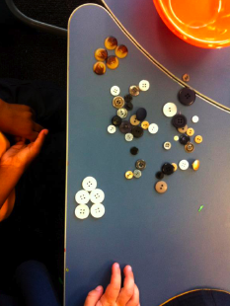
Pattern Stations
We want to highlight growing patterns throughout learning sequence
Provide a variety of materials:
Shapes, numbers, musical instruments copy, create & perform patterns, Lego, stamps, buttons, blocks, threading, pompoms
Different formats, horizontal, vertical, circular
Pattern blocks: symmetrical, growing patterns. Spatial patterns with tessellations

Slide 10
Growing Patterns
Opportunity to do the following: Copy, describe, extend a repeating pattern, identify a missing part in a repeating pattern
Want to focus on identifying the unit of repeat not just the alternating colours
I’ve made a pattern with some colour blocks from Roosters tail, who can find my pattern? Break into each unit of repeat
Using 3 different colour blocks create a pattern. Now see if you can find a partner & join your pattern & see if repeats
Book: What happens each time a new animal arrives? What pattern do you notice?
Using animals or teddies, replicate the pattern that happened in the story (extension: what if 20 animals joined the journey, how can you work out how many animals go on the journey?
Growing pattern stations: toothpicks, make a triangle label how many picks were used, how many to make next triangle?
How many were added each time? Is there a pattern with the number? Odd or even? Discuss how a growing pattern is different to a repeating pattern

Slide 11
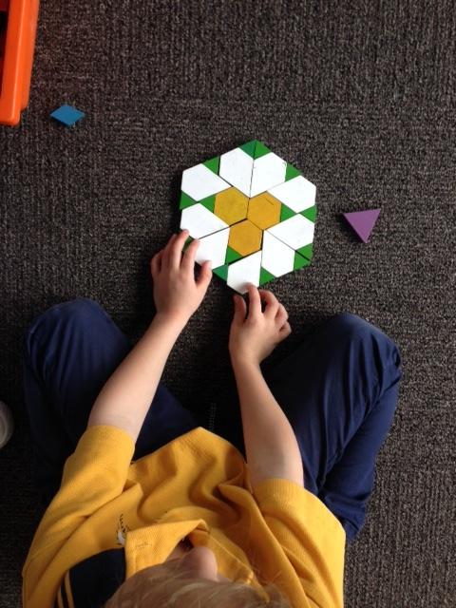
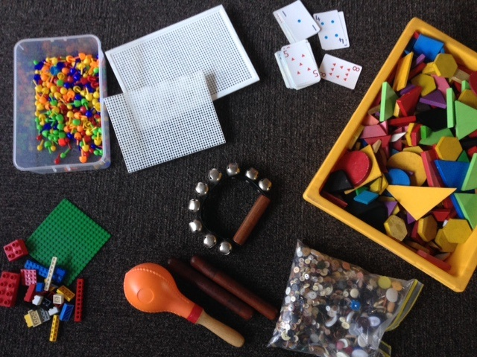
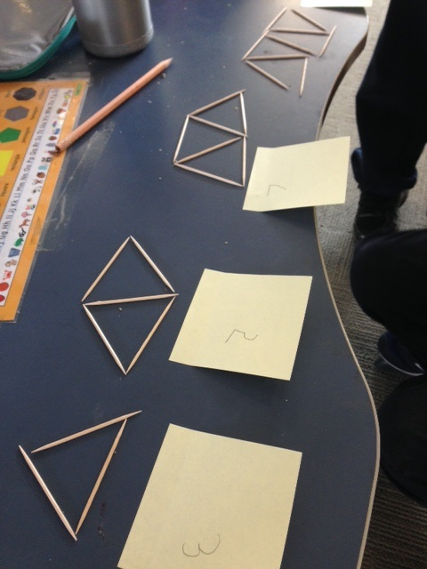
Examples

Slide 12
Pattern & Structure
Almost every content descriptor in the Australian Curriculum involves some mathematical pattern along with its structure. Young children's awareness of pattern & structure reflects how well they are able to acquire meaningful mathematical concepts & recognise the relationship between them.
Muir, T, Livy, S, Bragg, L, Clark, J, Wells, J & Attard, C, (2007) ‘Engaging with Mathematics through Picture Story Books’, Albert Park, Teaching Solution, p6.

Slide 13
Next in Sequence
Ordinal numbers: which animals came in 1st, 2nd, 3rd etc
Match animals to bowls with number, 1 rooster, 2 cats, 3 frogs
Counting forward/backwards
Old McDonald had 10 animals on his farm. Some were pigs and some were cows. How many of each? Represent your thinking.
Make a model
Draw a diagram
Write a number sentence
Show it on a tens frame
Draw a picture

Slide 14
The Very Blue Thingamajig
What Maths can we find in the book?
-days of the week
-numbers
Maths language
Create your own thingamajig, use 10 different features on it.
-Record what features you used & how many of each
-How many thingamajigs did we make altogether?
-How many features in total did we use altogether?

Slide 15
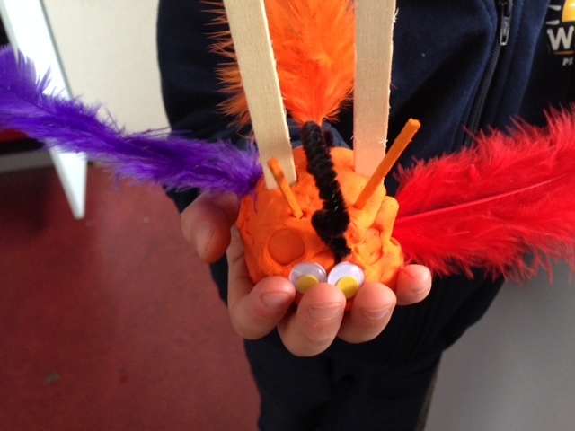
Examples

Slide 16
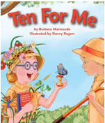
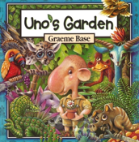
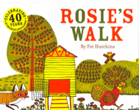
Other Picture Story Books

Slide 17
Transition to School
Over three years the project investigated the perceptions and expectations of all those involved in young children's transition to school. Effective transition programs
establish positive relationships between the children, parents, and educators.
facilitate each child's development as a capable learner. .
are well planned and effectively evaluated.
are flexible and responsive.
are based on mutual trust and respect.
rely on reciprocal communication among participants.
take into account contextual aspects of community and of individual families and children within that community.
Perry, B & Clark B, (2015) ‘Count Me In Effective Transitions’, pp 1-33.

Slide 18
Transition to School
In situations where positive relationships had been established between families and schools, children, and teachers (and between educators in prior-to-school settings and schools), children, parents, and early childhood educators reported positive feelings about the transition to school. Where such relationships were not in evidence, hesitations, anxieties, and concerns prevailed.
Effective transition programs recognise the role of the family and other educators and seek to collaborate in ways that build upon the child's experiences.
Many were familiar with what was expected at preschool or day care but were unsure of what their role could be in the school setting.
Perry, B & Clark B, (2015) ‘Count Me In Effective Transitions’, pp 1-33.

Slide 19
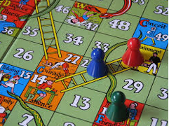
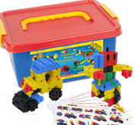
Support for Families
Capitalise on relationships:
Invite parents in to classroom weekly to support
Run maths family nights
Teach parents that maths is worthwhile and enjoyable, show parents how maths is relevant & accessible to all
Prompts could be given to parents:
Planks
Board games
Morphun
Picture books

